Slide 1

ROTARY INDIA WATER MISSION
2020-2025
R/IND/RIWM1

Slide 2

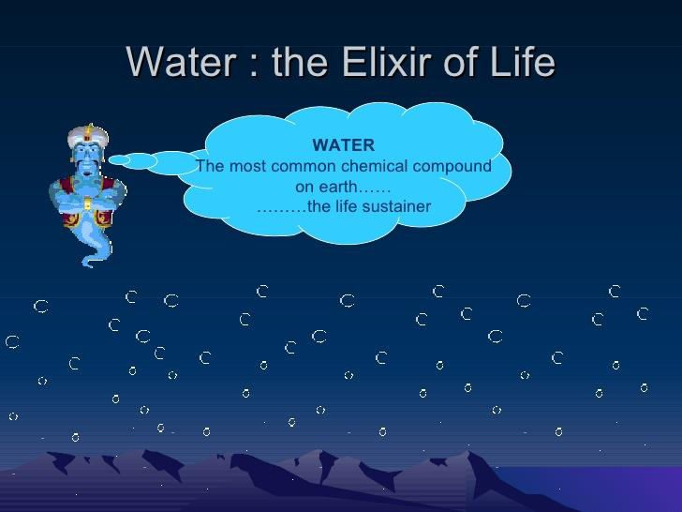

Slide 3
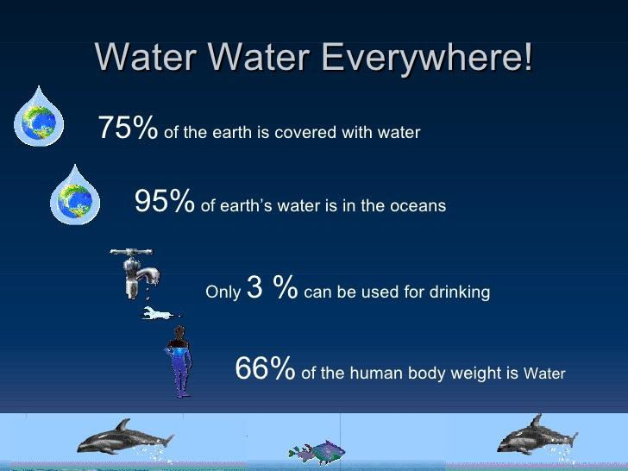

Slide 4
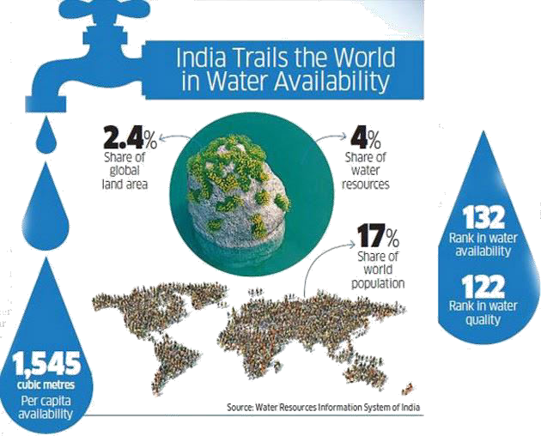
CURRENT WATER SCENARIO IN INDIA
21 cities of India are almost out of ground water including Delhi, Chennai and Bangalore
100 million urban population is facing water scarcity for drinking / other uses
500 million person in rural India are facing water shortages for drinking and agriculture

Slide 5
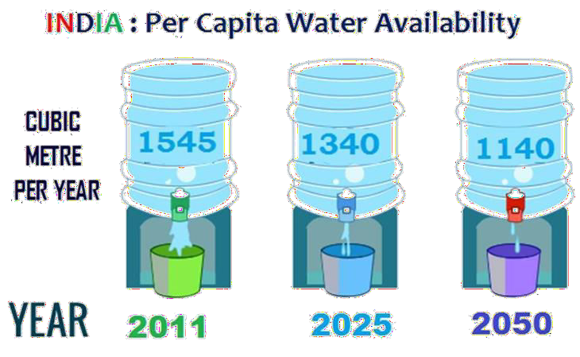
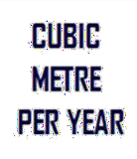
<
CURRENT WATER SCENARIO IN INDIA
International Norms
1700
INCREASING WATER STRESS

Slide 6
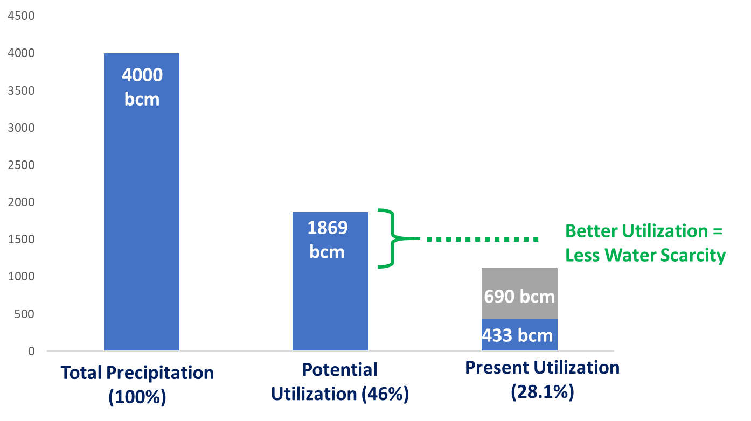
CURRENT WATER SCENARIO IN INDIA
Water Utilization
2%
9%
89%
Irrigation Domestic Industrial

Slide 7
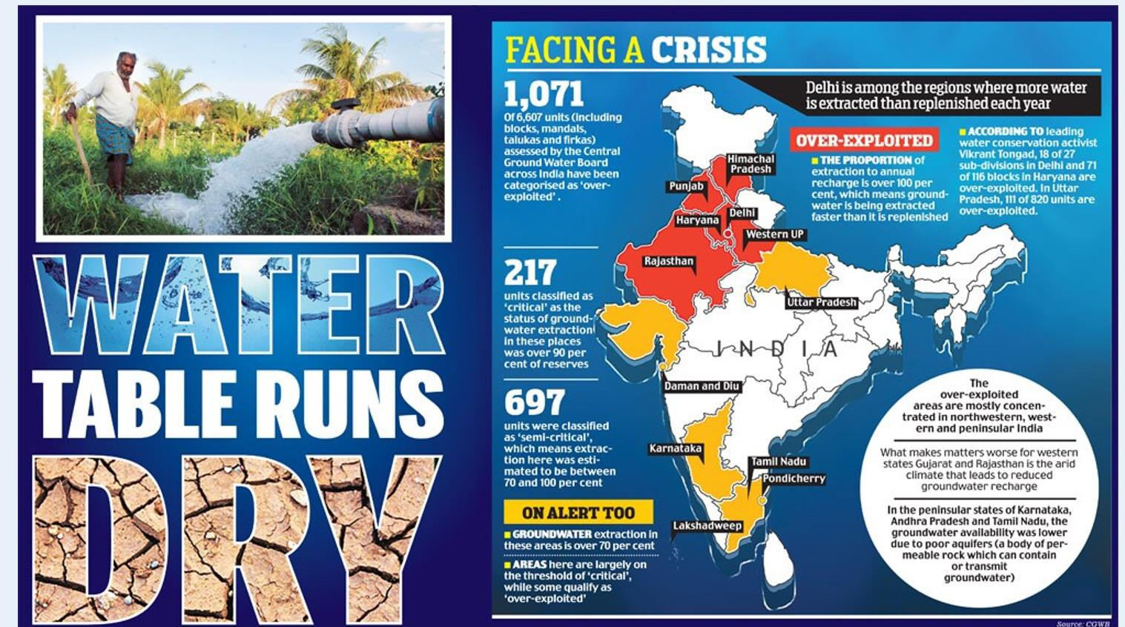
CURRENT WATER SCENARIO IN INDIA

Slide 8
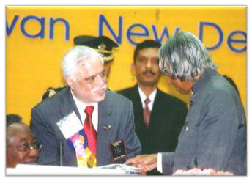
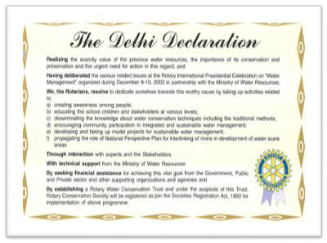
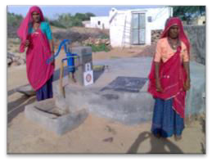
ROTARY INDIA WATER CONSERVATION TRUST (RIWCT)
Rotary India Presidential Conference, Delhi (Dec 2003) – Delhi Declaration
President Abdul Kalam was the Chief Guest of the event
RIWCT established with PRID Sushil Gupta as President
First Project was implemented in Churu District, Rajasthan aimed at
providing Family Tankas
MOU signed between RIWCT and PHDRDF in August, 2007
300+ projects implemented till date
Impacted more than :
  10 lakh people,
  500+ Villages
  35000+ Households

Slide 9
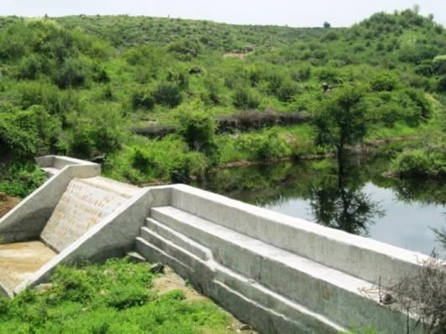
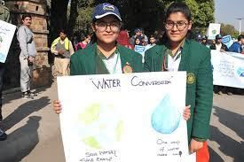
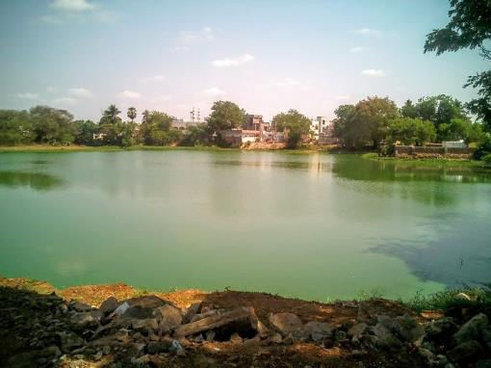
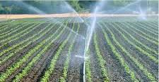
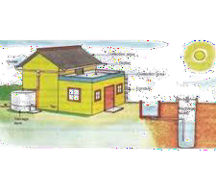
ROTARY INDIA WATER MISSION (RIWM)
WATERSHEDS : CHECK DAM
RIWM was launched on11th Sept, 2019 at New Delhi Verticals under RIWM :
WATERSHED DEVELOPMENT
AWARENESS
TRANSFORMATION OF WATER BODIES EFFICIENT USE OF WATER RAINWATER HARVESTING
AWARENESS
AWARENESS
TRANSFORMATION
TRANSFORMATION
EFFICIENT USE
EFFICIENT USE
RAINWATER HARVESTING
RAINWATER HARVESTING

Slide 10
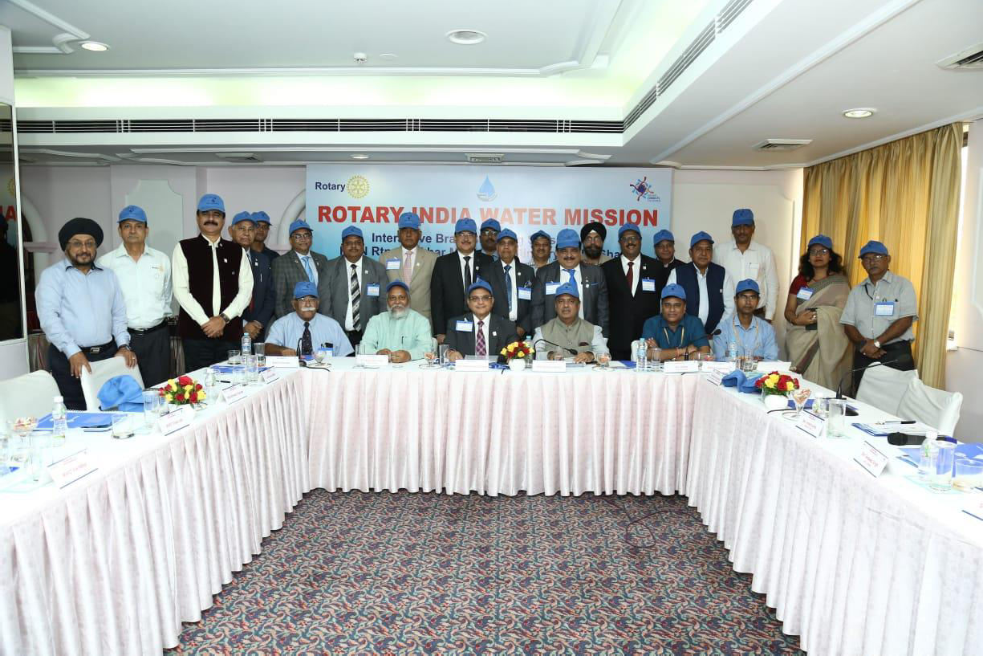

Slide 11
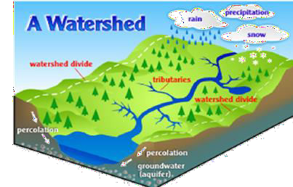

WATERSHED DEVELOPMENT
Restores degraded watersheds to increase capacity to capture rainwater
Reduce Soil erosion
Improves soil nutrients and carbon content
Increases agricultural yields
Benefits the whole ecosystem
TARGET :
10,000 WATERSHED STRUCTURES TILL 2025

Slide 12
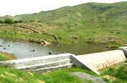
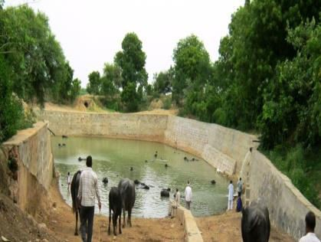
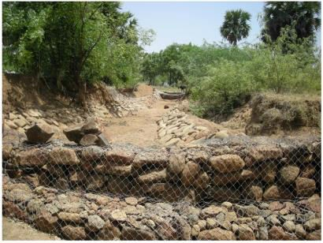
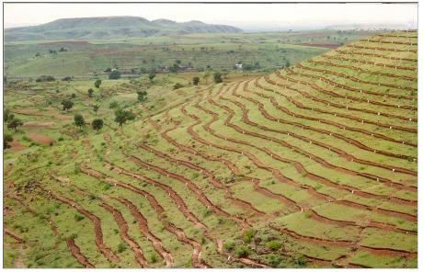
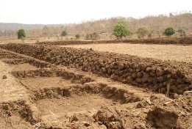
TYPES OF WATERSHED DEVELOPMENT
Check Dams
Farm Ponds/ Tanks
Gabion Structures
Continuous Contour Trenches/ Staggered Trenches
Earthen Bunding

Slide 13

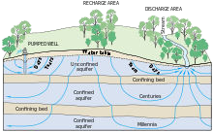

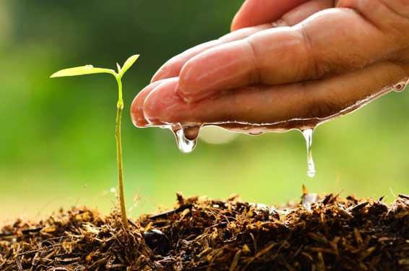

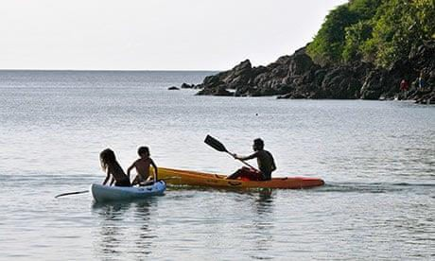
OBJECTIVES OF WATERSHED DEVELOPMENT
1.
2.
3.
Recharging of ground
Production of food, fodder, fuel
water to provide regular water supply (domestic and industrial) and irrigation
Wildlife preservation
4.
5.
Employment generation through industrial
6.
Erosion control and prevention of soil, degradation and conservation of soil and water
development dairy fishery production
Recreational facilities

Slide 14
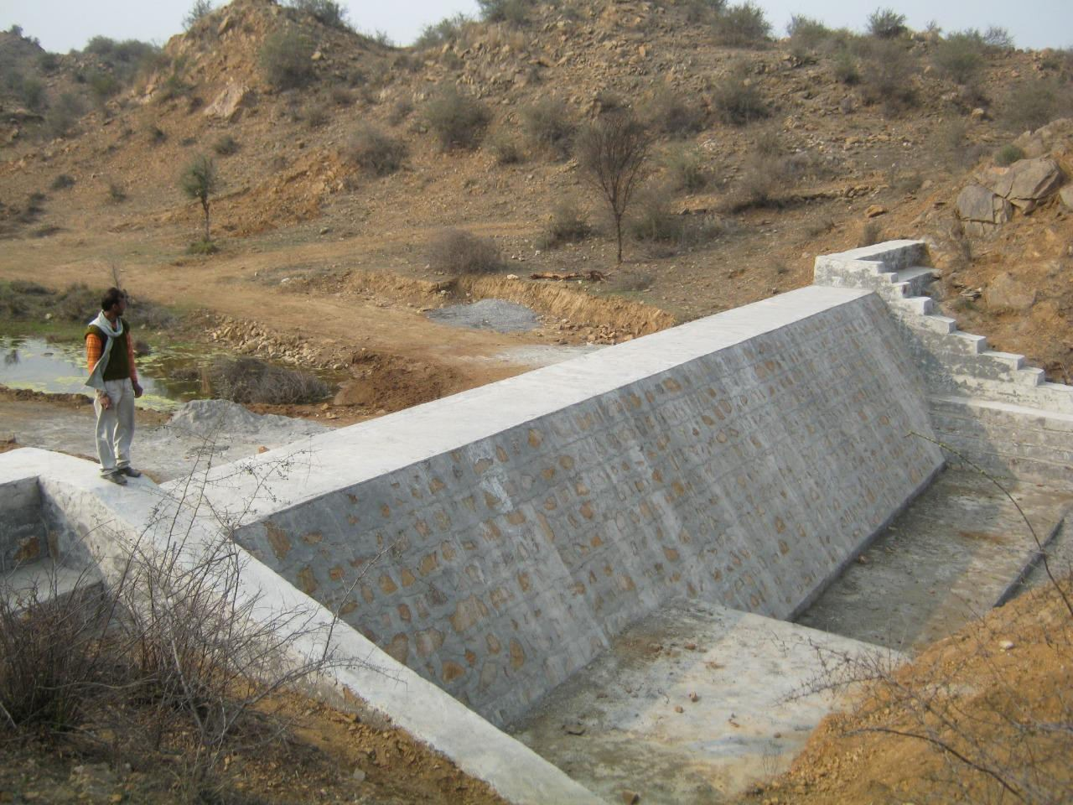
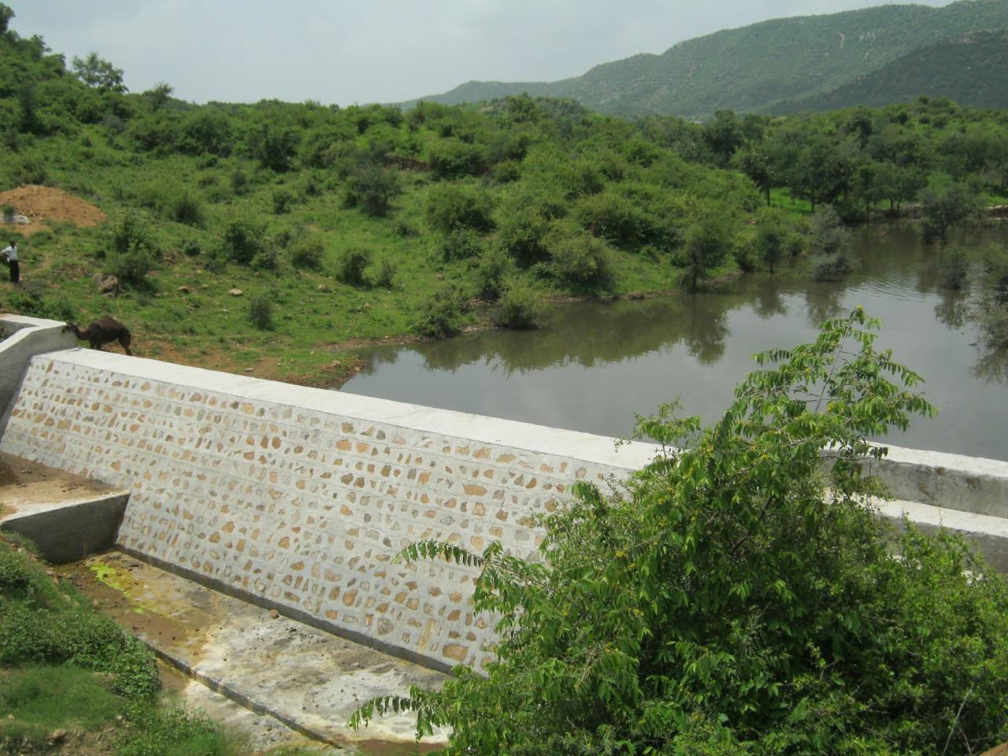
WATERSHED DEVELOPMENT
Before
After
Joshiwala Check Dam

Slide 15
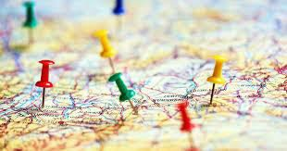
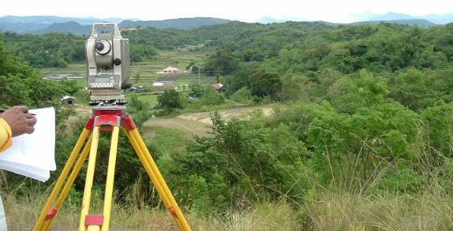


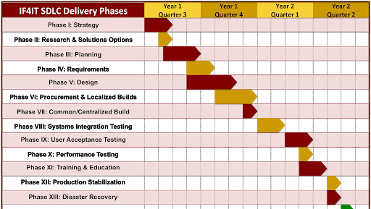
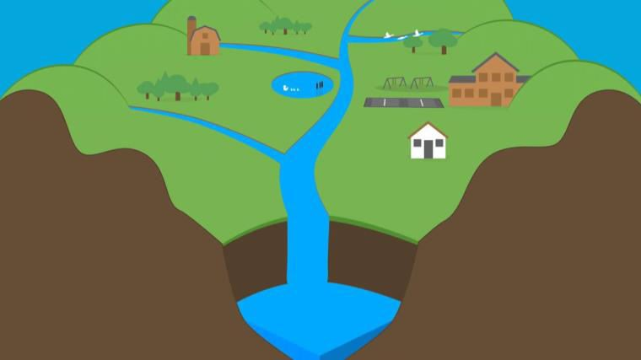
STEPS INVOLVED IN WATERSHED DEVELOPMENT
1. Site Selection
2. Resource Survey
3. People’s Participation
4. Watershed development project plan
5. Treatment of Watersheds

Slide 16

APPROXIMATE COSTS FOR WATERSHED DEVELOPMENT
PROJECTS
Check Dams
Farm Ponds/ Tanks Gabion Structures
Continuous Contour Trenches/
Staggered Trenches
Earthen Bunding
Rs. 5 Lakhs to Rs. 50 Lakhs
Rs. 50,000 to Rs. 2 Lakhs Rs. 1 Lakh to Rs. 3 Lakhs
Rs. 1 Lakh to Rs. 5 Lakhs
Rs. 10,000 to Rs. 2 Lakhs

Slide 17
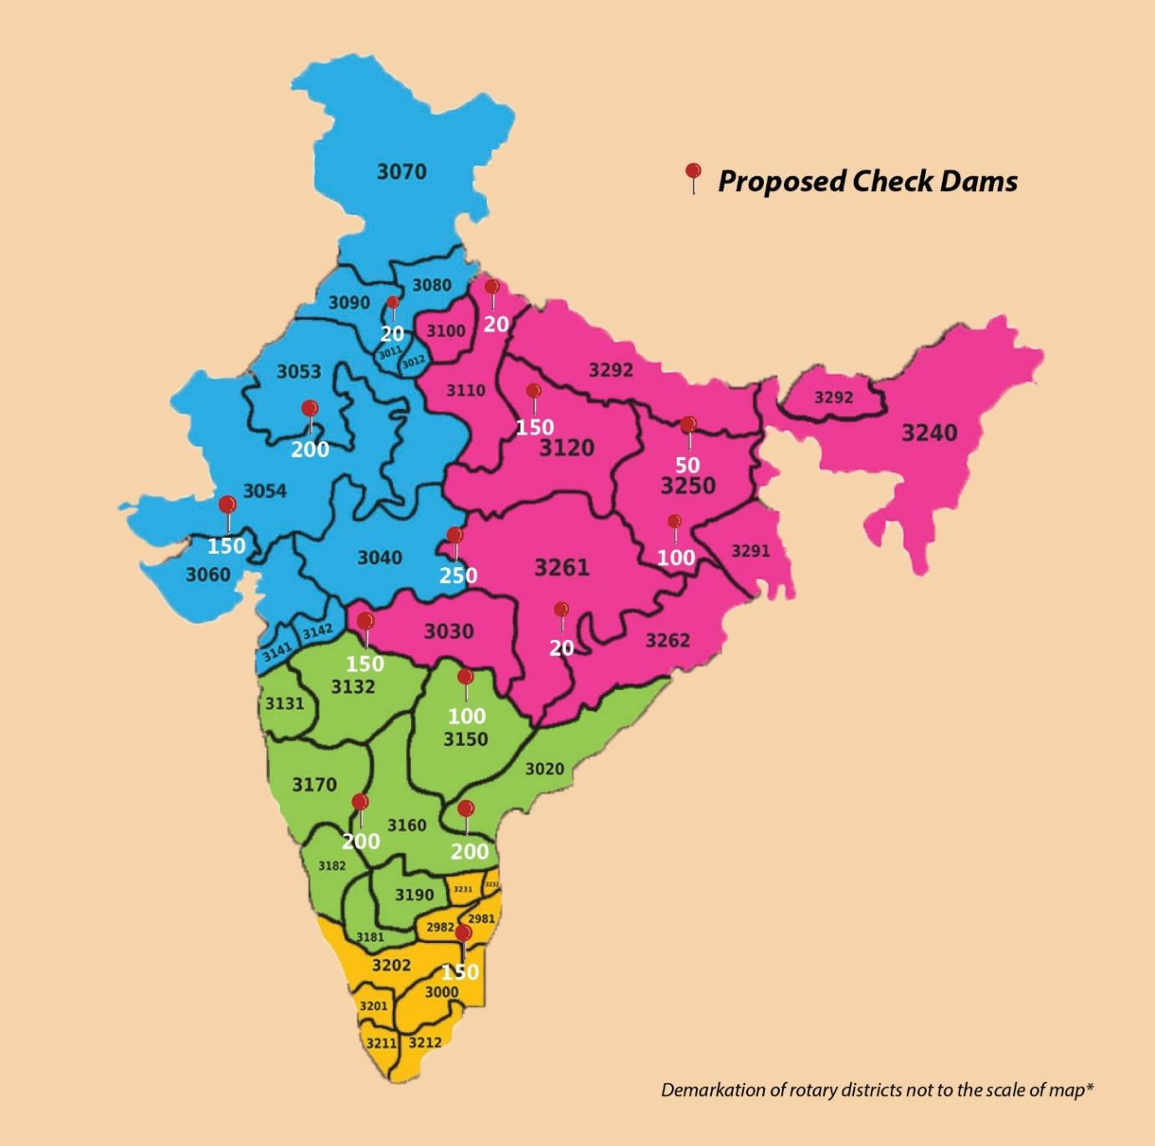

AVAILABILITY OF PROJECTS ALONGWITH PHDRDF
States / Union Territories | No. of Check Dams
Andhra Pradesh | 200
Chattisgarh | 20
Gujarat | 150
Jharkhand | 100
Karnataka | 200
Madhya Pradesh | 250
Uttarakhand | 20
Bihar | 50
Haryana | 20
Maharashtra | 150
Rajasthan | 200
Tamil Nadu | 150
Telangana | 100
Uttar Pradesh | 150
Total in States | 1740

Slide 18

AWARENESS
“Awareness is the greatest agent for change”
- Eckhart Tolle
OBJECTIVES :
Inform and Educate people about
  need of water conservation and management
  Water Literacy
  inculcate respect for WATER
BY :
Influencing their
  Attitude
  Behaviour
  Beliefs to drive action
TARGET :
REACH 500 MILLION PEOPLETILL 2025

Slide 19
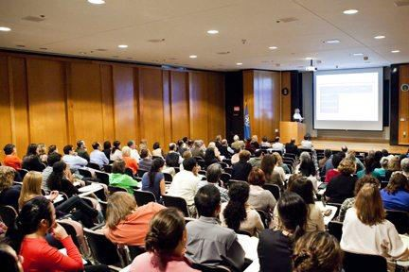
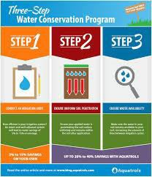
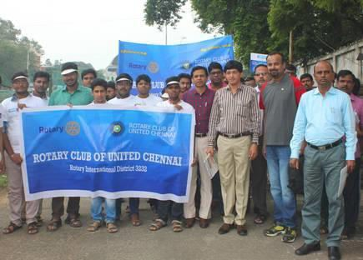
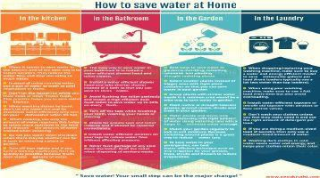
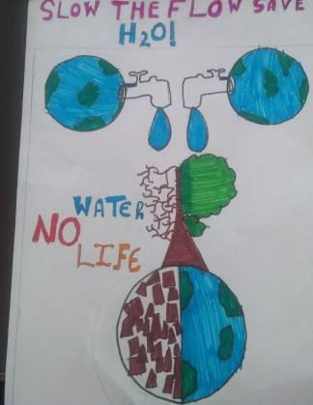
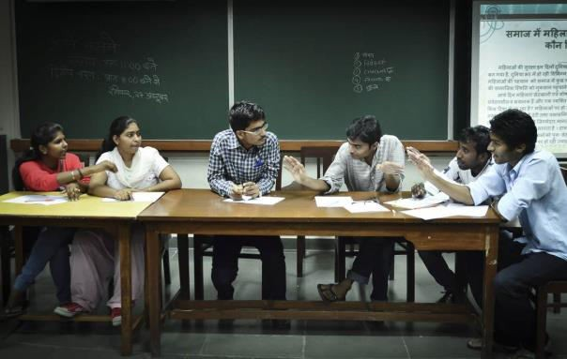
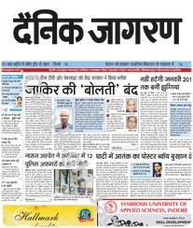


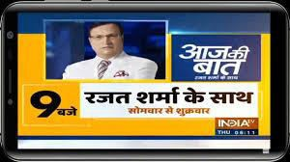
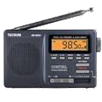

ACTION POINTS TO CREATE AWARENESS
Organize Seminars at District level
Distribution of Brochures/ flyers
by Clubs/ Districts
Organising Rallies at National & District level
Poster making competitions/ debates, slogan writing in Schools
Print and Electronic Media
Social Media

Slide 20


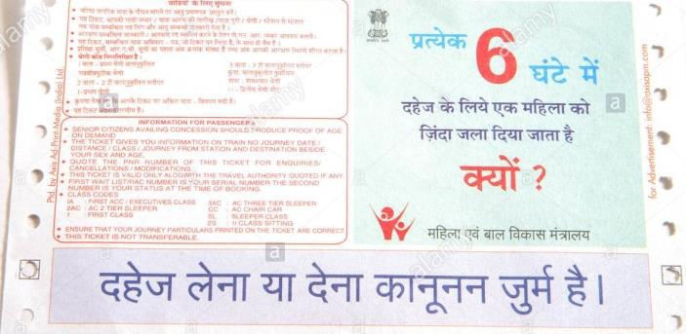


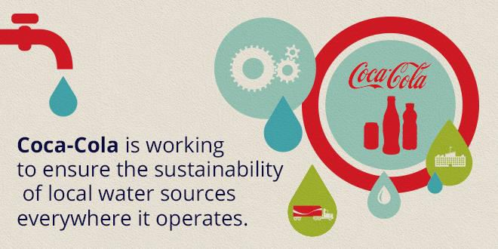
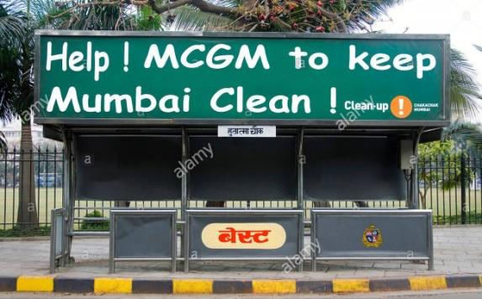
ACTION POINTS TO CREATE AWARENESS
Environmental / Water NGOs
and Community groups
Non-Conventional Media
Celebrity Endorsements/ Events
CSR Partnerships with Corporates & Media Houses
Co-promotion with Local Government bodies

Slide 21
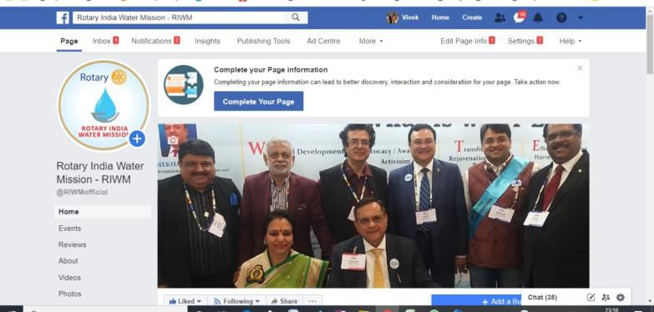
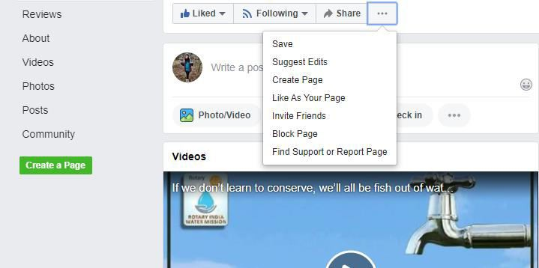
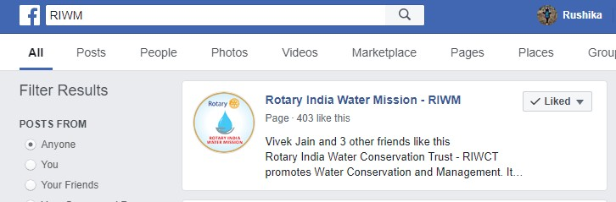
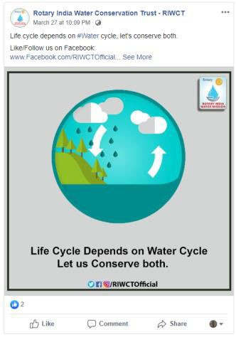
FACEBOOK FOR AWARENESS
@RIWMofficial
- Search for RIWM Page on Facebook
- Like RIWM Facebook Page
- Invite Friends to like RIWM Page
More the Engagement, higher the chances of Organic promotion/ more reach
- Engage with the post by LIKE, COMMENT, SHARE

Slide 22

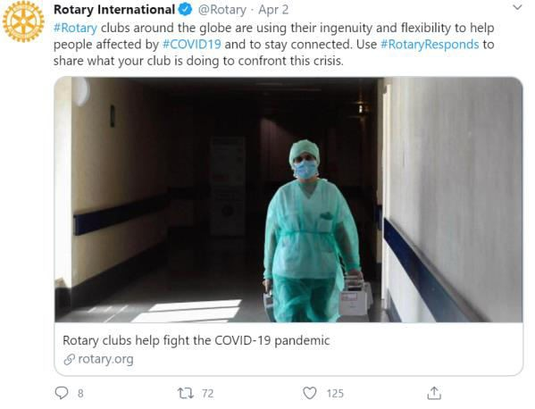
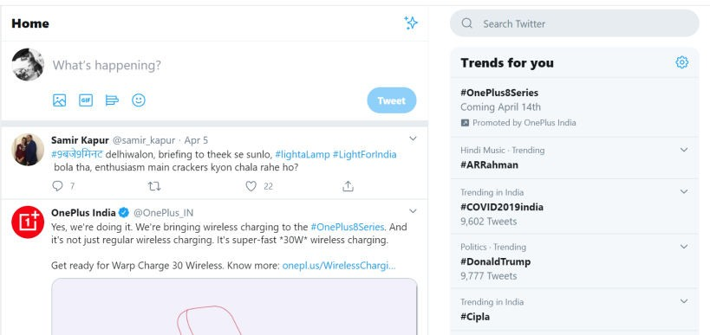

TWITTER FOR AWARENESS
@RIWMofficial
`
- Search for RIWM handle on Twitter
- Follow RIWM Twitter Handle
- Engage with the post by COMMENT, LIKE, RETWEET
#RotaryIndiaWaterMission
#SaveWaterSaveLives
@RIWM
Post new Tweets to showcase work in your region
Shortlist 2-3 Hashtags and use them across all tweets and Retweets
Tag RIWM handle with @

Slide 23
WHATSAPP FOR AWARENESS
Central Team to create Awareness messages
Central
ZWCs
District Governors
Forward diligently for
multiplier effect
Club Presidents
Club Members Friends, Relatives, Associates

Slide 24



TRANSFORMATION OF WATER BODIES
Before After
TARGET :
10,000 TRANSFORMATION OF WATER BODIES TILL 2025

Slide 25



TYPES OF WATER BODIES
1. LAKES/ JOHAD
2. PONDS
3. BAVDI/ STEPWELL
Man Sagar Lake, Jaipur, Rajasthan
Pinapadu Pond, Tenali, Andhra Pradesh
Lakkundi Kalyanis, Hampi, Karnataka

Slide 26



NEED FOR TRANSFORMATION OF WATER BODIES
Inadequate Channel capacity
Improper drainage condition
Unplanned Reservoir Operation
Dumping of sewage, Solid Waste and Liquid Waste
Lack of Sewage/ Drainage system in Villages

Slide 27






STEPS FOR TRANSFORMATION OF WATER BODIES
Identification/ Assessment
Community mobilization and permissions
Diversion of sewage/ polluted water coming to the water body
Desilting using JCB/ Dredgers for increasing the depth of water body
Digging of percolation pits and recharge
Introduction of biochemicals/ fish species

Slide 28





STEPS FOR TRANSFORMATION OF WATER BODIES
Embankment strengthening / Bund Development
Training and Awareness programs for community beneficiaries
Provide garbage boxes
Place Do’s and Don’t’s boards around Water bodies
Create recreational facilities

Slide 29




BENEFITS FOR TRANSFORMATION OF WATER BODIES
Acts as storage of water
Provides drinking water
Recharges Ground Water level
Provides water for cattle, animals and birds
Provides water supply for irrigation
Recreational Facilities

Slide 30

COST OF TRANSFORMATION
Depends on the following :
Area of the Water Body
Depth of Water Body
Solid Waste Constituents
Silting
Condition of Water
Vegetation
Sewage/ Industrial waste inlet
LAKE TRANSFORMATION above 25 acres – Rs. 1L to Rs. 2L/ acre
POND TRANSFORMATION – Rs. 2L to Rs. 5L/ acre
STEPWELL/ BAVDI RESTORATION – Rs. 2L to Rs. 10L

Slide 31

SITE IDENTIFICATION, TECHNICAL SURVEY AND
IMPLEMENTATION
EXISTING/ UNDERWAY MOUs
Central Team has MOUs with PHDRDF, Delhi, EFI, India, Satish Khede
Identify Sites,
Conduct Technical Surveys,
Prepare Project Reports, including
Project Estimates and budgets
Central Team has already identified 50 Water bodies across the country, alongwith existing partners
The List of available Water bodies shall be shared separately

Slide 32



WHAT IS EFFICIENT USE OF WATER
‘Strategies and activities that sustainably manage natural resources of fresh water to meet the current and future human demand’
1. REDUCE
2. RECYCLE/ REUSE
The key activities in Efficient use of Water are:
TARGET BY 2025:
REDUCE Consumption in 25Lakh Households
REDUCE Consumption Using 15,000 Drip/ Micro Irrigation Systems
RECYCLE/ REUSE Grey Water In 5,000 Sites

Slide 33


REDUCE CONSUMPTION OF WATER
AERATORS
WHAT DO AERATORS DO?
  Break water flow into fine droplets, while using less water
    Reduce splashing while washing hands and dishes
Conserves upto 90% water
Water Pressure is not impacted
Lasts for more than 5 years
Costs Rs.30 only per tap plus Labour
Available in Standard Sizes

Slide 34


REDUCE CONSUMPTION OF WATER
MICRO IRRIGATION SYSTEMS
WHAT ARE MICRO IRRIGATION SYSTEMS?
  Also called low volume/ low-flow/ or trickle irrigation
Uses lower pressure and flow than a traditional sprinkler system
TYPE 1 : SPRINKLER IRRIGATION SYSTEMS
TYPE 2 : DRIP IRRIGATION SYSTEMS
An Irrigation Sprinkler is a device used to irrigate agricultural crops, lawns, landscapes, golf courses, and other
areas
Saves water and nutrients by allowing water to drip slowly to the roots of plants, either from above or below of the soil surface

Slide 35


ADVANTAGES OF MICRO IRRIGATION SYSTEMS
Suitable for most types of field condition
Uniform and efficient distribution of water
More land available for cultivation
Ease of dispersion of fertilizers
Accurate and easy measurement of distributed water
Economic benefits – Labour and Energy
Soil erosion and weed growth is lessened

Slide 36


REDUCE CONSUMPTION OF WATER
3. LIFT IRRIGATION SYSTEMS
Lift irrigation is a method in which water is lifted by pumps to a storage facility at a height.
This water is used for irrigation as per the need.
Benefits : Minimal land acquisition problem and low water losses
Ownership : Either individually owned or owned by a group of farmers in a cooperative mode

Slide 37


2. REDUCE - MICROIRRIGATION SYSTEMS
IMPLEMENTATION PARTNERS
INDIAN PLUMBING ASSOCIATION FOR AERATORS
FINOLEX PIPES FOR DRIP
IRRIGATION

Slide 38

REUSE/ RECYCLE WASTE WATER WHAT IS GREY WATER?
Grey water or sullage is all the wastewater generated in households or office buildings from streams without fecal contamination
Sources of Greywater include :
Sinks,
Showers
Baths
Washing machines
Dishwashers

Slide 39





APPLICATION AREAS FOR GREYWATER RECYCLING AND AERATORS
Residential Houses
Residential Housing Complexes
Industrial Units
Commercial Complexes /
Hospitals
Schools / Colleges / Educational
Institutions

Slide 40




BENEFITS OF GREYWATER RECYCLING
Irrigation for agriculture and landscaping
Process water available
Indoor uses such as toilet flushing
Dust control or surface cleaning
Supplying artificial lakes
Reduced load on municipal water supply

Slide 41




HOW MUCH WILL THEY COST
1. AERATORS
2. GREY WATER RECYCLING
3. DRIP/MICRO IRRIGATION SYSTEM
Cost per Household: Estimated Rs. 200
Cost per System : Estimated Rs. 1,50,000 to Rs.
2,00,000 depending on Capacity
Cost per System : Estimated Rs. 40,000 per acre

Slide 42


RECYCLE GREYWATER – IMPLEMENTATION PARTNERS

Slide 43


WHAT IS RAINWATER HARVESTING?
It simply means catching and holding rain where it falls and using it. You can store it in tanks or you can use it to recharge groundwater
Storage of Ground Water
Recharge Ground Water
TARGET :
50,000 RWH STRUCTURES TILL 2025

Slide 44



RAIN WATER HARVESTING
Storage of rainwater on surface for future use
Recharge to Ground Water

Slide 45


COMPONENTS OF RAINWATER HARVESTING SYSTEM
Each rainwater harvesting system consists of following components :
Catchment area
Storage
Delivery ducts
Storage reservoirs
Extraction device
Filtration device
Recharge pit

Slide 46
TYPES OF RAIN WATER HARVESTING
Residential Houses
Residential Housing Complexes
Industrial Units
Commercial Complexes /
Hospitals
Schools / Colleges / Educational
Institutions

Slide 47

COST OF RAINWATER HARVESTING SYSTEM
Costs depend upon area of roof and other structures that you will use to harvest rain
Single Unit Houses : 300 Sq. meters - Rs.2000 to Rs. 30000
Housing Society / Complex: 4000 Sq. meters - Rs.9 Lakh
Schools: 2000 sq. meters - Rs.2.5 to Rs.3 Lakhs
Industrial / Commercial Complex: 3000 sq. meters - Rs.5 Lakhs

Slide 48
BENEFITS OF RAIN WATER HARVESTING
Groundwater table rises with quality improvisation
Economic benefits
Ready availability at the point of consumption
Reduces flooding/ Clogging
Flexible and adaptable technology

Slide 49



WHERE WILL THE PROJECTS IMMEDIATELY COME FROM?
Each Rotarian to become WATER NEUTRAL by having
Schools under RILM Program
Schools under WINS Program
Schools under Interact Program
Educational Institutions of Rotaractors
- Through RWAs connected with Rotarians
RWH at Home
RWH at Office/ Factory

Slide 50







SOURCES OF FUNDING
1. CSR
2. Global Grants
3. District Grants
4. Contributions from Philanthropists
5. Club Contributions
6. Government Funding

Slide 51

FINANCIAL PARTNERSHIP MODEL
20%
to 25%
Club Contribution
10%
to 15%
Community Contribution
60% to
Sponsors
70%
*Sponsors include CSR funding, Rotary grants,
Government subsidies etc.

Slide 52
CONSOLIDATED TARGETS FOR NEXT FIVE YEARS
Watersheds : 10,000 Watershed Structures
Awareness : Reach 500 million people
Transformation of Water Bodies : 10,000 Lakes/ Ponds/ Bavdis
Efficient Use of Water : Reduce Consumption In 25 Lakh Households and 15,000 Drip/ Micro Irrigation Systems Recycle Grey Water In 5,000 Sites
Rain Water Harvesting : 50,000 Projects
EXPECTED OUTCOME :Integrated work in all Verticals will produce 5000 Happy Villages

Slide 53
TARGETS FOR EACH DISTRICT FOR EACH YEAR
Watersheds : 50 Watershed Structures
Awareness : Reach 2.5million people
Transformation of Water Bodies : 50 Lakes/ Ponds/ Bavdis
Efficient Use of Water : Reduce Consumption In 12,500 Households and 75 Drip/ Micro Irrigation Systems
Recycle Grey Water In 25 Sites
Rain Water Harvesting : 250 Projects

Slide 54





CHANNEL PARTNERS

Slide 55
Let us Kindle the spark with-in to Look beyond ourselves to BE THE INSPERATION in making a difference by acting with Consistency , Credibility & Continuity.

Slide 56


PDG Ranjan Dhingra
Chairman & Managing Director
LARAON Engineers & Consultants Pvt. Ltd.
683, Udyog Vihar, Phase V Gurugram - 122016; Haryana
Tel: +91 124 4959001
Mobile: +919810052200
Email: r.dhingra@laraon.com
web: www.laraon.com

