Slide 1

Rotary India SANITATION MISSION
R/IND/RISM1

Slide 2

Why Rotary India Sanitation Mission?
India achieved ODF status in 2019 but many households still lack individual toilet.
Many household toilets are not functional and are not being used.
Only 3.27 lakh households (out of 17.87 lakhs) in the country have tapped water connection.
Only 54.5% of 15.5 lakhs total no of schools in India have handwashing facilities with soap
7% of the total of 31,000 Healthcare facilities in India don’t have water & 45% have no sanitation.

Slide 3

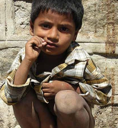

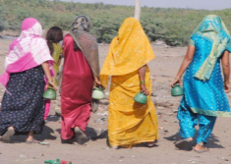
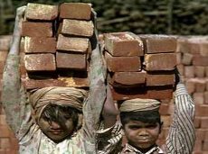
Some Statistics- India
3.87Crore
children
are stunted
30 Crore people
defecate in the open
32 lakh children
never been to school
15,000
children
die everyday before they turn five
India’s global footprint
1/3rd of world’s stunted children in
India
1/3rd of world’s open defecation in India
40% of world’s child marriages in India
28%
of world’s neonatal deaths in India
22% of world’s
U5 deaths and 20% of maternal deaths in India

Slide 4
WASH interventions critical for child survival
Percentage Reduction in Morbidity from Diarrhoeal Diseases
Per Cent
Water, Sanitation and Hygiene Components
Source: Meta-analysis by Fewtrell and Colford, 2004; Hand washing data by Curtis & Cairncross, 2003; Updated sanitation data by Cairncross, 2008 (by UNICEF)

Slide 5
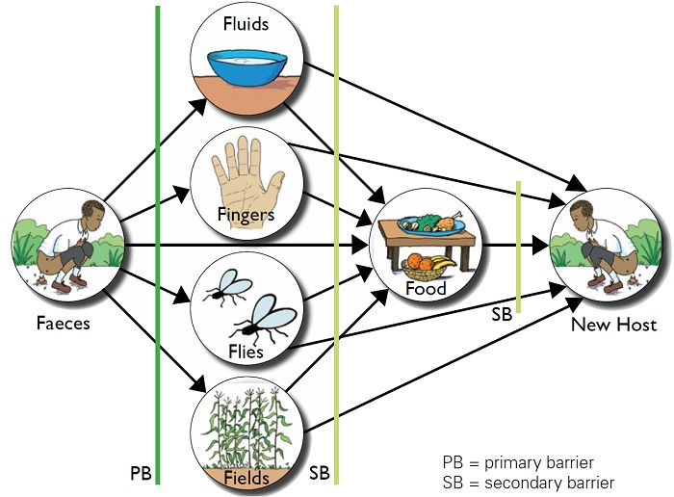
The ‘f’ diagram
Sanitation
Clean Water Supply
Hygiene

Slide 6
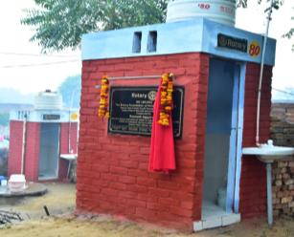
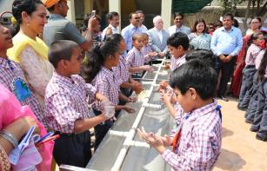
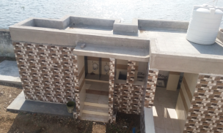
Rotary India
Sanitation Mission (RISM)
RISM supports Govt. of India’s resolve to provide sanitation access to every indivisual and safe drinking water to every household in India.
Verticals under RISM
ODF Plus Villages,
Individual Household Tap Connections,
WASH in Schools,
WASH in Healthcare Facilities,
Community & Public Toilets construction.

Slide 7
ODF Plus Strategy for Villages
39% rural sanitation coverage in 2014 (as per Govt. of India )
ODF (Open defecation Free) declaration by Rural India on 2nd October 2019
Over 10 crores household toilets constructed
6,03,055 villages & 706 districts covered
Govt. of India has launched a new strategy ODF Plus in 2019.

Slide 8

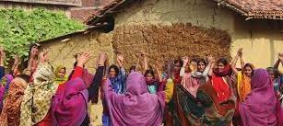
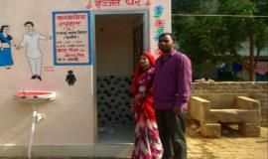
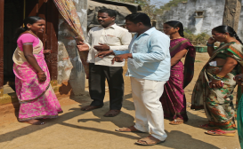
Elements of ODF Plus Villages
Sustained usage of Individual Household Latrines (IHHL)
Sanitation coverage of all the households including the construction of IHHL in new households
Retrofitting's of existing toilets
Construction of community and public toilets wherever required
Sustained behavioural change communication (BCC)

Slide 9
Elements of ODF Plus Villages
Sanitation coverage of public spaces, schools, healthcare facilities etc.
Solid and Liquid Waste Management (SLWM) with focus on 2 basic principles:
Segregation of waste at source
Reduce-Reuse-Recycle-Recover (energy)- Refuse(dispose) paradigm
Components of SLWM:
Biodegradable Waste Management
Plastic Waste Management
Greywater Management
Faecal Sludge Management

Slide 10
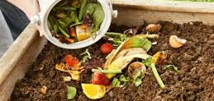
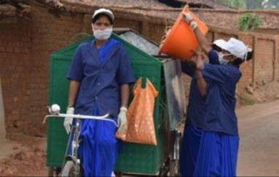
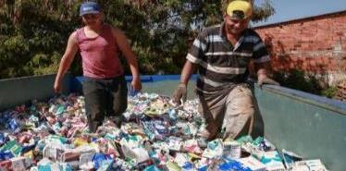
Solid & Liquid Waste Management
Biodegradable Waste Management
Composting at the household level
Composting at the village levels
IEC Campaigns
Plastic Waste Management
Segregation
Collection
disposal/treatment
IEC Campaigns

Slide 11
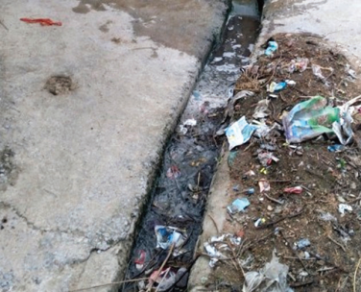
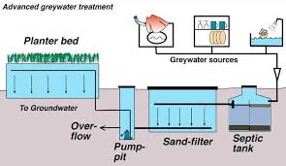
Solid & Liquid Waste Management
Greywater Management
At community level through soak pits or leach pits
At village level - conveyance through pipes or existing open drains and
Treatment of grey water before drains discharge into water bodies

Slide 12
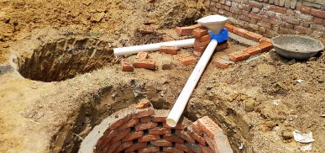
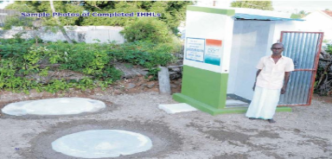
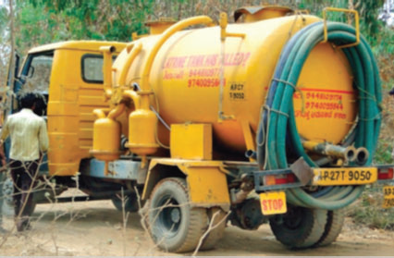
Solid & Liquid Waste Management
Faecal Sludge Management (FSM)
Twin pit toilet technology
Single pit upgraded into twin pit technology
Septic tanks – adding soak pit or desludging at periodic intervals of 3-5 years

Slide 13

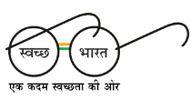
Jal Jeevan Mission (JJM)
Functional Household Tap Connections (FHTC) in every Rural Household
Har Ghar Nal Se Jal (HGNSJ)

Slide 14
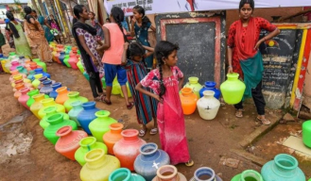
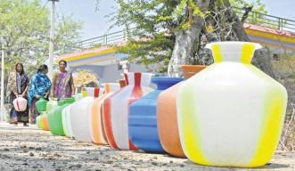
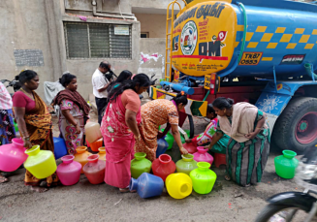
Jal Jeevan Mission
Piped water connections in only 3.27 Crore rural households out of total 17.87 Crore rural households as on March 2019 (as per GoI).
GoI has launched Jal Jeevan Mission (JJM) in 2019.
Functional Household Tap Connection (FHTC) to every rural household - Har Ghar Nal Se Jal (HGNSJ) by 2024.

Slide 15
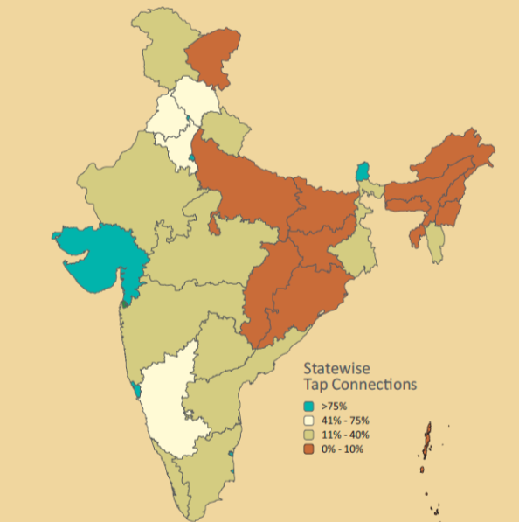
Coverage of HHTP (as on 1st April 2019)

Slide 16
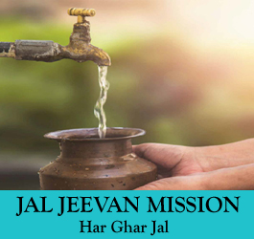
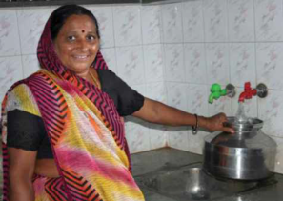
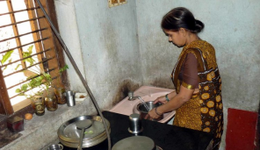
Jal Jeevan Mission
Tap water connection to every household in a village at the service level of 55 Lpcd.
Development of reliable drinking water source.
Making drinking water potable
Retrofitting of piped water supply schemes.
Grey water management.
Support activities & Capacity building.

Slide 17
Scheme Cycle for JJM Projects
PHASE - 1 | Planning and Mobilization | 3-6 Months
PHASE – 2 | Implementation | 6-12 Months
PHASE – 3 | Post Implementation | 3-4 Months
Note: For single villages, scheme cycle can range between 12 to 18 months from the day of G.P resolution.

Slide 18
Broad Outcomes of JJM
Reduced waterborne diseases and healthy rural communities
Reduced drudgery of women
Reduced drop out of upper primary school girls
Increased employment opportunities for rural people

Slide 19
Community & Public Toilets
Rotary India Sanitation Mission

Slide 20
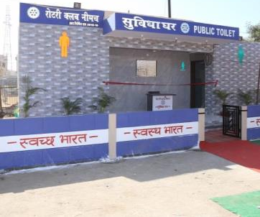
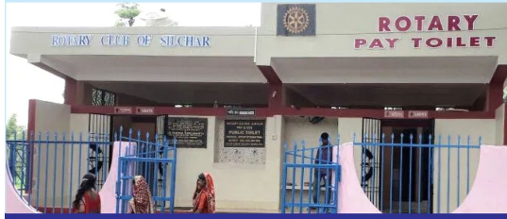
Public Toilets (PT)
Public toilets (PT) facility are provided for the floating population / general public in public places.
Markets, bus & train stations , parks etc.
Tentative basic cost for PT facility is Rs. 98,000/- per WC seat and urinal is Rs. 32,000/- per unit as per SBM guidelines.

Slide 21
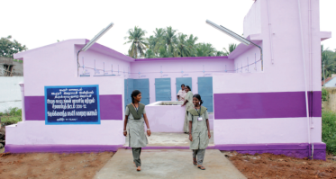
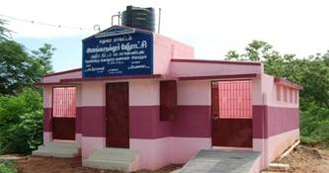
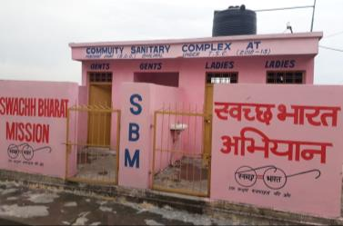
Community Toilets (CT)
Community toilets (CT) facility is a shared facility.
Provided for a defined group of residents or a community.
It is normally located in or near the community area.
Has sanitation, bathing and cloth washing facilities.
Tentative basic cost for PT facility is Rs. 98,000/- per WC seat and urinal is Rs. 32,000/- per unit as per SBM guidelines.

Slide 22
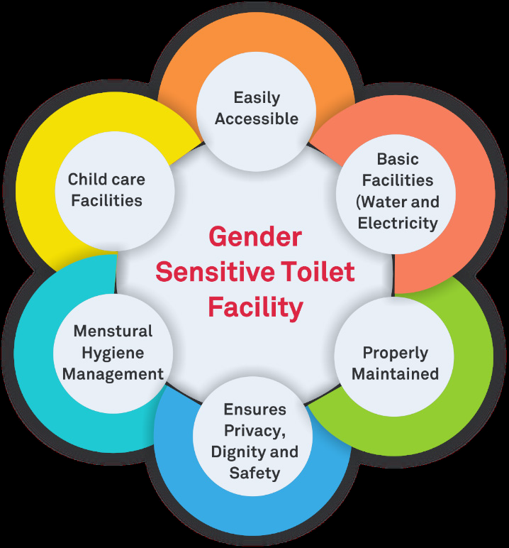
Notes:
Community and Public Toilet facilities need to be gender sensitive.
The facilities should be easily accessible, should have child care and MHM facilities, separate access for male and female toilets.
The facilities should be properly maintained and
Should have water and electricity.

Slide 23
Stages involved in CTs & PTs
Stages involved in CTs & PTs
Sl. No. | Stage | Description
1. | Field Data and Analysis | Information which forms the basis / need for the project
2. | Design & Construction | Including site maps, Design, Drawings & Bill of Quantities
3. | Cost Estimates | Land, Construction & O&M
4. | Sources of Funding | Financial contribution from various sources, User charges, Cost Recovery, Cross-subsidy
5 | Contracting | Roles & Responsibilities, Contracting type
6 | Operation & Maintenance | Staff requirements, Cleaning schedules, Consumables, etc.)
7 | Monitoring | Monitoring and Reporting Process
Notes:
These are stages involved in CTs and PTs projects

Slide 24
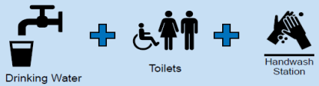

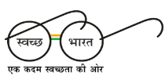
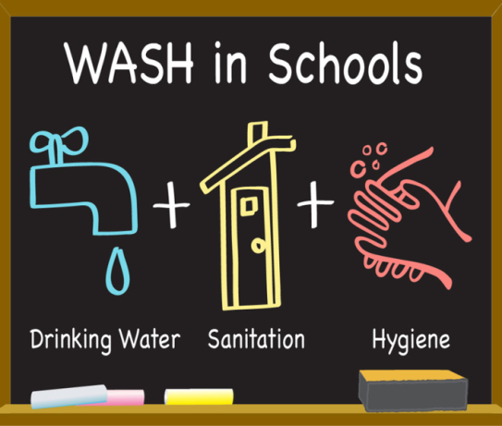
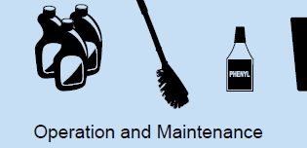
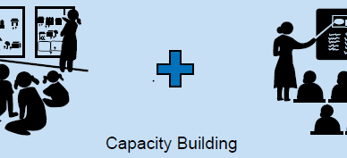

Slide 25
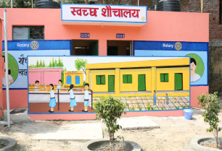
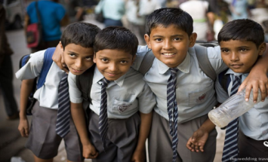
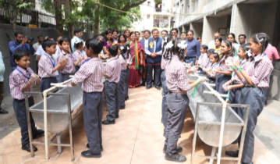
WASH in Schools (WinS)
WASH in Schools refers to water, sanitation and hygiene infrastructure and services in school.
WinS is acronym for WASH in schools
WASH in Schools is a flagship program of Rotary India.
Rotary in India is engaged in over 30,000 schools across India for WASH in Schools benefitting over 6 million children and 5 million families.
It is an integral part of WASH in Schools Target Challenge launched by TRF in 2016.

Slide 26

Coverage of WASH in Schools
There are 15,50,000 schools in India & out of these 70% are govt. schools.
95.2% of schools have functional separate toilet for girls.
93.2% of schools have functional separate toilet for boys.
90.7% of schools have functional drinking water facilities.
Only 54% of schools have handwashing facilities with soap.
(Source UDISE 2018-19 & UNICEF-2018)

Slide 27
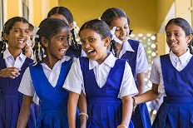
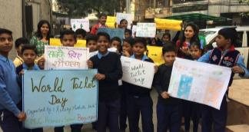
Benefits of WASH in Schools
Gender
Equity
Increased
Enrolment
Better Education Outcomes
Increased Attendance
Healthy
Generations of Children
Children as Agents of Change
Notes:
WASH in Schools promotes gender equity, improves children's health, school enrolment, attendance and retention and paves the way for new generation of healthy children. It develops children as agents of change.
It aims to improve the curriculum and teaching methods while promoting hygiene practices and community ownership of water and sanitation facilities within schools

Slide 28
Essential Elements of WinS
Elements of
WinS
Handwashing
with Soap
Improved Capacities
Gender
segregated toilets
Drinking Water
O&M
(Operation & Maintenance)
MHM
(Menstrual Hygiene Management)
BCC
(Behavior Change Communication)
Notes:
28
These are the essential elements of WASH in Schools. These can be divided in to 2 types of components – Hardware components and Software components.
Hardware Components: Construction/repairs of gender segregated toilets, MHM infrastructure, providing handwashing with soap and drinking water facilities,
Software Components: MHM training, O&M, BCC activities, Hygiene education and building the capacity of the stakeholders.

Slide 29
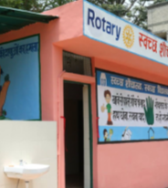

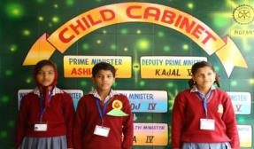

Defining Success for WASH in Schools
Implement Hardware Changes
Implement Software Changes
Engage Stakeholders
Monitor Operations
Evaluate the Program
Focus on Sustainability

Slide 30
Alignment with National Mission - SBM
Rotary’s WinS aligns with Swachh Vidyalaya program under Swachh Bharat Mission (SBM).
The program will have a 5 star rating system.
Recognition to clubs and schools based on criteria of Swachh Vidyalaya Puraskar by MHRD.
MHRD will soon open the entries for SVP 2019-20. http://samagra.mhrd.gov.in/swachh.html

Slide 31

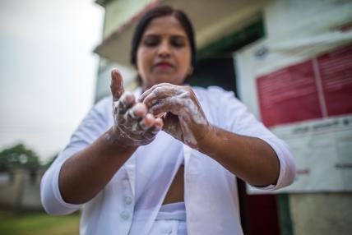
WASH in Healthcare
Facilities
(WinHCF)

Slide 32
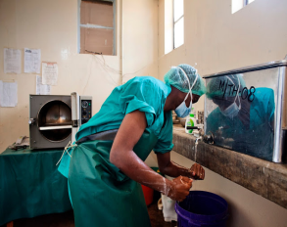
WASH in Healthcare Facilities
What is “WASH in health care facilities”?
Water
Sanitation
Health care waste management
Hygiene
Environmental cleaning infrastructure, and services
Across all parts of a healthcare facility.

Slide 33
WASH in Healthcare Facilities
“Health care facilities” ?
Facilities that provide health care, including
Primary (health centres and clinics),
Secondary, and Tertiary (district or national hospitals),
Temporary structures designed for emergency contexts,
They may be public or private,
They may be located in urban or rural areas.

Slide 34
WASH (Water, Sanitation & Hygiene)
in Healthcare Facilities (WinHCF)
India has around 31,000 healthcare facilities.
7% of these facilities don’t have water & 45% have no sanitation.
Lack functional toilets, safe water, no soap at the hand washing stations.
Poor hand hygiene behaviour practises by staff.
130 mothers die for every 100,000 babies born.
28 out of every 1,000 new born do not survive beyond their first month.

Slide 35
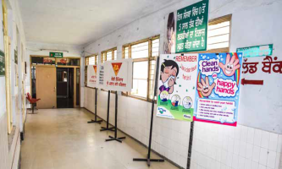
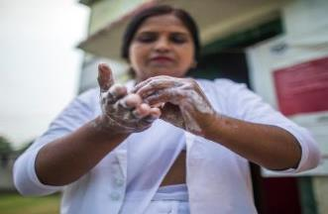
Benefits of WASH in Healthcare Facilities
Reduced diarrhoeal and other health care associated infections.
Improved health care facilities & services.
Reduction in deaths.
Shorter hospital stays and lower out-of-pocket payments.
Improved hygiene practices at home.

Slide 36
Elements of WASH in Healthcare Facilities
Safe & reliable water supply.
Safe and accessible toilets for patients and staff of all ages, genders and abilities.
Handwashing stations with running water and soap.
Effective cleaning.
Safe waste management systems.
O&M (Operation & Maintenance ) plans.
Good hand hygiene practices.
Training of healthcare staff and capacity building.

Slide 37
Prospective Partnerships
UNICEF India
World Vision
Sulabh International
Aga Khan Foundation
PHD Chamber of Commerce & Industry RDF (Rural development Foundation
India sanitation Coalition
Habitat for Humanity
Give India
Tata Trusts & Tata Projects Ltd.

Slide 38
Average Project Cost
SN | Description | Average Cost (INR)
1 | ODF Plus Village | 25 lakhs
2 | Household Tap Connections per village | 10 Lakhs
3 | WASH in Schools | 2.5 Lakhs
4 | WASH in Health Care Facilities | 3 lakhs
5 | Community Toilet Block | 10 Lakhs
6 | Public Toilet Block | 8 Lakhs

Slide 39
RISM Year-wise Goals
Sl. No | Program | 2020-2021 | 2021- 2022 | 2022- 2023 | 2023- 2024 | 2024- 2025 | Dec. 2025 | Total
1 | ODF Plus Villages | 400 | 1150 | 1150 | 1150 | 1150 | - | 5000
2 | H/hold Tap Connections | 160 | 280 | 280 | 280 | - | - | 1000
3 | WASH in Schools | 15000 | 30000 | 30000 | 30000 | 30000 | 15000 | 1.5 Lakhs
4 | WASH in Healthcare | 50 | 100 | 100 | 100 | 100 | 50 | 500
5 | Community Toilets | 50 | 100 | 100 | 100 | 100 | 50 | 500
6 | Public Toilets | 50 | 100 | 100 | 100 | 100 | 50 | 500

Slide 40


