Slide 1


Rotary India HEALTH
MISSION
CURATIVE
R/IND/RIHM-C1

Slide 2


Health Management
Scope of Work
Existing costs of health procedures are extremely prohibitive for masses
Government facilities are by and large poor
Utilization of Rotary Member Management skill
Create a public private partnership model.
Objective: Benefit to the masses at large (बहुजन हिताय – बहुजन सुखाय)
Rotary India Health Mission - Curative

Slide 3
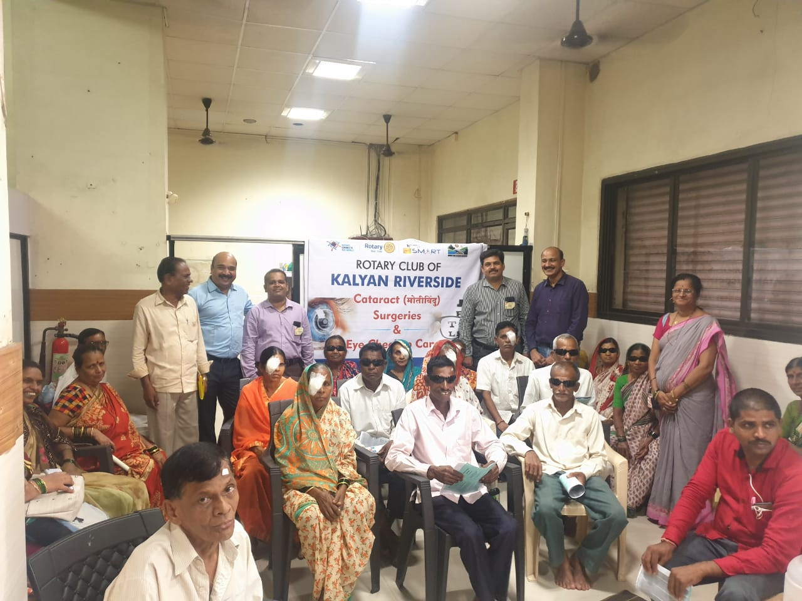
Health Management
Scope of Work
Blood Banks
Eye Hospitals & Eye Banks
Dialysis Centers
Paediatric Heart Surgeries
Mobile Clinics
Skin Banks
Hospital Equipment
Health Camps

Slide 4

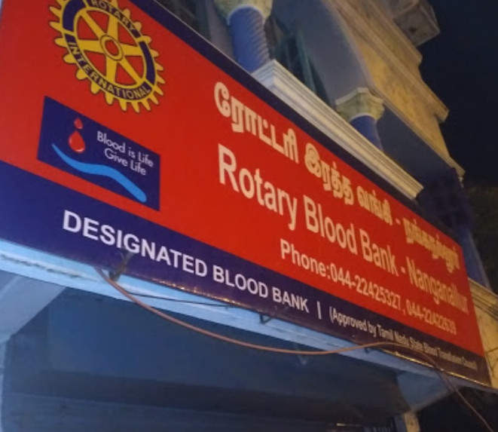
Health Management
Curative: Scope of Work
WHY SET UP A BLOOD BANK
WHO recommends that at least one percent of a country’s population should donate blood to satisfy the country’s needs.
India fell short of 19 Lakh units of blood in 2016-17
2,760 Blood Banks in India

Slide 5
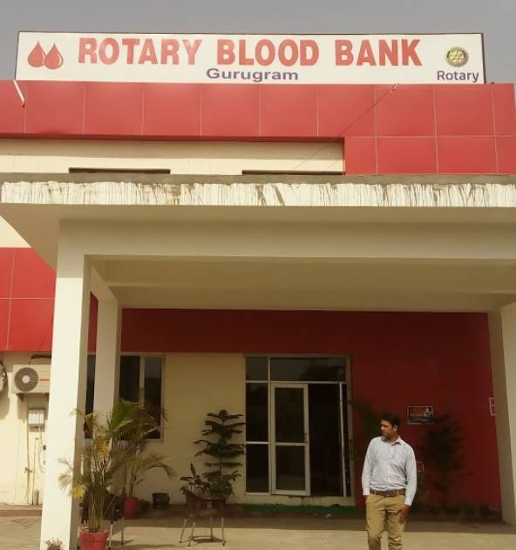
Health Management Curative: Scope of Work
SETTING UP A NEW BLOOD BANK
Min area: 150 sq. mts. Preferred however is 250 sq. mts.
Major equipment : Cost – Rs.1.25 Cr.
Staff: 15-20 personnel for a 24x7 Blood Bank
Ref. - The Drugs & Cosmetics Act, 1940

Slide 6
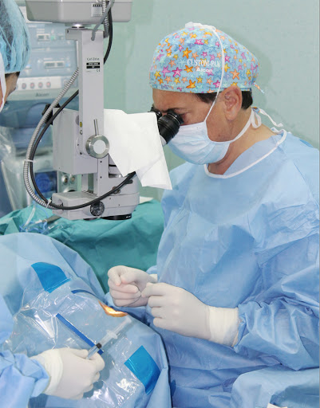
Health Management
Curative: Scope of Work
EYE HOSPITALS/EYE SURGERIES
Common Eye Surgeries
  Cataract Surgery
  Glaucoma Surgery
  Diabetic Retinopathy Surgery
Cost of setting up Eye Hospital
About Rs. 60 Lakhs with modern equipment's

Slide 7
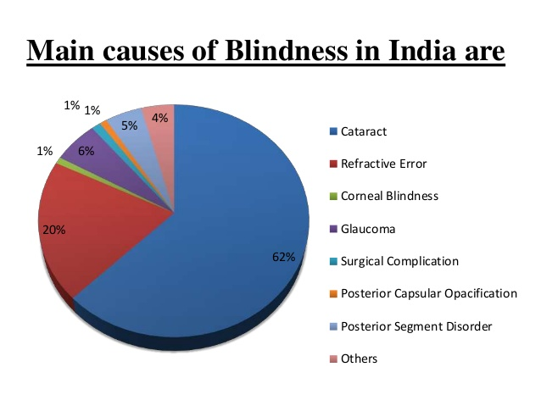
Health Management
Curative: Scope of Work
CATARACT
The most significant cause of bilateral blindness in India
Responsible for 50-80% of the bilaterally blind
India is a signatory to the World Health Organization resolution on Vision 2020: The right to sight
12 Million blind in India
GOAL FOR 2020-21: 150,000 Cataract surgeries

Slide 8
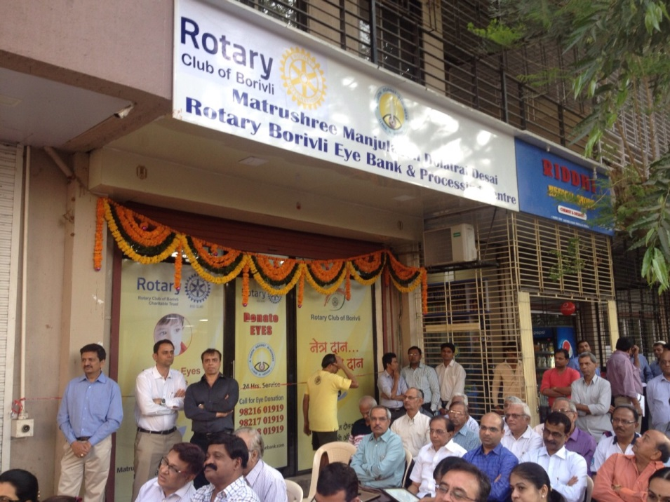
Health Management
Curative: Scope of Work
EYE BANKS
4th of the world’s blind in India - 27 million
Requirement of our country We need one million eyes per annum then only we can meet our demand
2,70,000 donor eyes are required to perform 1,00,000 corneal transplants per year in India
Cost of setting up Eye Bank
About Rs. 80 Lakhs

Slide 9
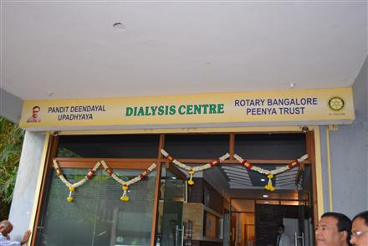
Health Management
Curative: Scope of Work
DIALYSIS CENTRES
The number of patients undergoing dialysis in India is increasing by 10-15 per cent every year
India's demand for dialysis is growing at a rate of 31 percent

Slide 10
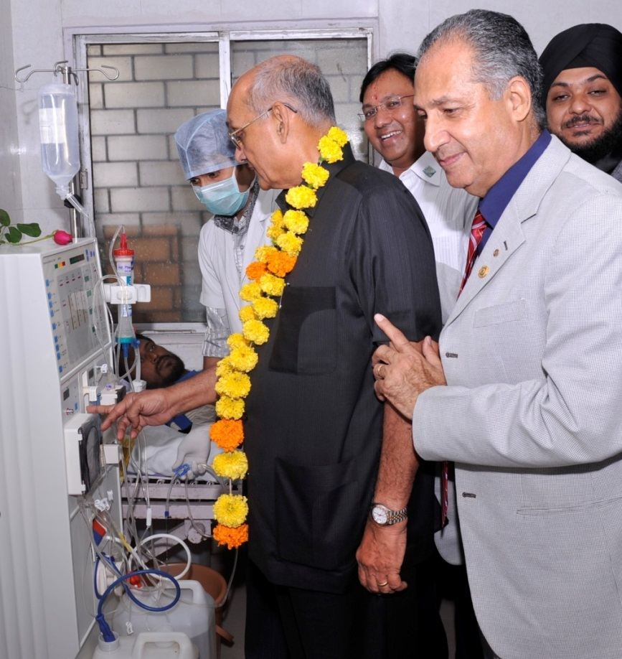
Health Management
Curative: Scope of Work
DIALYSIS CENTERS
The total cost of treatment, at avg. 2 dialysis per week, is at least, about Rs.10,000 per month.
One Center with 6 Dialysis Units will conduct about 120 dialyses per week
Cost of setting up is Rs.30 Lakhs (thr’ Fairfax) or up to 45 Lakhs (otherwise)

Slide 11
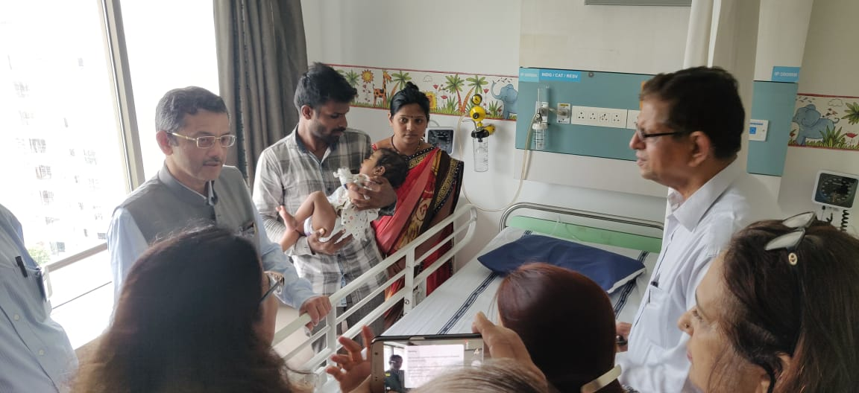
Health Management
Curative: Scope of Work
PAEDIATRIC HEART SURGERIES
Every year, more than one Lakh children are born with Congenital Heart Disease. These can be corrected with timely interventions
Every year, about 25,000 surgeries are performed in India. There is huge unmet need!
Different types of heart surgeries – from less serious to highly serious

Slide 12
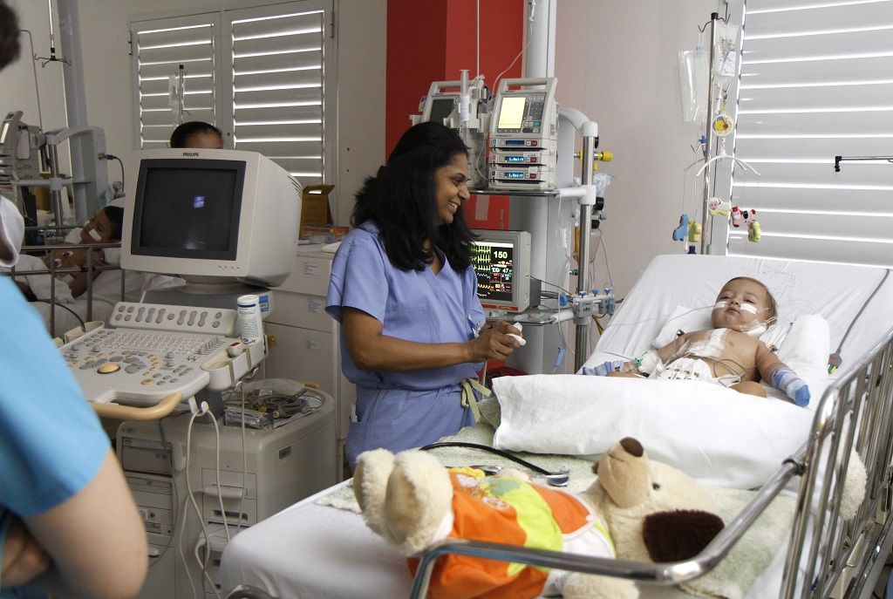
Health Management
Curative: Scope of Work
PAEDIATRIC HEART SURGERIES
Cost of surgeries varies from region to region and according to Grade of heart defect.
Cost in Mumbai: Rs. 75,000/- to Rs. 4.00 Lakhs.
For Rotary, the cost varies from Rs. 50,000/- to Rs. 2.5 Lakhs

Slide 13
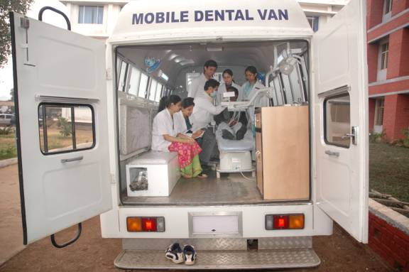
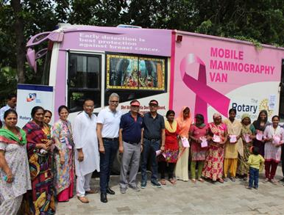
Health Management
Curative: Scope of Work
MOBILE CLINICS – VANS
Dental
Eye
Blood Collection
General Check up
Mobile surgical units
Mobile ENT Van
Mammography Vans
Ambulances – Cardiac and General
COST : Rs. 10 Lakhs to 50 Lakhs approx. depending on requirement

Slide 14
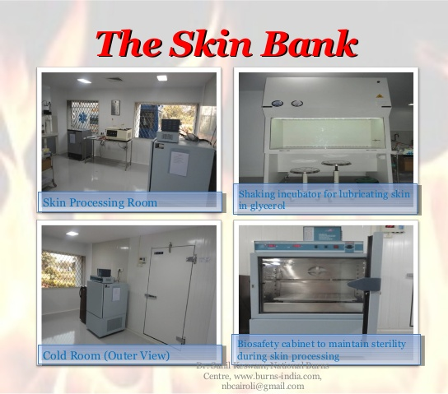
Health Management
Curative: Scope of Work
WHAT IS A SKIN BANK
Skin banking is a facility to collect skin from eligible deceased donor.
There are only about 12 established functional skin banks in India.
The population of India is 1,340 million.
7 million cases of burns are reported annually and many die because of lack of efficient care.012

Slide 15
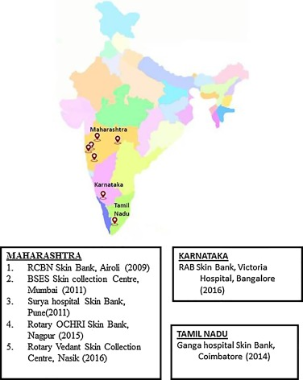
Health Management
Curative: Scope of Work
BASICS OF SETTING UP SKIN BANK
Population: 3-5 Millions and willing to donate skin
Availability of Plastic Surgeon
Industrial belt e.g. Chemical Industry
Good connectivity through Ambulances
COST OF SETTING UP SKIN BANK
Equipments: Rs. 15 Lakhs
Space: about 100 sq. mts.
Infrastructure cost: varies from region to region.
Total: Appx. 30 Lakhs

Slide 16


