Slide 1
Rotary India Environment MISSION
SOLID WASTE MANAGEMENT
R/IND/RIEM1

Slide 2
S – Solid Waste Management
T – Tree Plantation
A – Awareness
R – Renewable Energy

Slide 3
Solid waste management
Wet Waste & Dry Waste

Slide 4
Introduction :
The urban population of total 44 cr people living in India generate 62 million tonnes of waste every day.
Of the total, only 70% is collected, the remaining 30% again goes in the environment.
The solid waste is the biggest polluter of the environment.
The solid waste management consists of collection, segregation, reuse/recycle, transportation, processing and disposal in landfill sites in a scientific manner.

Slide 5
Waste – facts:
Biodegradable 51% : Kitchen waste, green waste and paper waste : compost
Recyclable 17.5% : Polyethylene : road construction and fuels : Tin, glass, bottles cans, plastics : Recycled products
Inert materials 31% : Dirt debris and Construction & Demolition : Building materials
Composite waste : Clothing, tetra packs, plastics, toys etc; Recycled products or burning in thermal plants and residual derived fuel.
Remaining soil and sand for roads and other construction works.
Medical and hazardous waste : e waste, chemicals, paints, pesticides, batteries etc : special scientific treatment for recycling and disposal Is required.

Slide 6
WHAT Clubs can do
SOLID WASTE MANAGEMENT
Segregation of Waste at Source
Use Organic Waste to make Compost
Say No to Plastic

Slide 7
Segregation of waste :
The segregation of waste at source is the basic need for proper waste management.
Clubs can help households in urban & rural areas to segregate & manage waste locally.
Rotary clubs should create awareness about ill effects of solid waste and how to manage it.

Slide 8
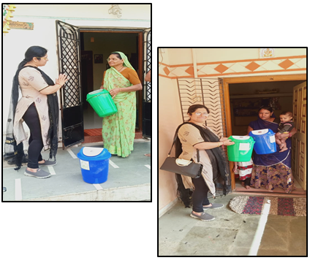
DUSTBIN DISTRIBUTION
Dustbin
Distribution
For segregation

Slide 9
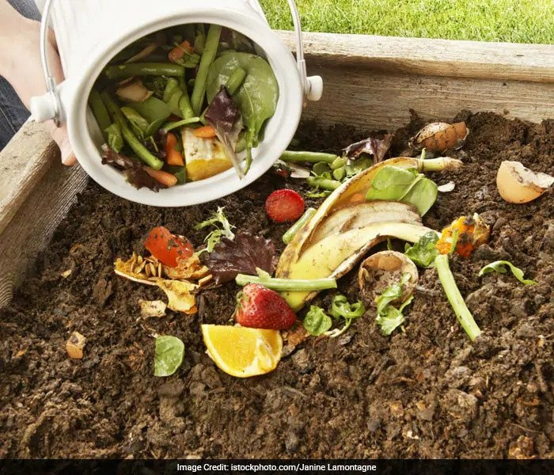
Create compost:
Household Compost
Community Composting

Slide 10
Compost Creation AT HOME

Slide 11
Community composting

Slide 12
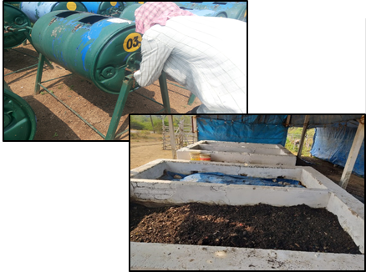
Community composting

Slide 13
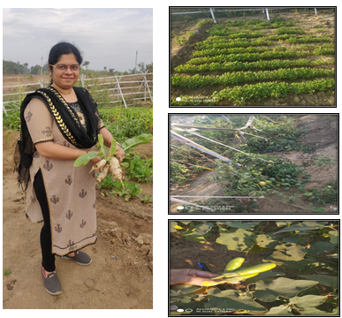
Community composting

Slide 14
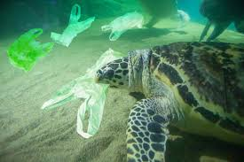
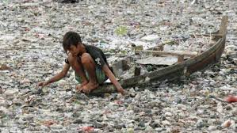
Why are Plastics bags a problem?
SAY NO TO PLASTIC
Harmful to the environment
Takes 1000 years to decompose
Kills Animals & sea life
Reduces Rain Water percolation
Drop in Water Table
The list is endless

Slide 15
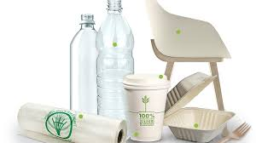
The various other Alternatives
Use biodegradable items;
Carry a cloth/jute bag Personal Water Bottle
Recycle / Reuse Plastic
Encourage alternate material products, ex. Glass Bottles, Metal Containers

Slide 16
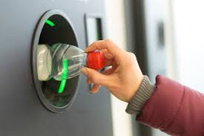
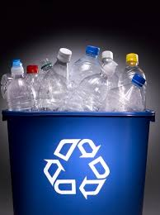
Plastic Pet Bottle Menace
Pet Bottle crushing machine can be installed in Railway and other prominent public places, the bottle crushed is used for recycling and has commercial value to it.

Slide 17
Goals By 2025
3,500 Villages to have Waste Management & Composting by 2025
5,000 Community Composting in Urban Parks
7,000 Plastic Bottle Crushing / Shredding Machines Pan India

Slide 18
COST
Waste Management and composting in 1 village – Rs. 10 to 15 lakh
Bottle crushing/Shredding machine – 1.25 to 1.5 lakh per machine
Community Composting in urban parks – 2.5 lakh each park (depending on size and capacity of the park)

Slide 19
Rotary India Environment MISSION
TREES - Lungs of Earth

Slide 20
S – Solid Waste Management
T – Tree Plantation
A – Awareness
R – Renewable Energy

Slide 21
Goal
Mission – Plant More Trees
India Goal 30 Crore Trees in 6 years
India Goal 20-21 = 5 Crore Trees
Your District Goal = 15 Lakh Trees per year

Slide 22
Where to Plant
Identify location for Mass planting
Land areas in Schools, Colleges, Hospitals, Factories and free urban areas
Traffic Islands, River Banks, Road sides, City Parks, Home gardens & Govt. land
Cost Rs.100/- per Tree for 3 years(use MGNREGA)
Notes:
MGNREGA- "Mahatma Gandhi National Rural Employment Guarantee Act", initiated with the objective of "enhancing livelihood security in rural areas by providing at least 100 days of guaranteed wage employment
& to create durable assets (such as roads, canals, ponds and wells).
It is to be implemented mainly by Gram Panchayats (GPs).

Slide 23
What & How to Plant
Identify type of Trees to be planted
Shade Trees,
Fast Growing Trees,
Medicinal Trees,
Fruit Bearing Trees etc.
Use Saplings of 3’ and above in height

Slide 24
What & How to Plant
Tree Saplings available with Govt. Department – Forest, Agriculture etc. – 1 year advance order to be placed
Ensure maintenance & sustainability - Ex. Each School child to adopt 5/10 trees
Latest technology may be adopted Miyawaki Method
Notes:
Miyawaki Method: Miyawaki is a technique pioneered by Japanese botanist Akira Miyawaki, that helps build dense, native forests. The approach is supposed to ensure that plant growth is 10 times faster and the resulting plantation is 30 times denser than usual. It involves planting dozens of native species in the same area, and becomes maintenance-free after the first three years.

Slide 25
Mini Forest with Miyawaki Method

Slide 26
Promote Tree Plantation
Distribute at Weddings, Social Functions & Festivals
Distribute through Religious Places
Instead of Bouquets at Functions / Meetings give Plants
Inculcate importance of Trees in Schools/Colleges
Arrange field trips for Students
Involve & utilize Rotaractors & Interactors

Slide 27
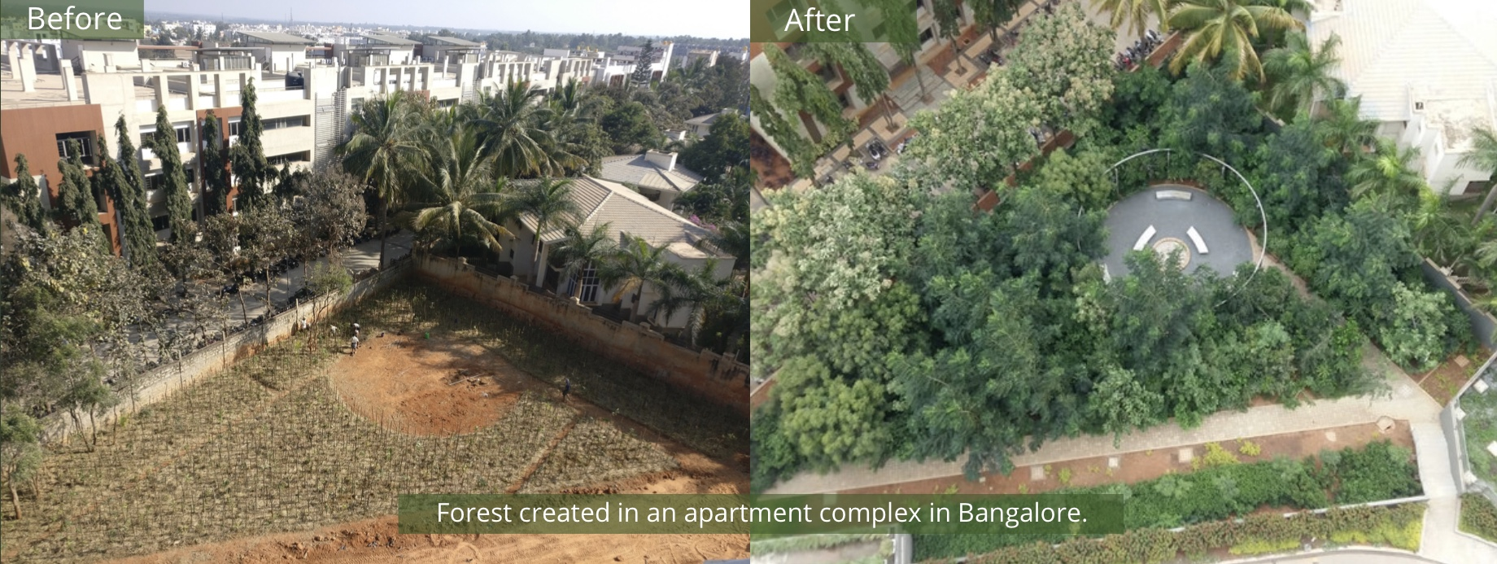
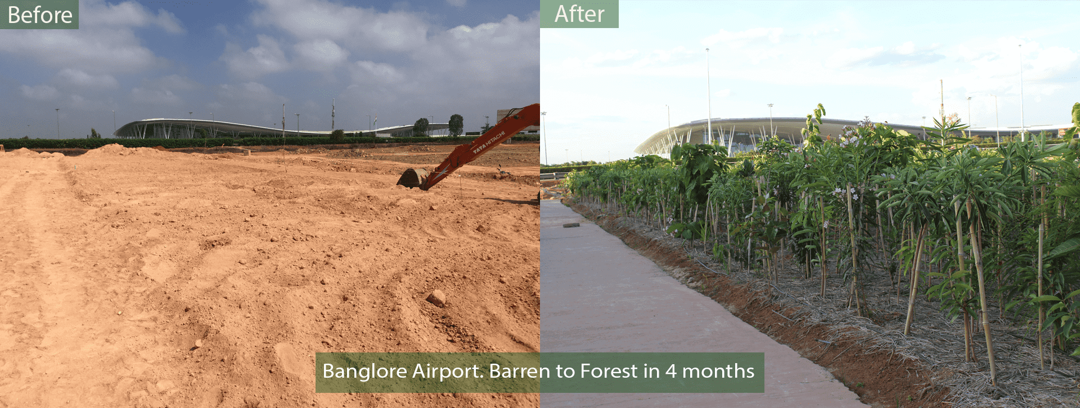

Slide 28
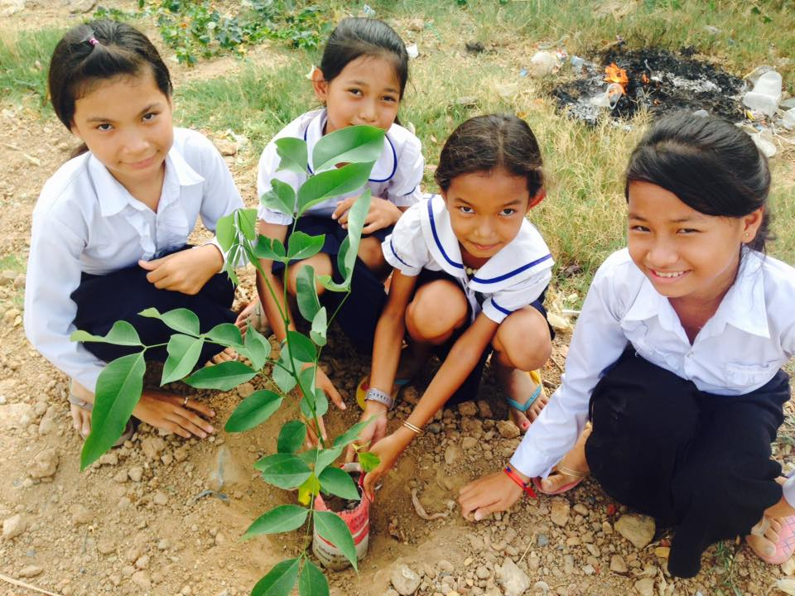
If you want to hear the
Sound of the bird, don’t buy a cage.
PLANT A TREE

Slide 29
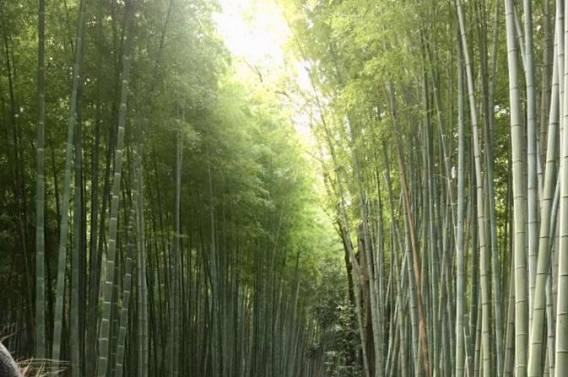
‘Trees permit human beings to exist – they are miracles of Science, and of art’

Slide 30
Your Goal – 15 Lakh Trees

Slide 31
Rotary India Environment MISSION
awareness

Slide 32
“IF YOU WANT TO CHANGE ATTITUDE
START WITH CREATING AWARENESS”

Slide 33
S – Solid Waste Management
T – Tree Plantation
A – Awareness
R – Renewable Energy

Slide 34
Awareness - Youth
Involve Schools
Colleges
Local Citizen Bodies
Interact
Rotaract
Religious Institutions

Slide 35
Awareness - Youth - I
E-Learning / Animation
Illustrated Comic Books
Messages on School Groups.
Essay / Painting / Elocution / Debates / Quiz Contests, Etc
Setting up Nature Clubs

Slide 36
Awareness - Youth -II
Use of Street Plays / Flash Mobs /Theme Songs / Dance / Videos, etc.
Nature Camps
Thematic RYLAs on Environment Topic
Earth Day, Environment Day etc. - India Wide Event

Slide 37
Awareness - Adults
Campaigns / Seminars
Social Media
Media - Press / Television / Hoardings
Car Stickers / Flyers
Messages on City Entrances etc.
Use Adult Literacy Primers
Paper Less Rotary Communication

Slide 38
Yearly District Goals
500 Schools – Comprehensive Awareness Campaign
10000 Car Stickers
10 Environment RYLAs
50 Nature Camps

Slide 39
Rotary India Environment MISSION
RENEWABLE ENERGY

Slide 40
S – Solid Waste Management
T – Tree Plantation
A – Awareness
R – Renewable Energy

Slide 41
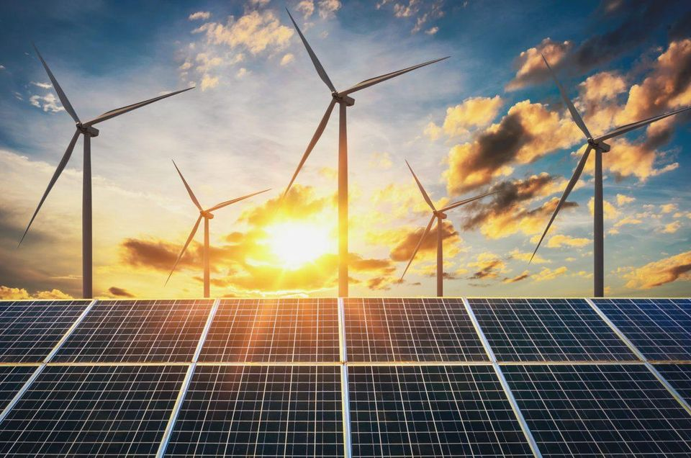
What is Renewable Energy?
Renewable Energy is Energy Generated from Natural Resources such as Sunlight, Wind, Tides, etc

Slide 42
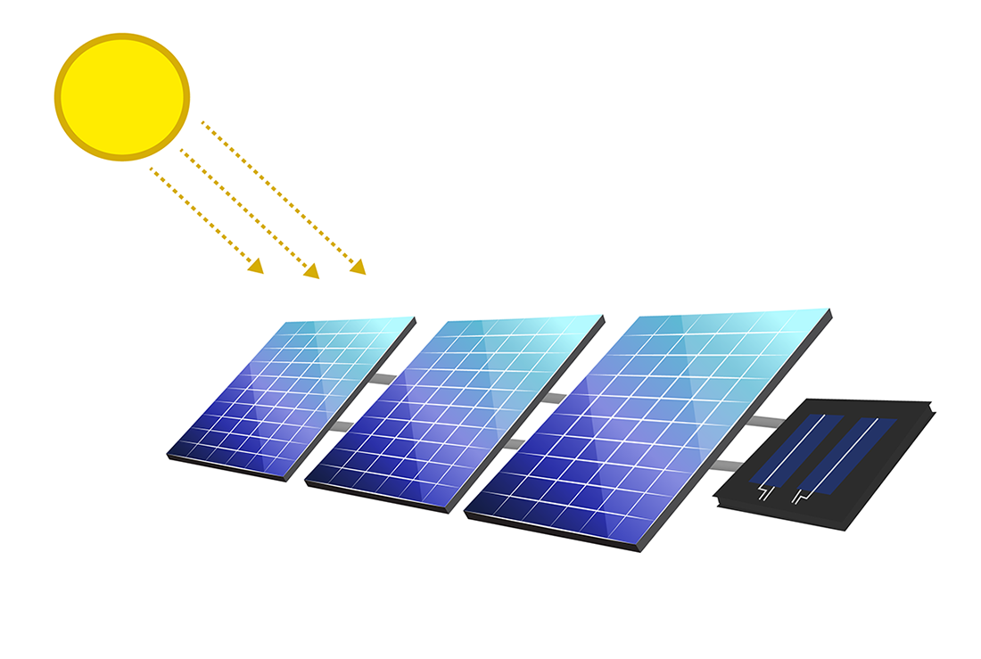
Our focus – solar energy

Slide 43
why solar Energy
Abundance of Sunshine availability
Reduces Carbon Emission
Relatively Economical
Non-Hazardous

Slide 44
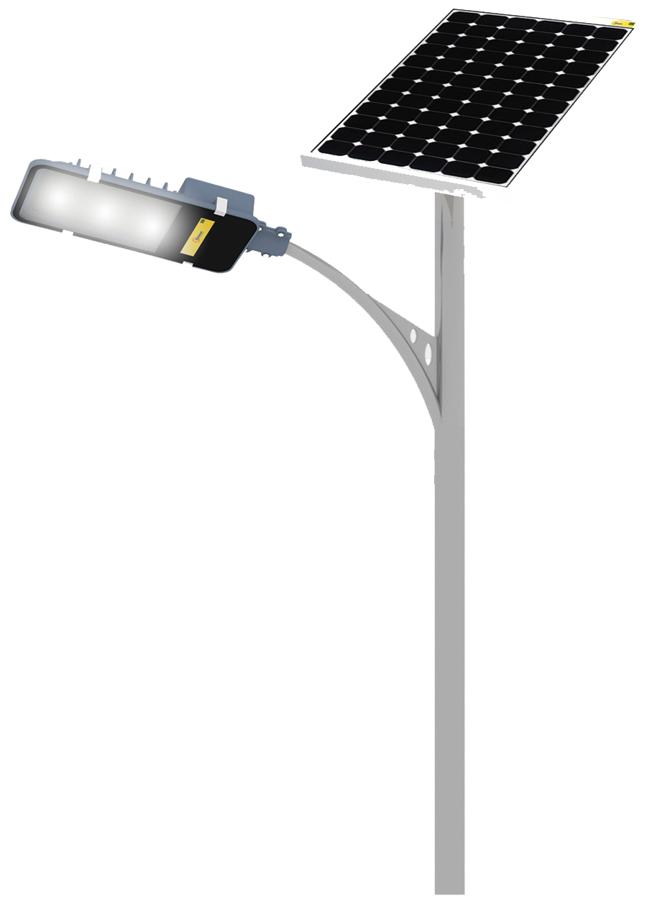
Where solar energy
Light up village household without electricity
Light up Slums
Rural Schools

Slide 45
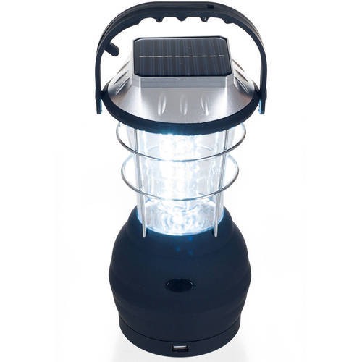
Cost - solar energy
Promote Solar Energy in the remote areas
Cost for a Portable Solar Lantern with built-in Charging Point – Rs. 1,000
Avail Government Subsidies

Slide 46
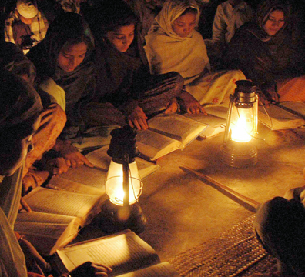
What clubs can do
Identify the areas where Solar Panels are required and act accordingly
Identify States which are supporting Solar Energy and those who are not and act accordingly

Slide 47
Thank you

