Slide 1
ROTARY INDIA
DISASTER MANAGEMENT
R/IND/RIDM1

Slide 2
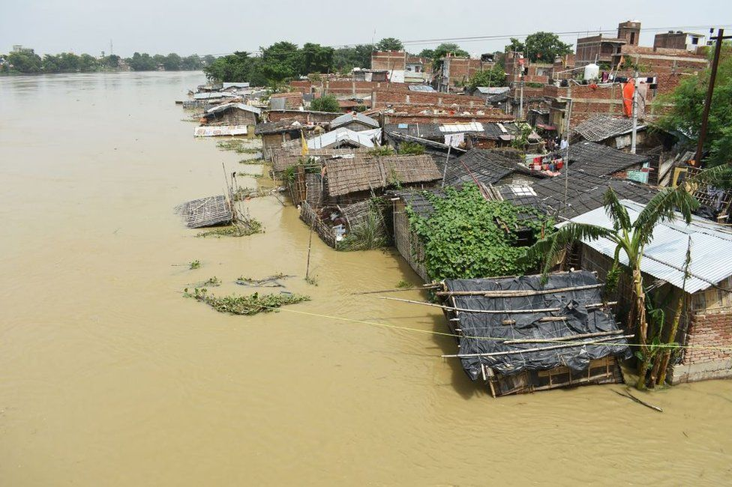
Disaster Management
Are We Ready For Another Natural Disaster?

Slide 3
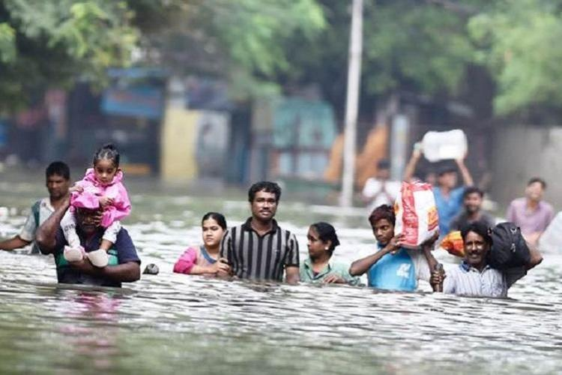
Water and Climate related Disaster
Floods
Cyclones
Droughts
Tsunami

Slide 4
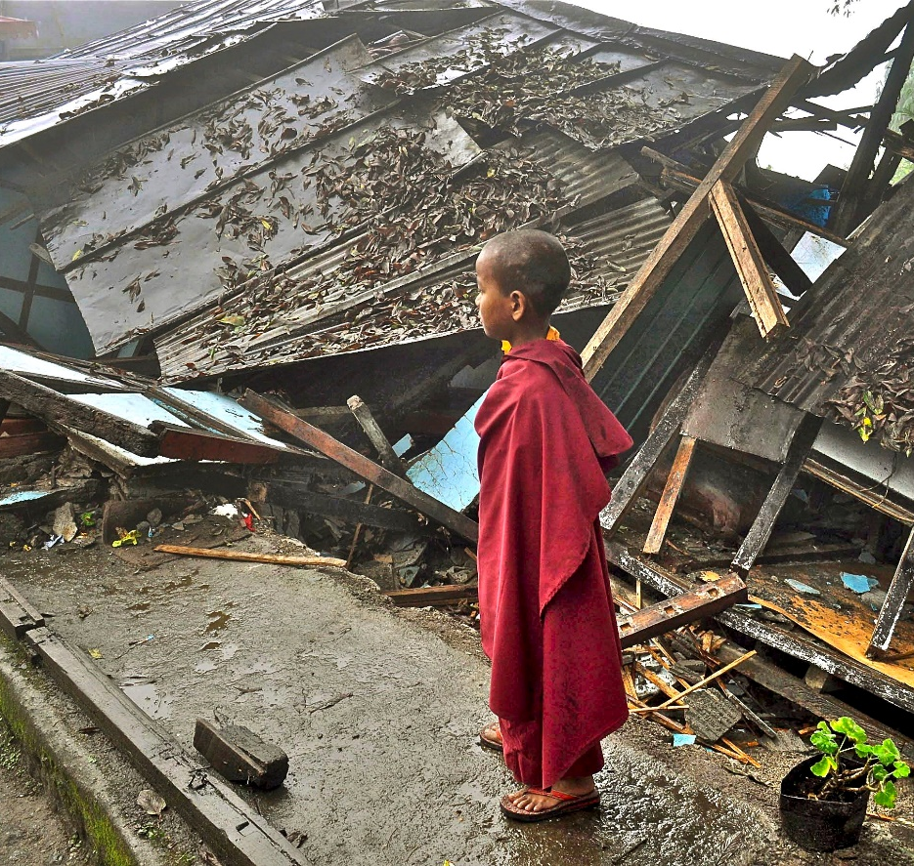
Geological, Chemical and Biological Disaster
Earthquakes
Chemical and Industrial Disasters
Biological and Disaster Epidemics/Pandemics

Slide 5
Seismic Map of India: Earthquake Prone Areas

Slide 6
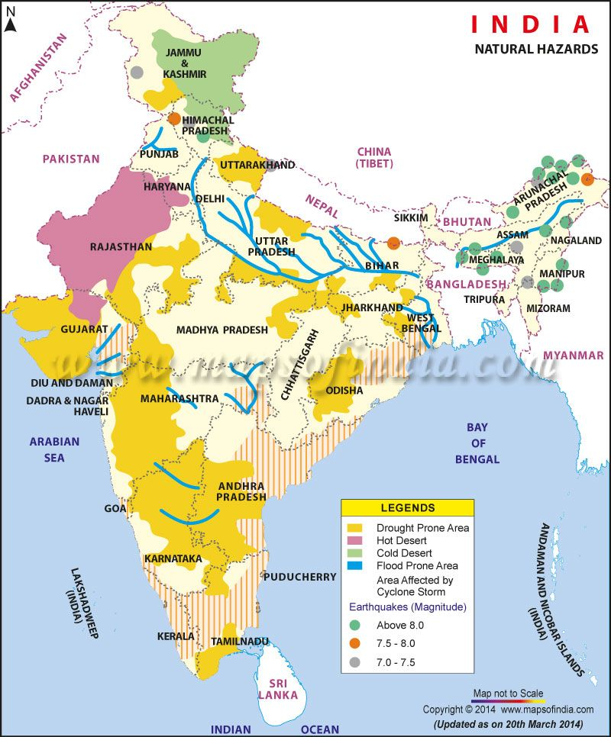
Flood, Cyclone & Drought Prone Areas

Slide 7
Types of Disaster in India (From 1980 – 2019)
Type of Disaster | No. of times occurred | Lives affected / lost
Major Floods | 21 times | More than 17 crore lives affected
Earthquake | 3 times | More than 45,000 lives lost
Drought | 4 times | More than 4 crore lives affected
Epidemic | 3 times | More than 10,000 lives lost
Storm/Cyclone | 10 times | More than 10,500 lives lost & 50 lakh lives affected
Tsunami | 1 time | More than 10,000 lives lost

Slide 8
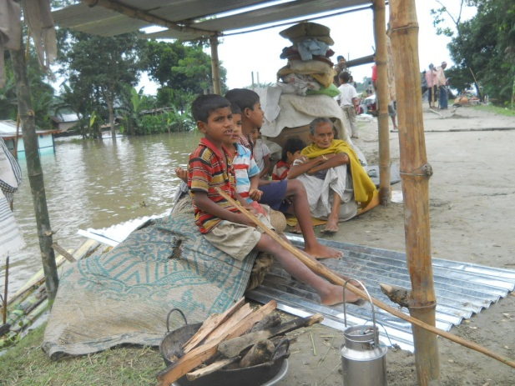
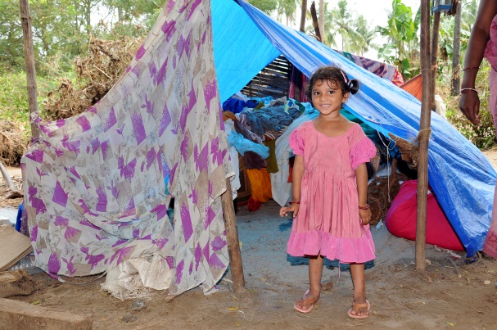
Disaster Management Plan: Type of Support required
3Rs
Rescue
Relief
Rehabilitation

Slide 9
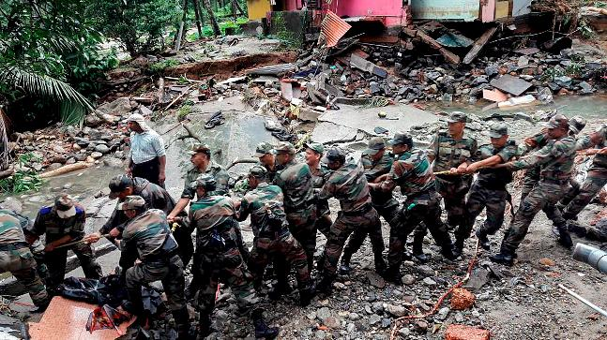
Rescue: Out of Scope of RIDM
Rescue done by Indian Military, Paramilitary Forces, trained experts etc. under National Disaster Management Authority (NDMA)

Slide 10
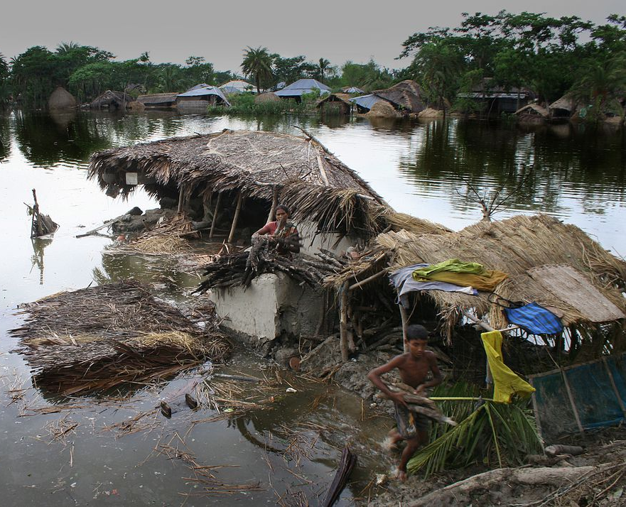
Relief
Shelter
Food
Clothes
Medical
Mental Health

Slide 11
Relief
Program Types
Shelter Kit Program
Others – Need based support

Slide 12
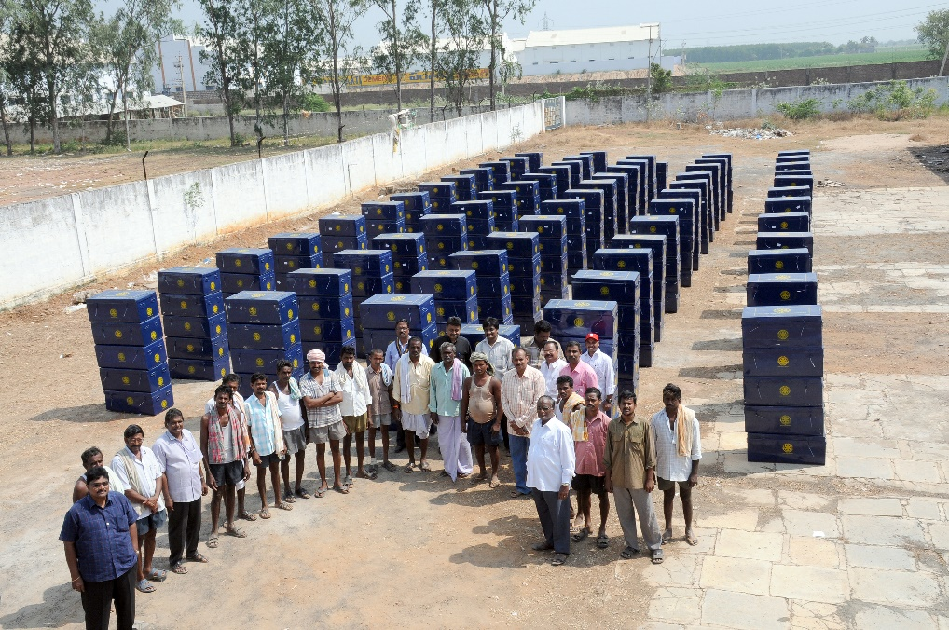
Relief : Shelter Kit Program
Depending on the intensity of the Disaster the apex body to decide on the number of Shelter Kits to be delivered in the affected area
Shelter Kits to take care of: Shelter, Food, Clothes, Medical & Mental Health

Slide 13
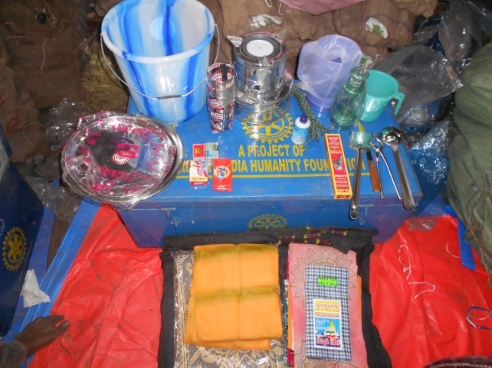
Relief
Shelter Kit Content
Shelter
2 Tarpaulins (15 x 20 ft.)
Mosquito Nets
2 Blankets (optional)
2 Bed sheets

Slide 14
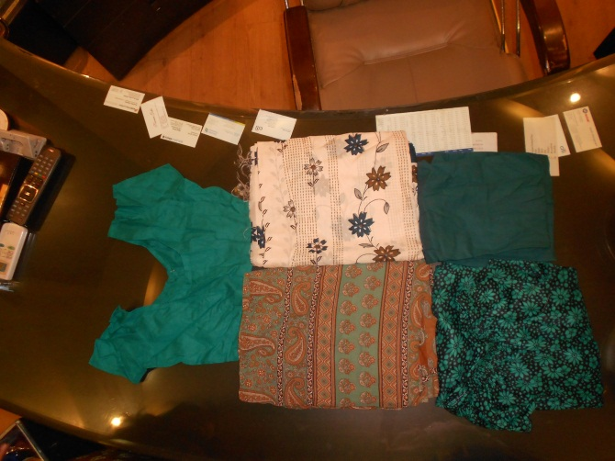
Relief
Shelter Kit Content
Clothing
2 sets for Man
2 sets for Woman
2 sets for Boy
2 set for Girl

Slide 15
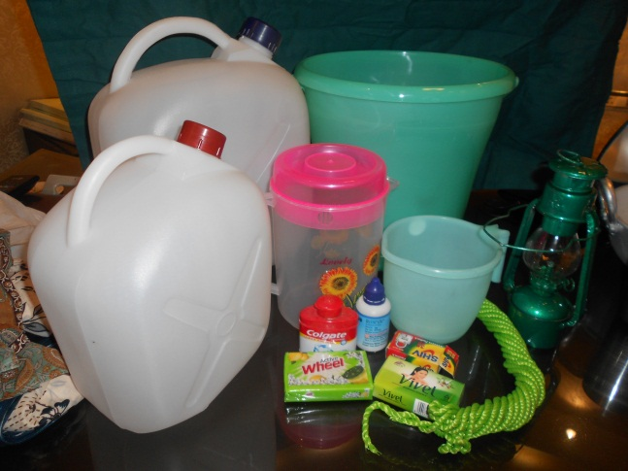
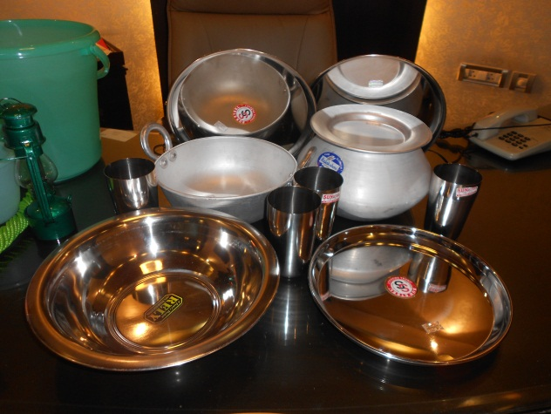
Relief
Shelter Kit Content
Food
Boxes with food for 7 days
Stove
Jerrycan for Kerosene
Cooking Utensils
Eating Utensils
Matches/Candles
Jug/Mug
Community Kitchen (Optional)

Slide 16
Relief
Shelter Kit Program
Medical
Deploy large tents for medical facility
Create a pool of
Volunteer Doctors
Volunteer Paramedics
Volunteer Rotarians, Family members, Rotaractors and Inner Wheel members

Slide 17
Relief
Shelter Kit Program
Mental Health
Have tie ups with organizations like -
Art of Living
Ramkrishna Mission
Brahma Kumaris
NIMHANS
Isha Foundation

Slide 18
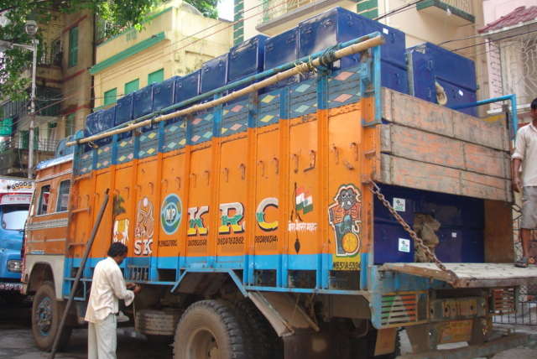
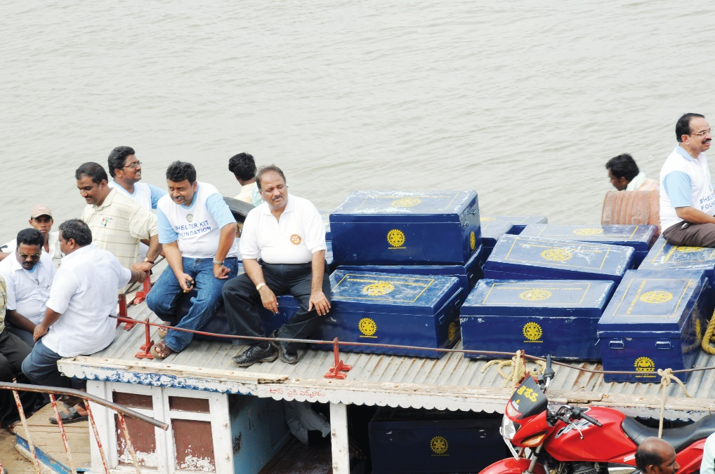
Relief
Shelter Kit Governance
Tracking of every deployment of Shelter Kit
Capture learning from past disasters
Identify Disaster hotspots
Identify warehousing facility

Slide 19
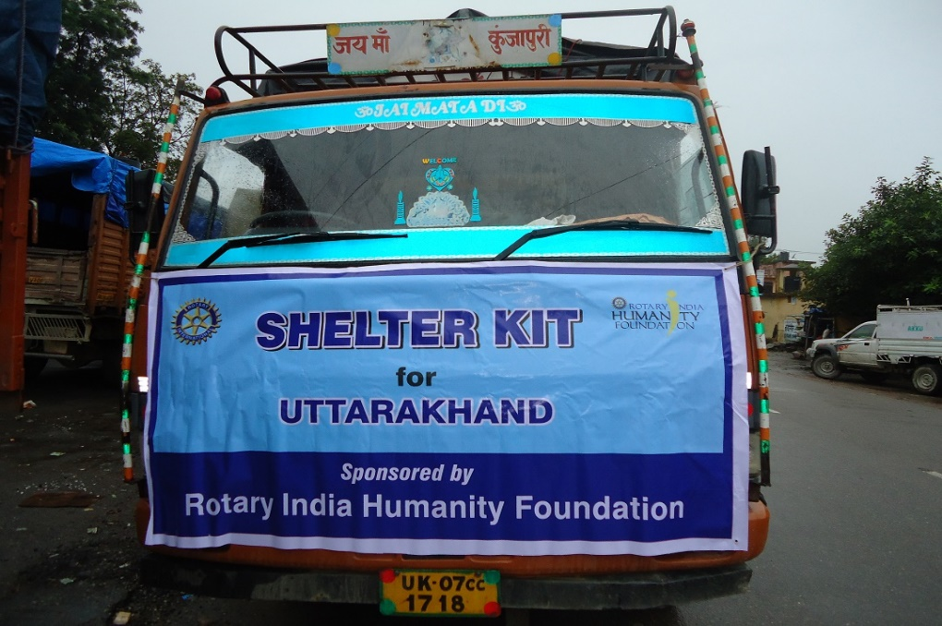
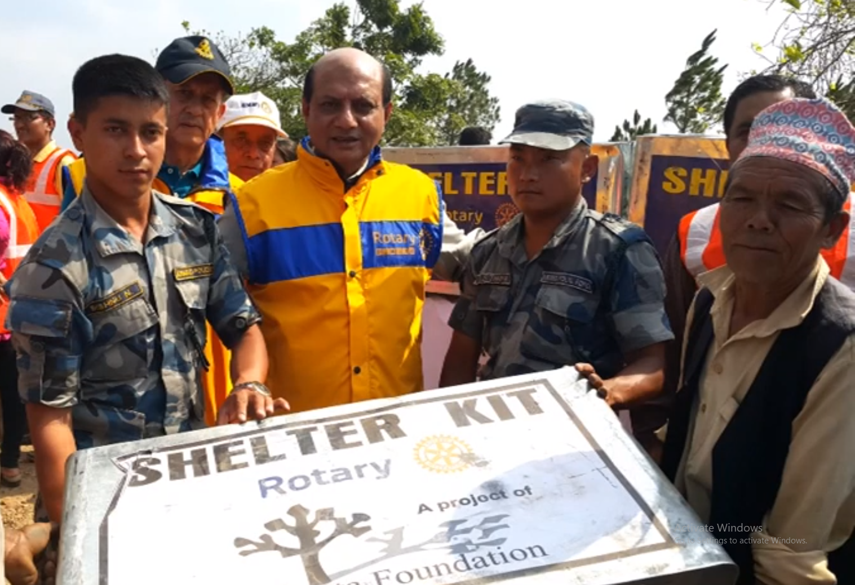
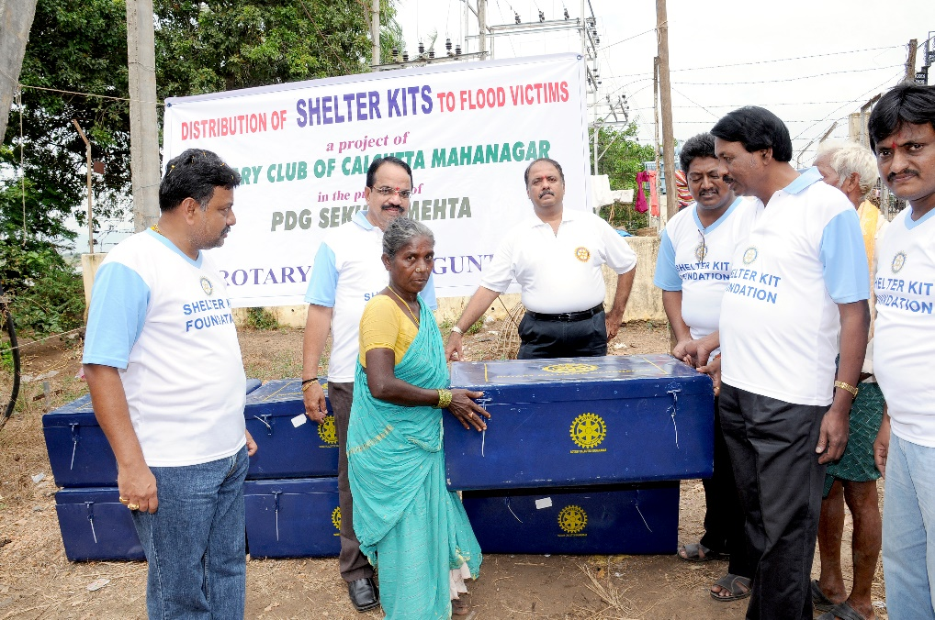
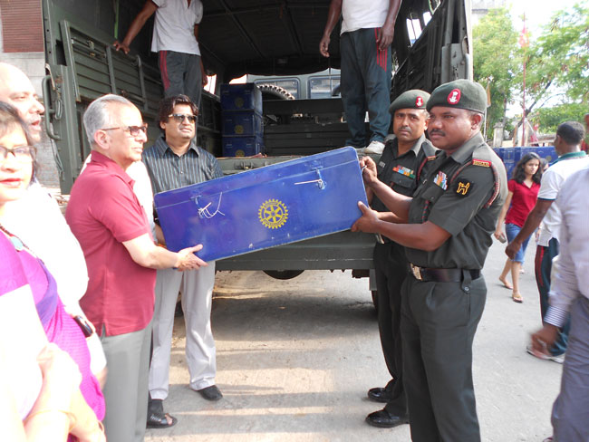
ReLIEF

Slide 20
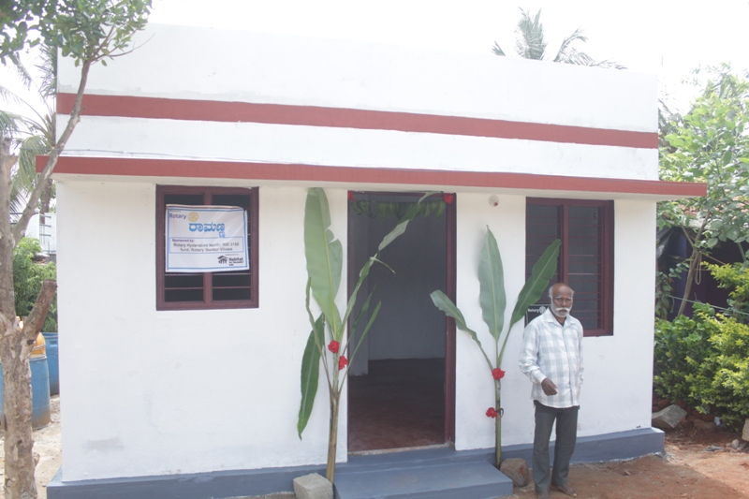
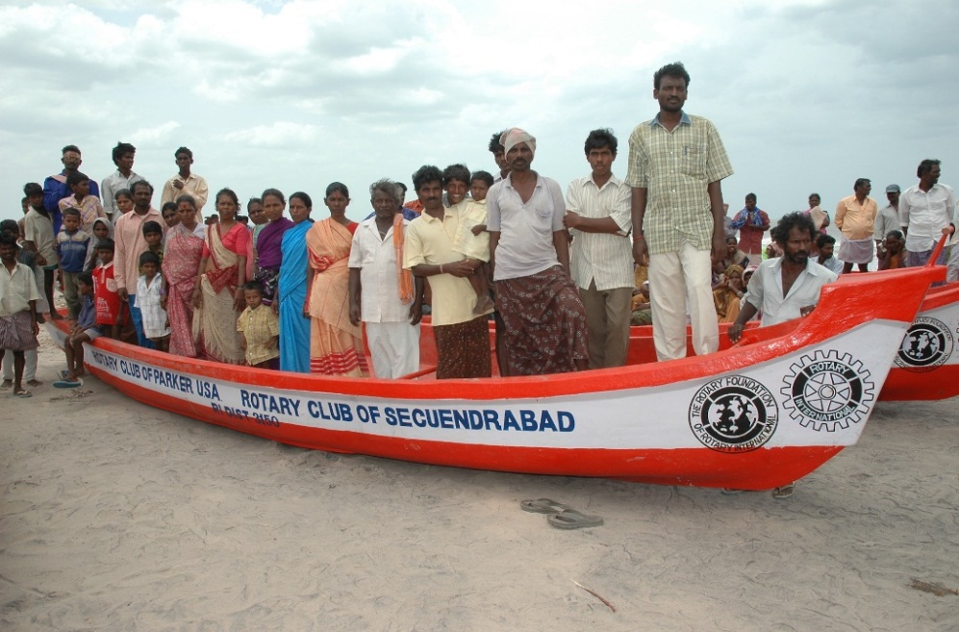
Rehabilitation
Rehabilitation
Re-building of Homes
Re-building of Schools
Others

Slide 21
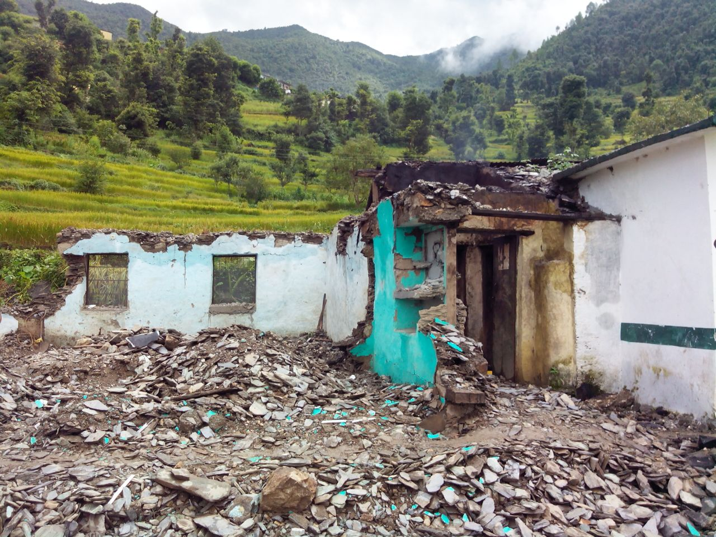
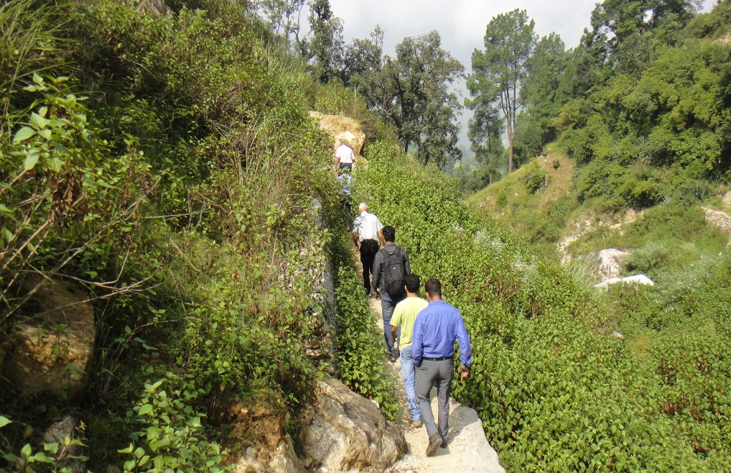
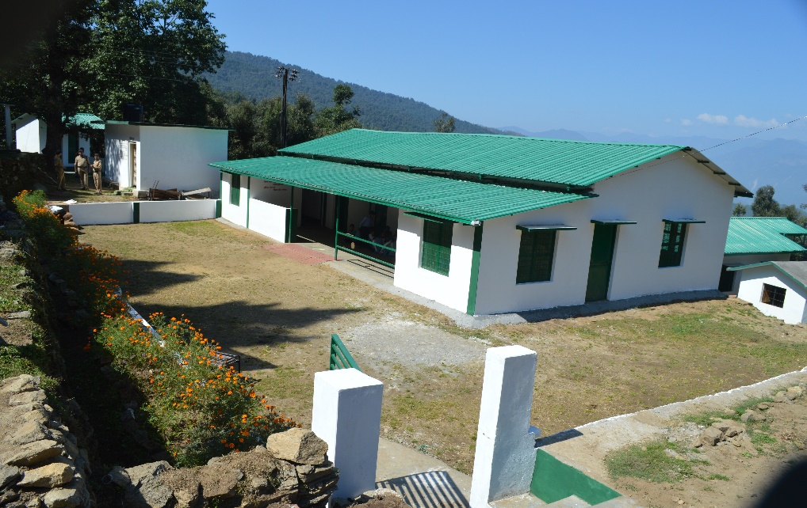
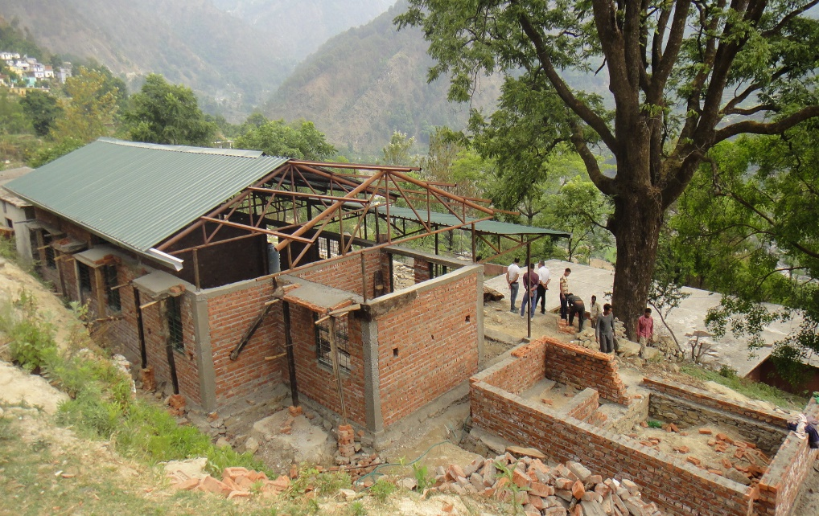
Rehabilitation – Uttarakhand Schools
Disaster struck school
Rotarians visiting the disaster affected site
New School built
Rebuilding of School

Slide 22
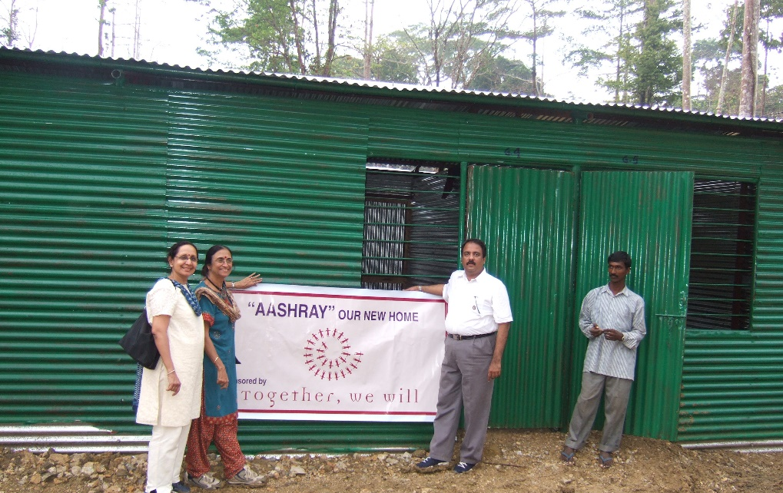
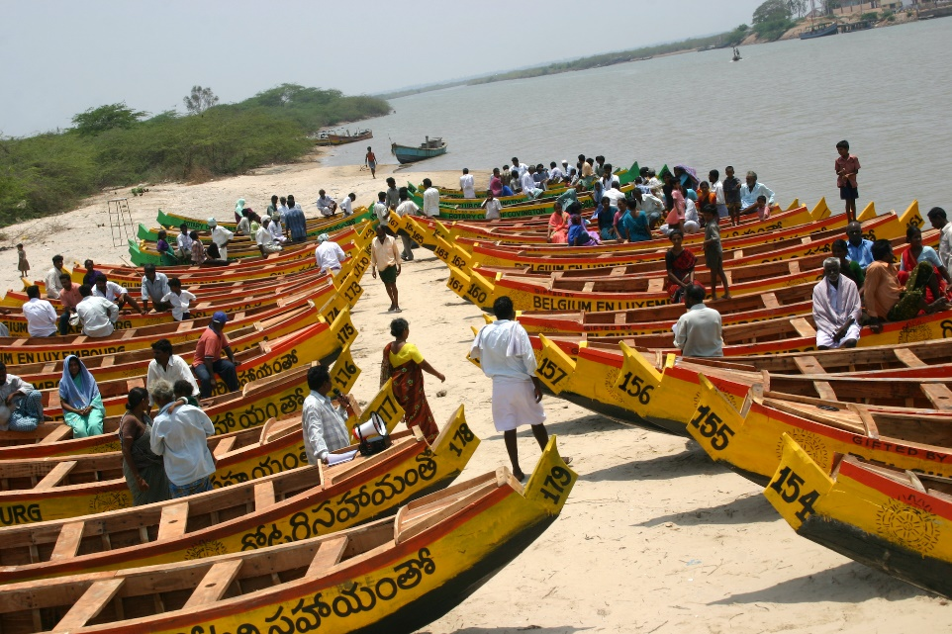
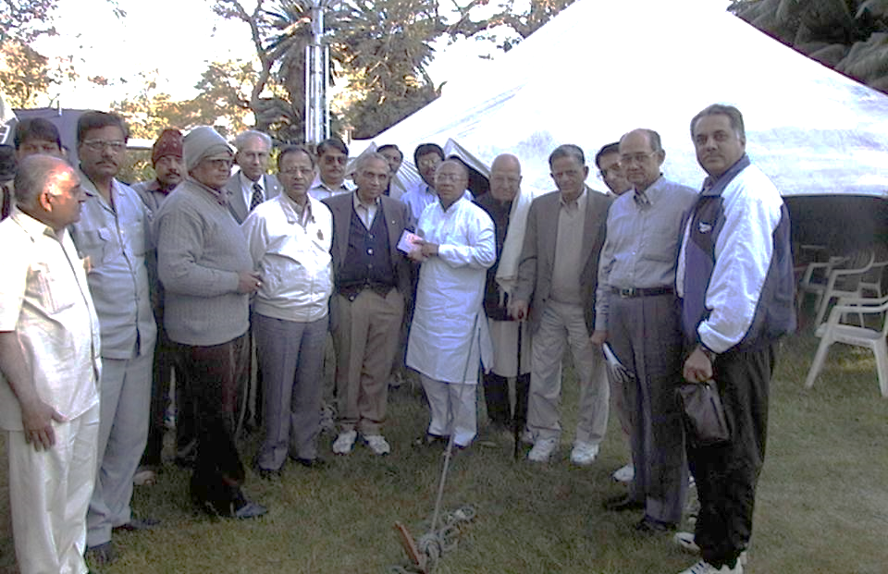
Rehabilitation

Slide 23
Partnerships ( Examples)
NGOs
Habitat for Humanity
Shelter Box
Art of Living etc.
Isha Foundation
Rotary India Literacy Mission
Government
NDMA
Military & Para – Military
Railways
NIMHANS
Corporates
Airlines
Transport Companies

Slide 24
RIDM - GOALS
2020-21 – 2,400 Shelter Kits
2021-22 – Addl.1,600 Shelter Kits
2022-23 – Addl. 2,000 Shelter Kits
2023-24 – Addl. 2,000 Shelter Kits
2024 -25 – Addl. 2,000 Shelters Kits

Slide 25
Cost
ITEMS | AMOUNT IN RS.
Cost per Shelter Kit (without food) | 7,500/-
Cost of Food (Rice, Wheat, Dal etc. for one week) | 1,000/-

Slide 26
Shelter Kit Locations
Belgaum – 100
Chennai – 100
Coimbatore – 200
Dibrugarh – 100
Delhi – 200
Gujarat – 200
Guwahati – 100
Himachal Pradesh – 100
J&K – 100
Kochi – 100
Kolkata – 200
Mumbai – 200
Nellore – 50
Odisha – 200
Patna – 100
Uttarakhand - 100
Vishakhapatnam – 200
Vellore – 50
Vishakhapatnam – 200

Slide 27
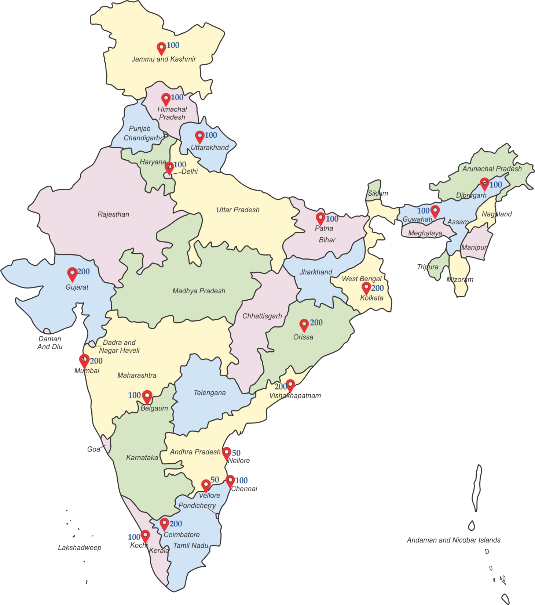
Shelter KIT Locations

Slide 28
RIDM Star Recognition
Individual Rotarians – Sponsoring for 50 shelter kits
Club – Sponsorship for 100 shelter kits
District – Sponsoring for 300 shelter kits
Corporates – Sponsoring for 500 shelter kits

Slide 29
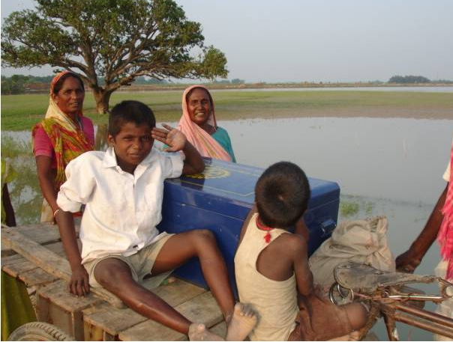
India is a disaster prone country.
Disasters have been part of our lives – Let us face it!

