Slide 1



Water, Sanitation & Hygiene
(WASH)
LAKSHYA MARCH 12, 2021

Slide 2


Suggested Activities under WASH
Watershed Development
Transformation of Water Bodies
Rainwater harvesting
H/Hold Tap Connections in Villages – Har Ghar Nal se Jal
WASH in Schools and Healthcare Facilities
Toilets - Household, Community and Public

Slide 3
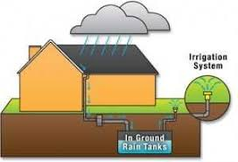
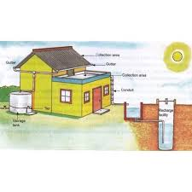
RAINWATER HARVESTING
Residential houses
Residential housing complexes
Industrial units
Commercial complexes
Hospitals
Educational institutions
Storage of Ground Water
Recharge Ground Water

Slide 4
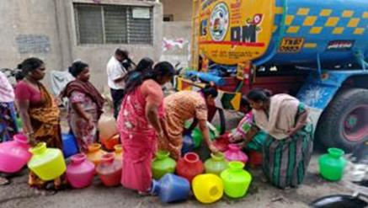
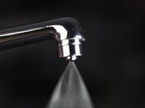
Jal Jeevan Mission (JJM) -Har Ghar Nal Se Jal (HGNSJ)
Piped water connections in only 3.27 Crore rural households out of total of 17.87 Crore as of March 2019
GoI has launched Jal Jeevan Mission (JJM) in 2019.
Efficient use of water by promoting
AERATORS

Slide 5
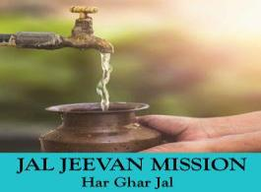
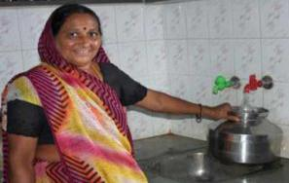
Jal Jeevan Mission (JJM) - Har Ghar Nal Se Jal (HGNSJ)
Tap water connection to every household in a village at the service level of 55 Lpcd.
Development of reliable drinking water source.
Making drinking water potable
Retrofitting of piped water supply schemes.
Grey water management.
Support activities & Capacity building.
nN

Slide 6
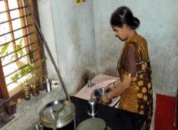
Jal Jeevan Mission (JJM) - Har Ghar Nal Se Jal (HGNSJ)
Scheme Cycle
PHASE-1 | Planning & Mobilization | 3-6 Months
PHASE-2 | Implementation | 6-12 Months
PHASE- 3 | Post Implementation | 3-4 Months
Broad Outcomes of JJM
Reduced waterborne diseases and healthy rural communities
Reduced drudgery of women
Reduced drop out of upper primary school girls
Increased employment opportunities for rural people
Note: For single villages, scheme cycle can range between 12 to 18 months from the day of G.P resolution.

Slide 7
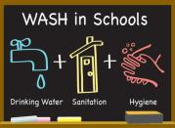
WASH in Schools
14.7 Lakhs schools in India
Elements of
WinS
Handwashing
with
Soap
Improved Capacities
Gender segregated toilets
Drinking Water
O&M
MHM
BCC
Hardware Components
70-80% of total cost
cover 20-30% of the scope of the total project
Software Components
20-30% of total cost
cover 70-80% of the scope of the total project

Slide 8
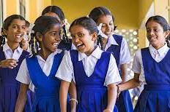

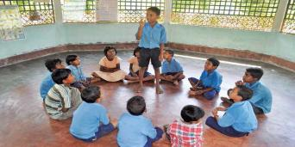

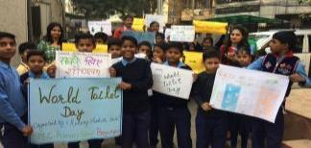
Benefits of WASH in Schools
Gender Equity
Increased Enrolment
Better Education Outcomes
Increased Attendance
Healthy Generations of Children
Children as Agents of Change
Alignment
with
National Mission

Slide 9
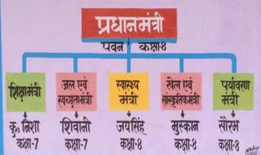
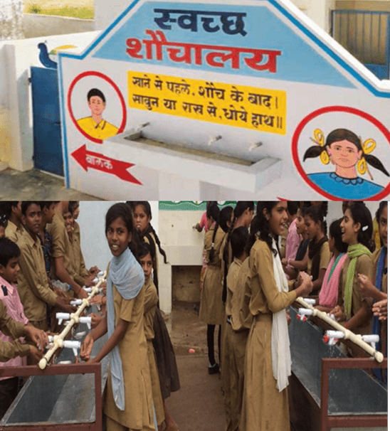
WASH in Schools- Defining Success
Implement Software Changes
Implement Hardware changes
Engage stakeholders
Monitor operations
Evaluate the program
Focus on sustainability

Slide 10
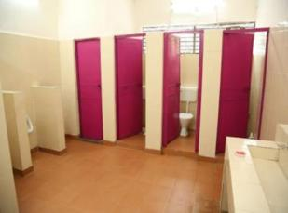
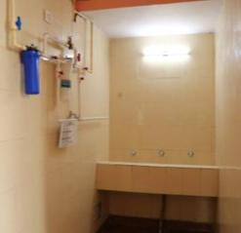
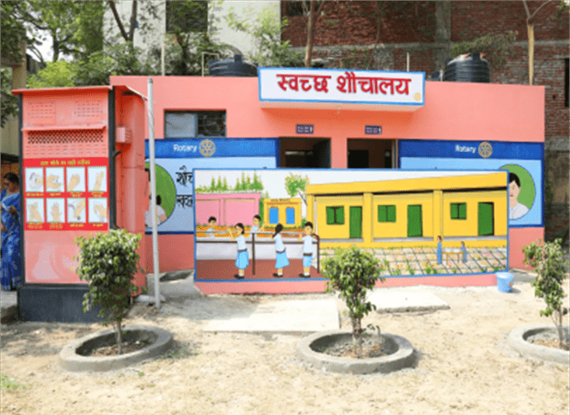
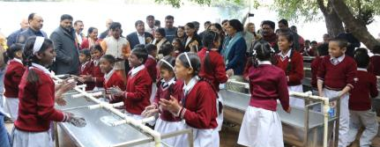
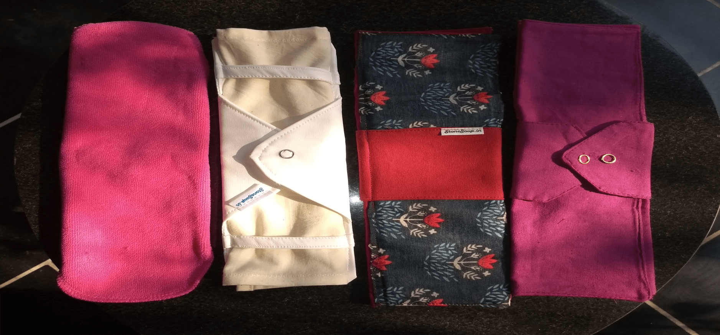
Gender Segregated Toilet Blocks, Drinking Water,
MHM & Handwashing Facilities

Slide 11
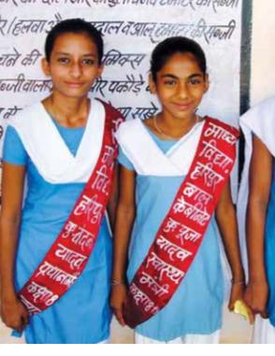
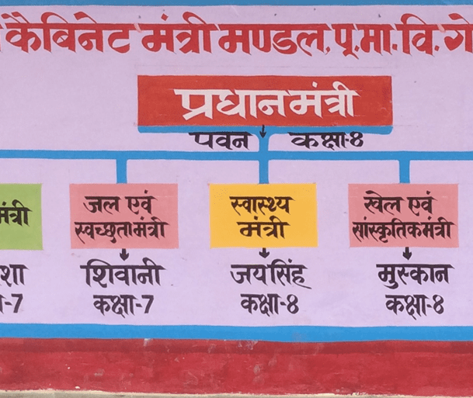
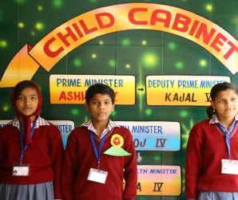
Children in leadership Role - Child Cabinet

Slide 12
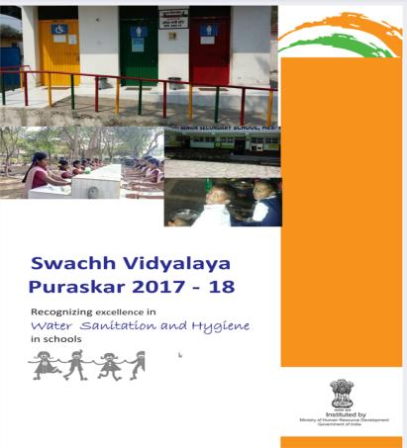
WASH in Schools Planning & Swachh Vidyalaya Puraskar
Planning
Outcome (health, education)
Child friendly, differently abled friendly, climate-resilient WASH services/ facilities
Standards/ Norms
Capacities for behaviour change
Swachh Vidyalaya Puraskar Grading
Score | STAR | Remarks
90% - 100% of the Norms | ***** | Excellent Keep it up!!
75%- 89% adherence to the Norms | **** | Very Good
51% - 74% adherence to the Norms | *** | Good, but there is a scope for improvement
35%- 50% adherence to norms | ** | Fair, Needs Improvement
Below 35% adherence to the Norms | * | Poor : Needs considerable Improvement

Slide 13

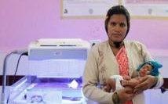
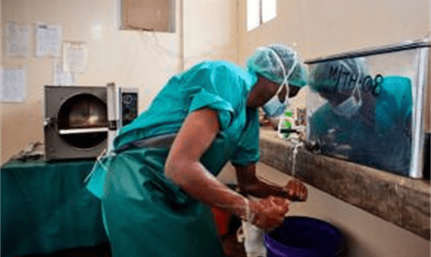
WASH in Healthcare Facilities (WinHCF)
Safe & reliable water supply
Safe and accessible toilets.
Handwashing stations with running water and soap
Safe waste management systems
O&M (Operation & Maintenance ) plans
Good hand hygiene practices
Training of healthcare staff and capacity building
India has around 31,000 healthcare facilities.
7% of these facilities don’t have water & 45% have no sanitation.
Lack of functional WASH facilities & poor hygiene practices.
130 mothers die for every 100,000 babies born.
28 out of every 1,000 new-borns do not survive beyond their first month.

Slide 14
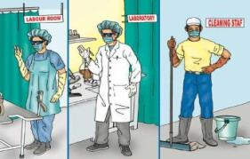
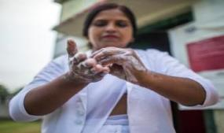
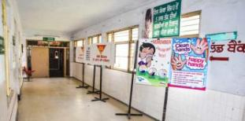
Benefits of
WASH in Healthcare Facilities
Reduced diarrheal and other health care associated infections (HCAI) & AMR.
Improved health care facilities & services.
Reduction in deaths.
Shorter hospital stays and lower out-of-pocket payments.
Improved hygiene practices at home.

Slide 15
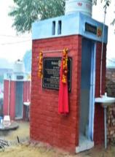
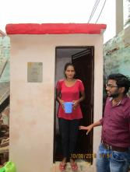
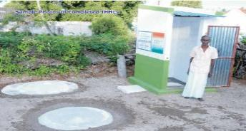
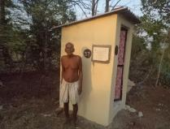
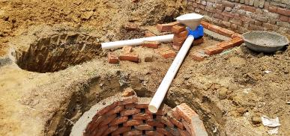
Household Toilets (IHHL)
Sanitation coverage of all the households as a part of the ODF Plus Strategy launched by GoI
Use of twin pit technology
Sustained usage of Individual Household Latrines (IHHL)
Sustained behavioural change communication (BCC) activities.

Slide 16
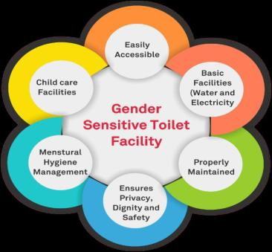
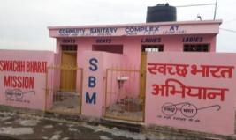
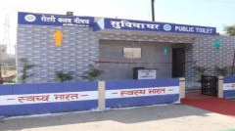
Public Toilets (PT)
Public toilets (PT) facility is provided for the floating population/general public in public places.
Examples include- market places, bus/railway stations, parks etc.
Tentative basic cost for PT facility is Rs. 98,000/- per WC seat and urinal is Rs. 32,000/- per unit as per the SBM guidelines.

Slide 17
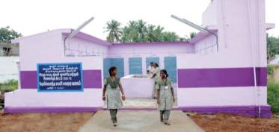
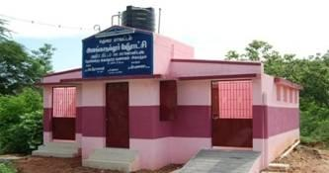
Community Toilets (CT)
Community toilets (CT) facility is a shared facility.
Provided for a defined group of residents or a community.
It is normally located in or near the community area.
Has sanitation, bathing and cloth washing facilities.
Tentative basic cost for PT facility is Rs. 98,000/- per WC seat and urinal is Rs. 32,000/- per unit as per the SBM guidelines.

Slide 18
Thank you!

