Slide 1



EMPOWERING GIRLS
LAKSHYA MARCH 12, 2021

Slide 2
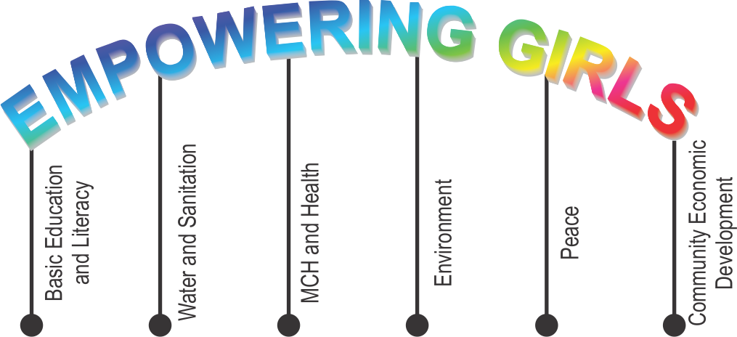

Sending girls back to school – AshaKiran program
Scholarships for
Distribution educational and support materials
Teaching self defence techniques to girls
construction and maintenance of toilets
Promotion of reusable sanitary napkins
Nutrition drives for girls
Awareness on Nutrition
Partnership with national nutritional organization
Sanitary napkins – promotion and distribution
Partnership with production units
Counselling for victims of violence and discrimination
Partnership with specialized organization
Skill development projects for girls
Setting up of reusable sanitary napkin production units
BEL | Drive for enrolment and retention of girls in educational institutions
 | Scholarships for girls to continue education
 | Distribution of things (cycle, solar light etc) that help to motivate the girls to continue education
WASH | construction and maintenance of toilets in schools, in communities
MCH and Health | Nutrition drives for girls
Environment | Sanitary napkins distribution
Peace | Counselling for victims of violence and discrimination
Community Eco Dev | Skill development projects for girls

Slide 3
Topics :
Overarching theme
Scenario
Issue
Actions

Slide 4
Scenario - Global
Education:
132 million girls - out of school
  34.3 million from primary school
  30 million from lower-secondary school
  67.4 million from upper-secondary school. World Bank
  Drinking water in schools
19% of schools had no drinking water service
570 million children affected
Sanitation and menstrual hygiene management (MHM):
23% schools have no toilet facilities
335 million girls (36%) - without water and soap facility Unicef
Sexual violence:
15 million girls (aged 15 to 19) have experienced forced sexual encounter or other types of sexual abuses

Slide 5
Scenario - India
Education:
40% of adolescent girls between 15-18 years – not attending school.
30% girls of poorest families – never been to school.
Sanitation and menstrual hygiene management (MHM):
23 million girls drop out of school annually – no toilet facilities
22% schools do – no separate functional toilets
63% schools don’t give education on menstrual health. - Survey by the Ministry of Education, 2015
Sexual violence:
Every 20 minutes a girl is raped in India

Slide 6
MAJOR ISSUES
Availability, Accessibility and Affordability
  Water and Sanitation
  Health
  Education
Child Marriage
Child Labour
Gender inequality
Violence

Slide 7
Basic Education and Literacy
Sending girls back to school – Asha Kiran progran
Scholarships for girls to continue education
Distribution of educational and support materials (cycle, solar light etc)
Teaching self defence techniques to girls

Slide 8
WASH
Construction of toilets in school
  Gender segregated
  Adequate
Promotion of reusable sanitary napkins

Slide 9
MCH and Health
Nutrition drives for girls
Awareness on locally available low cost Nutrition
Partnership with national nutritional organizations and institutions

Slide 10
Support the Environment
Partnership with reusable Sanitary napkins production units
Promotion and distribution of reusable sanitary napkins

Slide 11
Peace
Counselling for victims of violence and discrimination
Partnership with specialized national organizations

Slide 12
Community Economic Development
Promote skill development program for girls
Setting up of reusable sanitary napkin production units by women and girls

Slide 13
ADVOCACY/AWARENESS
Talks
Rallies
Nukkads
Puppet shows
IEC distribution
Non-conventional media etc

Slide 14
THANK YOU

