Slide 1
SUPPORT THE ENVIRONMENT
LAKSHYA MARCH 13, 2021

Slide 2
S – Solid Waste Management
T – Tree Plantation
A – Awareness
R – Renewable Energy

Slide 3
SOLID WASTE MANAGEMENT

Slide 4
Waste – facts:
Biodegradable 51% : Kitchen waste, green waste and paper waste : compost
Recyclable 17.5% : Polyethylene : road construction and fuels : Tin, glass, bottles cans, plastics : Recycled products
Inert materials 31% : Dirt debris and Construction & Demolition : Building materials
Composite waste : Clothing, tetra packs, plastics, toys etc; Recycled products or burning in thermal plants and residual derived fuel.
Remaining soil and sand for roads and other construction works.
Medical and hazardous waste : e waste, chemicals, paints, pesticides, batteries etc : special scientific treatment for recycling and disposal Is required.

Slide 5
WHAT Clubs can do?
SOLID WASTE MANAGEMENT
Segregation of Waste at Source
Use Organic Waste to make Compost
Say No to Plastic

Slide 6
Solid waste management
Wet Waste & Dry Waste

Slide 7
Segregation of Waste
The segregation of waste at source is the basic need for proper waste management.
Clubs can help households in urban & rural areas to segregate & manage waste locally.
Rotary clubs should create awareness about ill effects of solid waste and how to manage it.

Slide 8
Promote use of 2 Bins
House to House information and awareness creation
For segregation

Slide 9
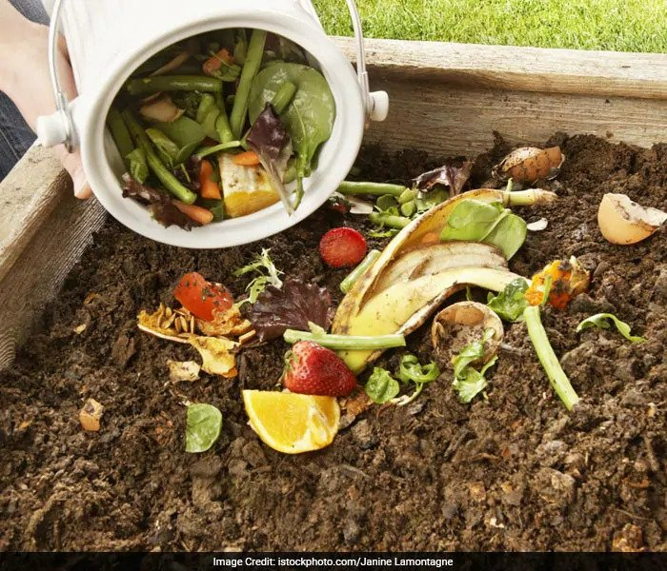
Create Compost
Household Compost
Community Composting

Slide 10
Compost Creation AT HOME

Slide 11
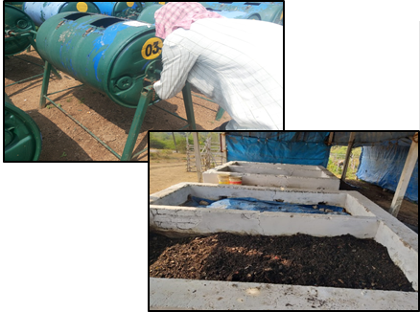
Community composting

Slide 12
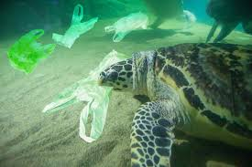
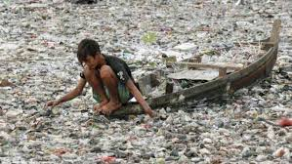
Why are Plastics bags a problem?
SAY NO TO PLASTIC
Harmful to the environment
Takes 1000 years to decompose
Kills Animals & sea life
Reduces Rain Water percolation
Drop in Water Table
The list is endless

Slide 13
The various other Alternatives
Use biodegradable items;
Carry a cloth/jute bag Personal Water Bottle
Recycle / Reuse Plastic
Encourage alternate material products, ex. Glass Bottles, Metal Containers

Slide 14
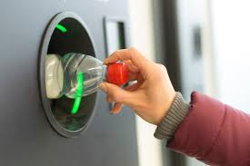
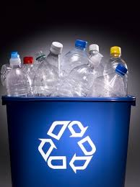
Plastic Pet Bottle Menace
Pet Bottle crushing machine can be installed in Railway and other prominent public places, the bottle crushed is used for recycling and has commercial value to it.

Slide 15
TREES - Lungs of Earth

Slide 16
Where to Plant?
Identify location for Mass planting
Land areas in Schools, Colleges, Hospitals, Factories and free urban areas
Traffic Islands, River Banks, Road sides, City Parks, Home gardens & Govt. land
Use MGNREGA
Notes:
MGNREGA- "Mahatma Gandhi National Rural Employment Guarantee Act", initiated with the objective of "enhancing livelihood security in rural areas by providing at least 100 days of guaranteed wage employment
& to create durable assets (such as roads, canals, ponds and wells).
It is to be implemented mainly by Gram Panchayats (GPs).

Slide 17
What & How to Plant?
Identify type of Trees to be planted
Shade Trees,
Fast Growing Trees,
Medicinal Trees,
Fruit Bearing Trees etc.
Use Saplings of 3’ and above in height

Slide 18
What & How to Plant?
Tree Saplings available with Govt. Department – Forest, Agriculture etc. – 1 year advance order to be placed
Ensure maintenance & sustainability - Ex. Each School child to adopt 5/10 trees
Latest technology may be adopted Miyawaki Method
Notes:
Miyawaki Method: Miyawaki is a technique pioneered by Japanese botanist Akira Miyawaki, that helps build dense, native forests. The approach is supposed to ensure that plant growth is 10 times faster and the resulting plantation is 30 times denser than usual. It involves planting dozens of native species in the same area, and becomes maintenance-free after the first three years.

Slide 19
Mini Forest with Miyawaki Method

Slide 20
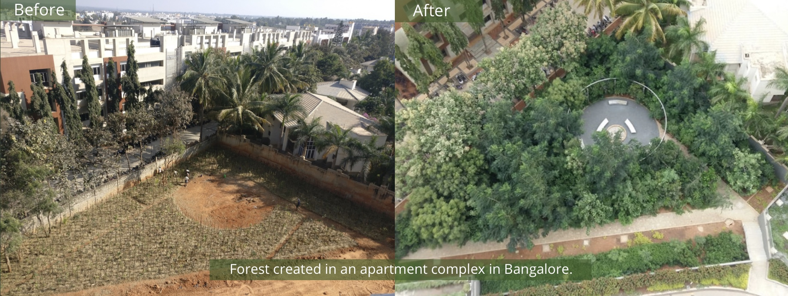
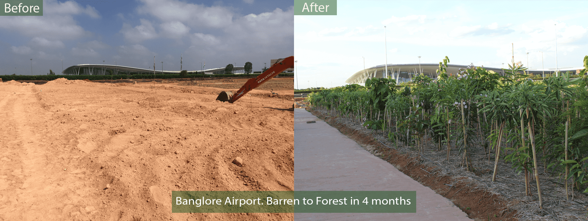

Slide 21
Promote Tree Plantation
Distribute at Weddings, Social Functions & Festivals
Distribute through Religious Places
Instead of Bouquets at Functions / Meetings give Plants
Inculcate importance of Trees in Schools/Colleges
Arrange field trips for Students
Involve & utilize Rotaractors & Interactors

Slide 22
awareness

Slide 23
“IF YOU WANT TO CHANGE ATTITUDE
START WITH CREATING AWARENESS”

Slide 24
Awareness - Youth
Involve Schools
Colleges
Local Citizen Bodies
Interact
Rotaract
Religious Institutions

Slide 25
Awareness - Youth - I
E-Learning / Animation
Illustrated Comic Books
Messages on School Groups.
Essay / Painting / Elocution / Debates / Quiz Contests, Etc
Setting up Nature Clubs

Slide 26
Awareness - Youth -II
Use of Street Plays / Flash Mobs /Theme Songs / Dance / Videos, etc.
Nature Camps
Thematic RYLAs on Environment Topic
Earth Day, Environment Day etc. - India Wide Event

Slide 27
Awareness - Adults
Campaigns / Seminars
Social Media
Media - Press / Television / Hoardings
Car Stickers / Flyers
Messages on City Entrances etc.
Use Adult Literacy Primers
Paper Less Rotary Communication

Slide 28
RENEWABLE ENERGY

Slide 29
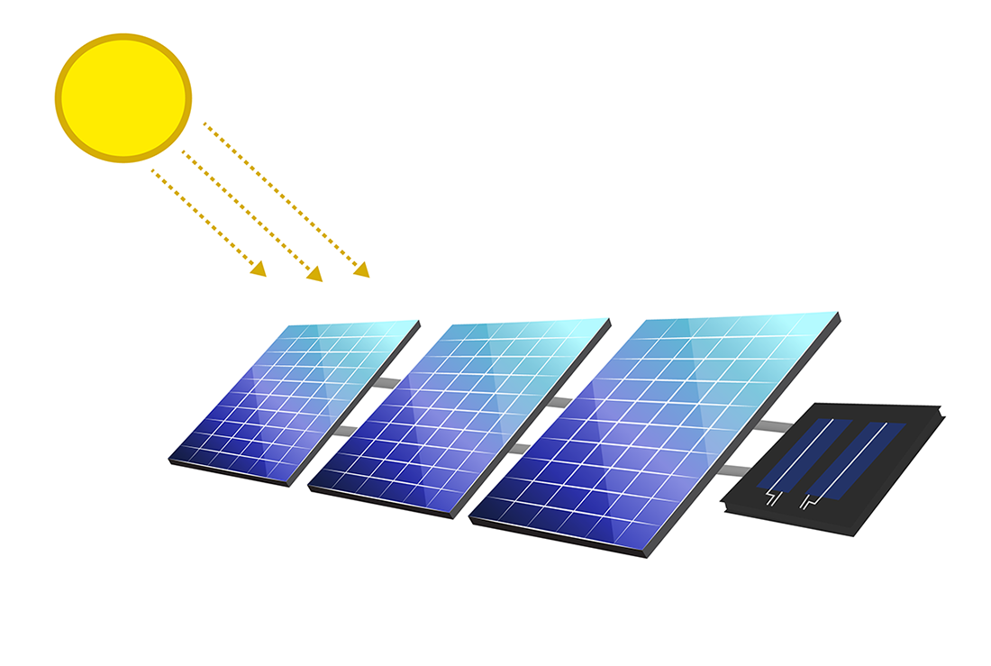
Our focus – Solar Energy

Slide 30
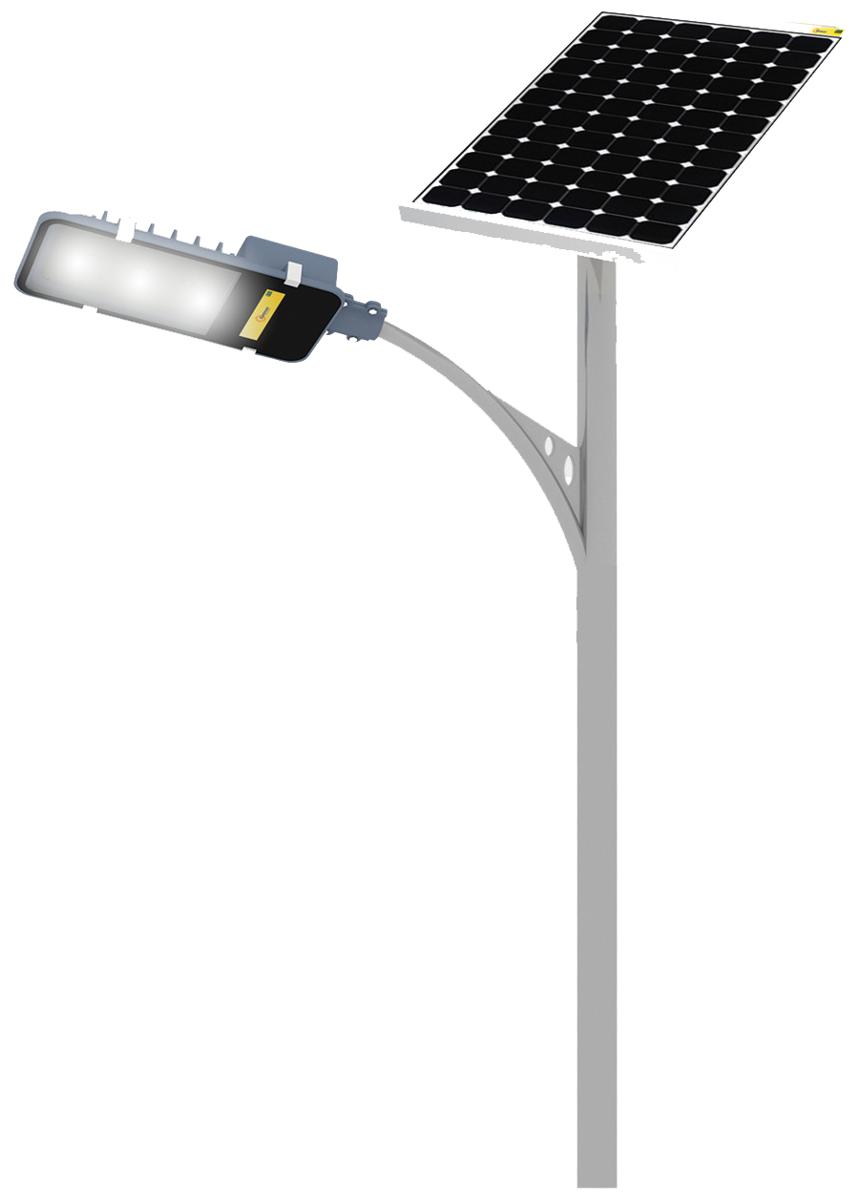
Where solar energy?
Light up village household without electricity
Light up Slums
Rural Schools

Slide 31
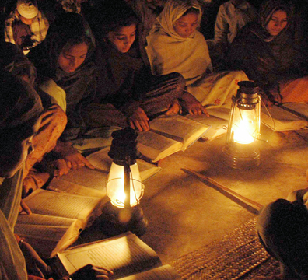
What clubs can do?
Identify the areas where Solar Panels are required and act accordingly
Identify States which are supporting Solar Energy and those who are not and act accordingly

Slide 32
S – Solid Waste Management
T – Tree Plantation
A – Awareness
R – Renewable Energy

Slide 33
Thank you

