Slide 1



DISASTER MANAGEMENT
LAKSHYA MARCH 14,2021

Slide 2
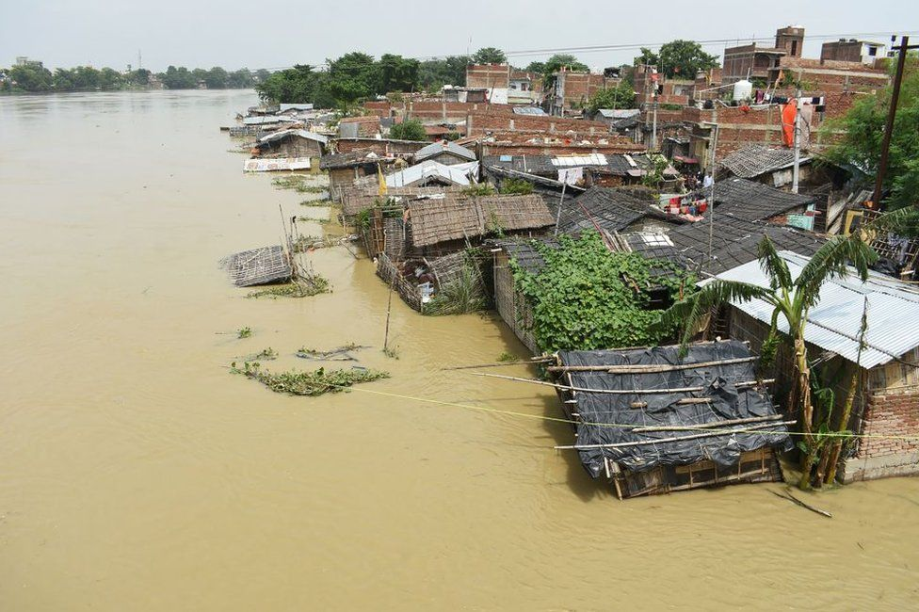

Disaster Management
Are We Ready For Another Natural Disaster?

Slide 3
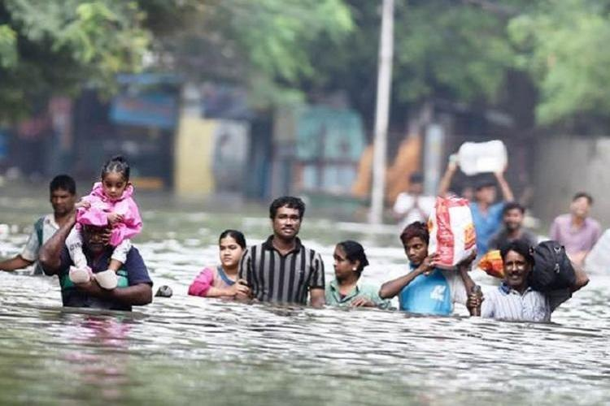
Water and Climate related Disaster
Floods
Cyclones
Droughts
Tsunami

Slide 4
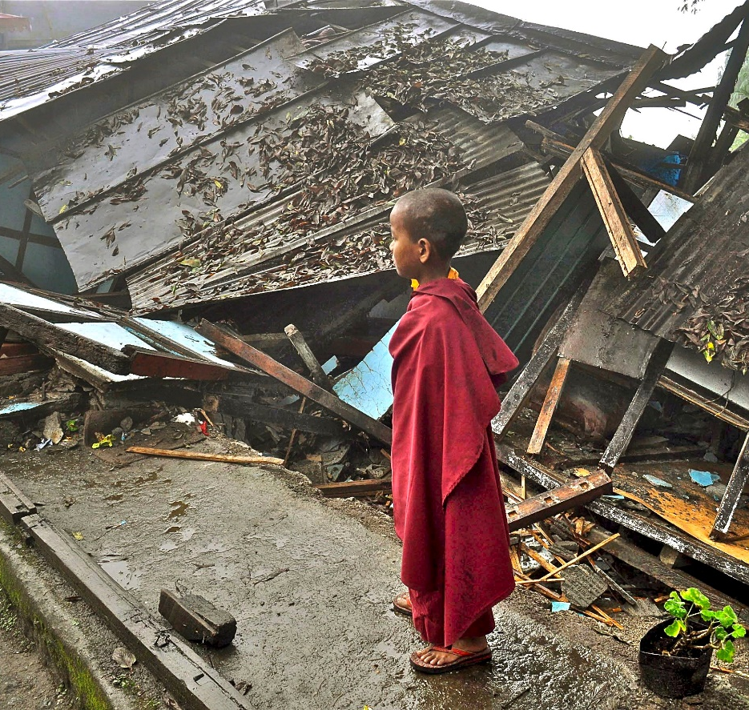
Geological, Chemical and Biological Disaster
Earthquakes
Chemical and Industrial Disasters
Biological and Disaster Epidemics/Pandemics

Slide 5
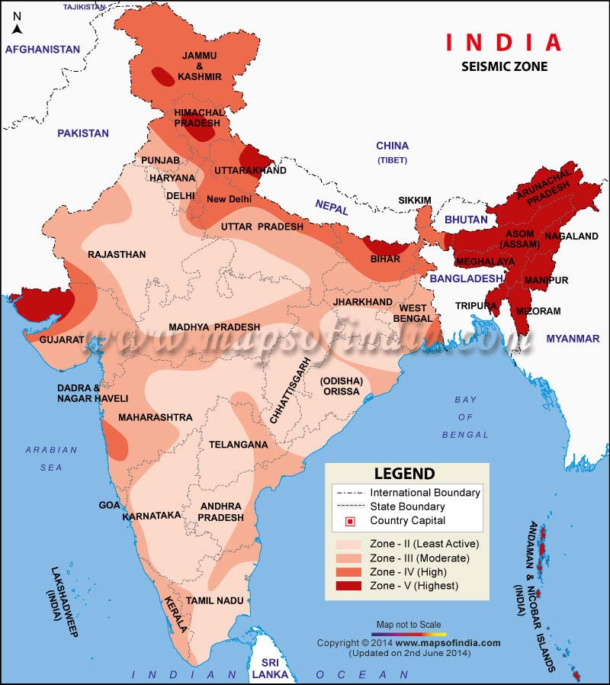
Seismic Map of India: Earthquake Prone Areas

Slide 6
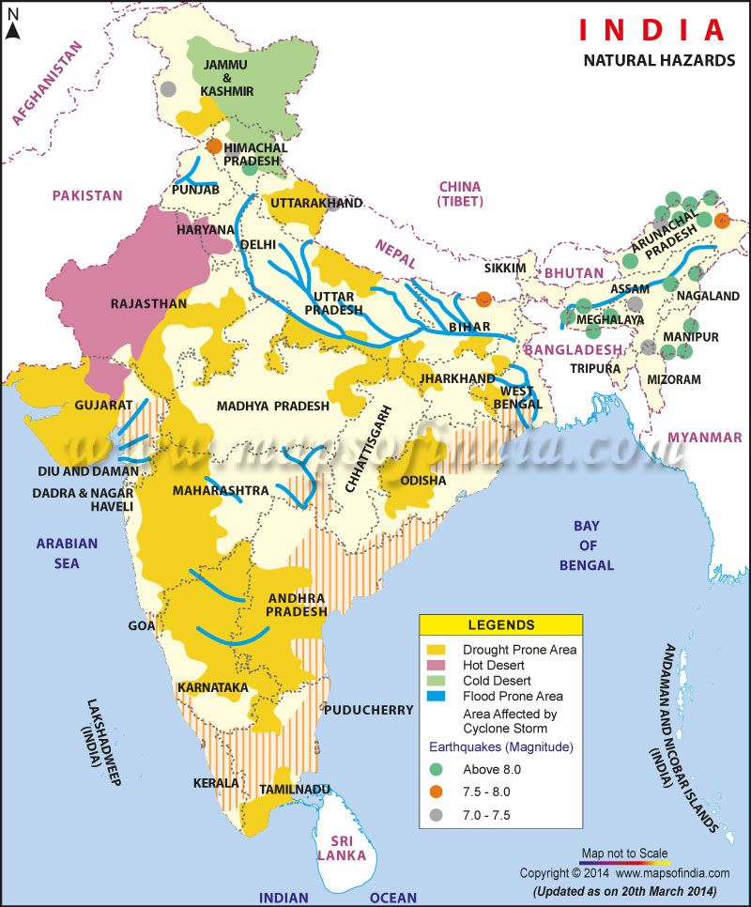
Flood, Cyclone & Drought Prone Areas

Slide 7
Types of Disaster in India (From 1980 – 2019)
Type of Disaster | No. of times occurred | Lives affected / lost
Major Floods | 21 times | More than 17 crore lives affected
Earthquake | 3 times | More than 45,000 lives lost
Drought | 4 times | More than 4 crore lives affected
Epidemic | 3 times | More than 10,000 lives lost
Storm/Cyclone | 10 times | More than 10,500 lives lost & 50 lakh lives affected
Tsunami | 1 time | More than 10,000 lives lost

Slide 8
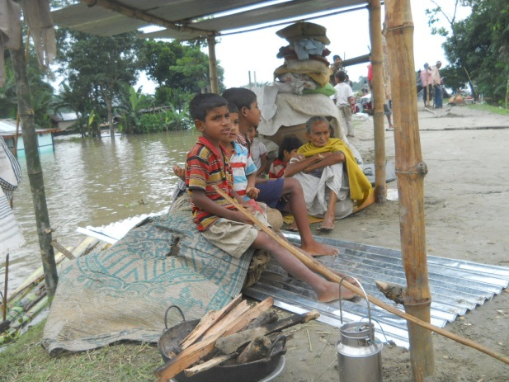
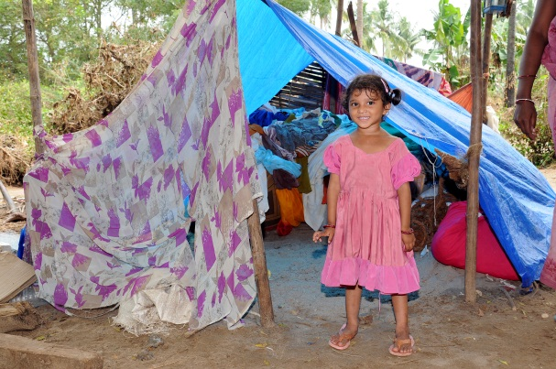
Disaster Management Plan: Type of Support required
3Rs
  Rescue
  Relief
  Rehabilitation

Slide 9
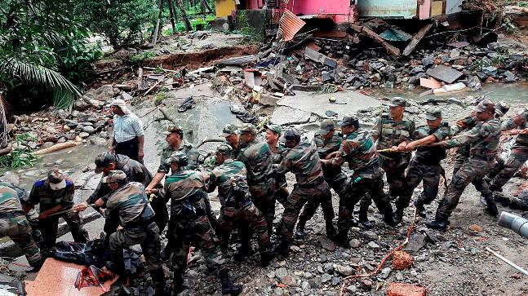
Rescue : Out of OUR SCOPE
Rescue done by Indian Military, Paramilitary Forces, trained experts etc. under National Disaster Management Authority (NDMA) - NDRF

Slide 10
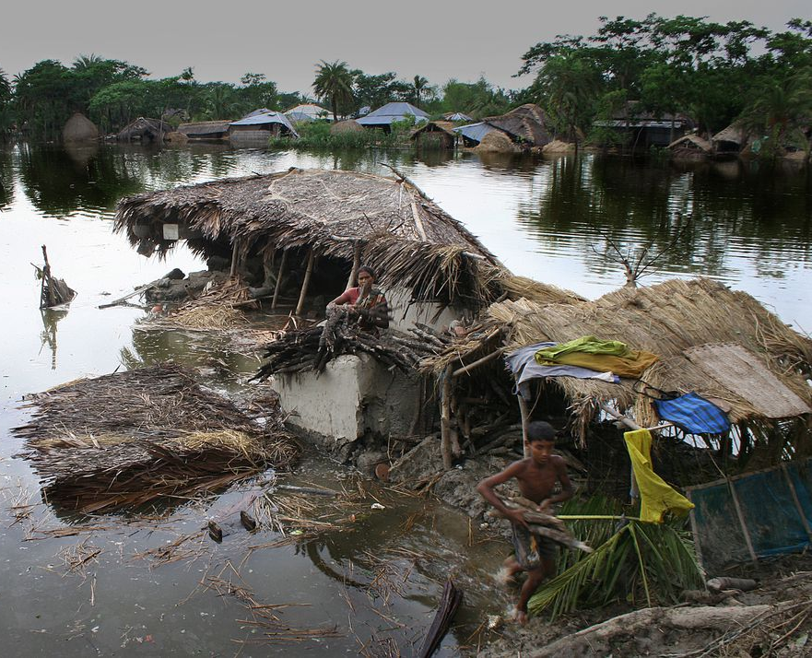
Relief
  Shelter
  Food
  Clothes
  Medical
  Mental Health

Slide 11
Relief
Program Types
  Shelter Kit Program

Slide 12
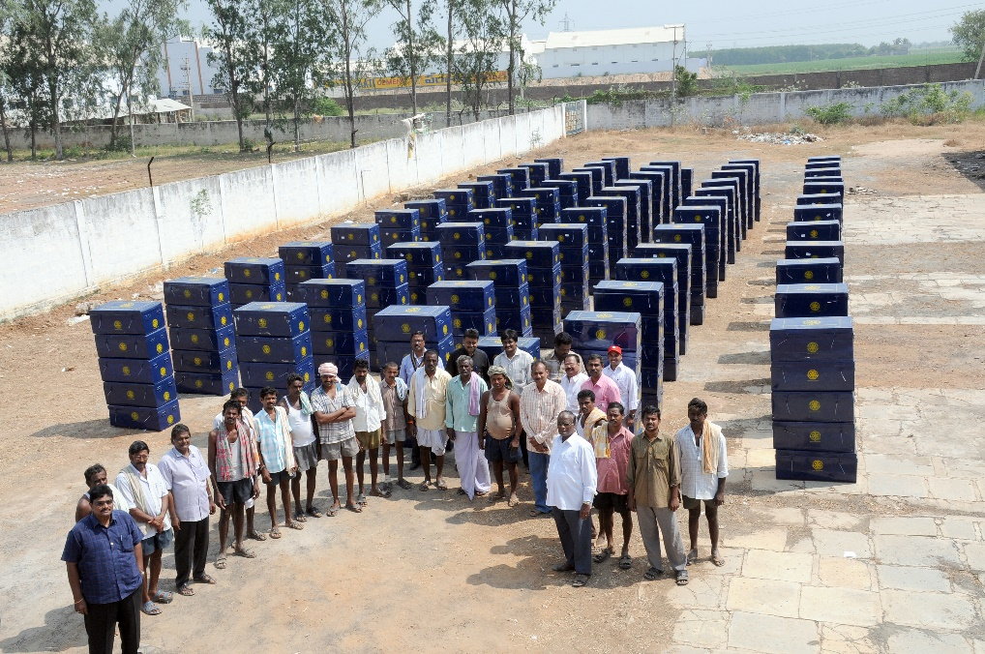
Relief : Shelter Kit Program
Depending on the intensity, we can decide on the number of Shelter Kits to be delivered in the affected area
Shelter Kits to take care of: Shelter, Food, Clothes, Medical & Mental Health

Slide 13
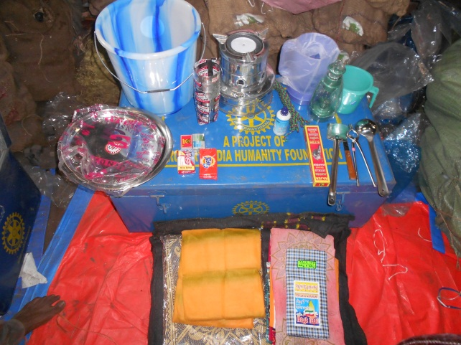
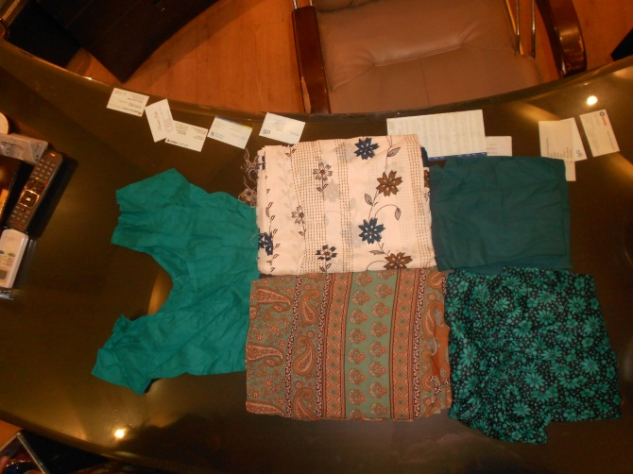
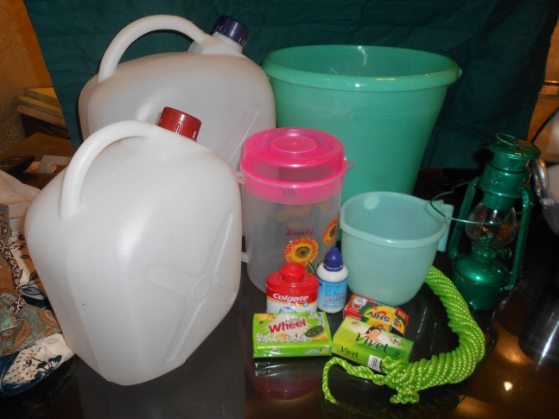
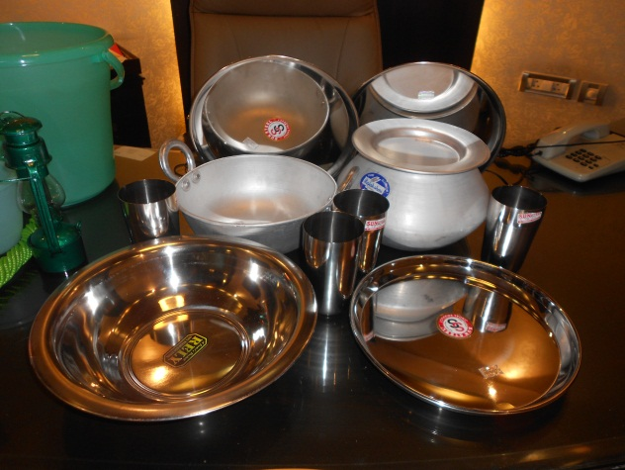
Relief – Shelter Kit has 52 items

Slide 14
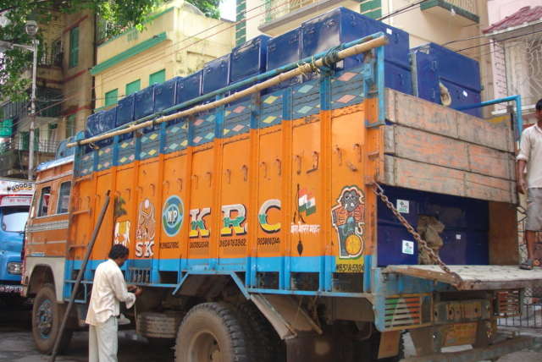
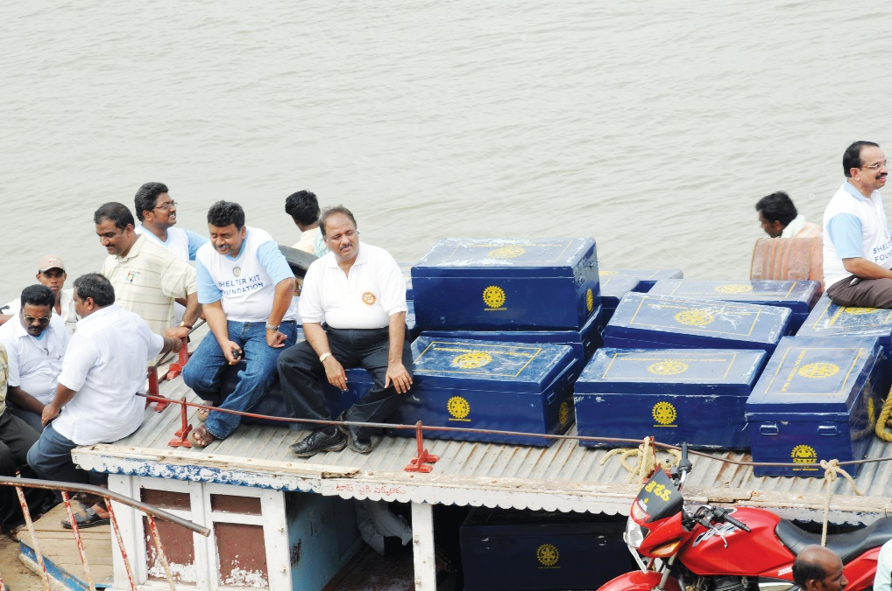
Relief - Shelter Kit Governance
    Tracking of every Shelter Kit
    Capture learning from past disasters
    Identify Disaster hotspots
    Identify warehousing facility

Slide 15
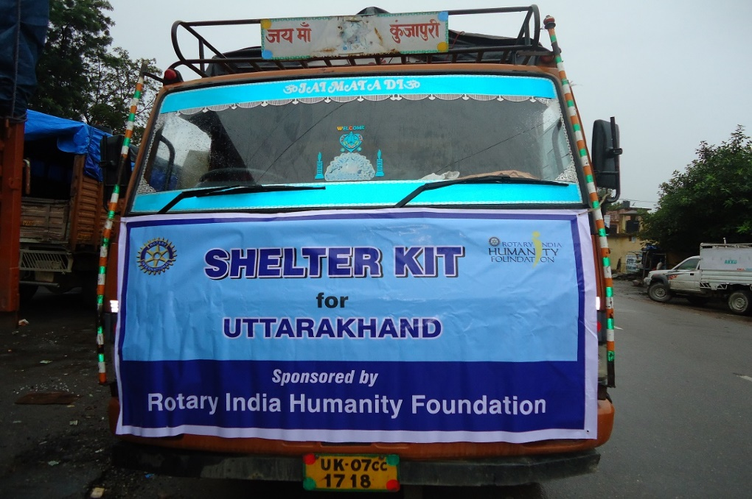
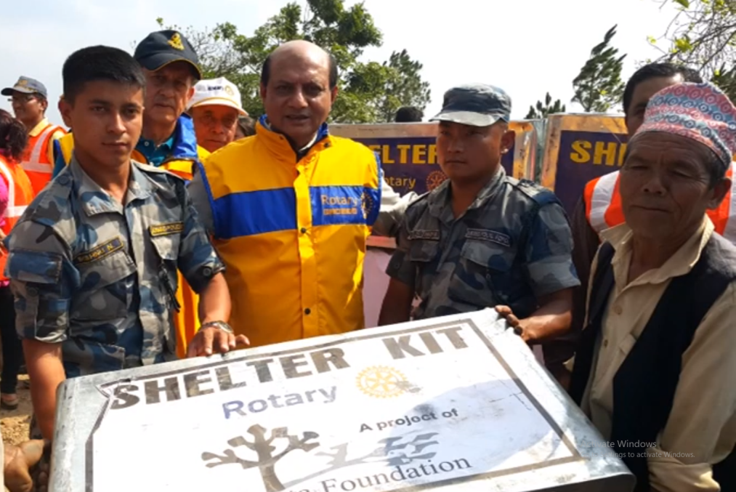
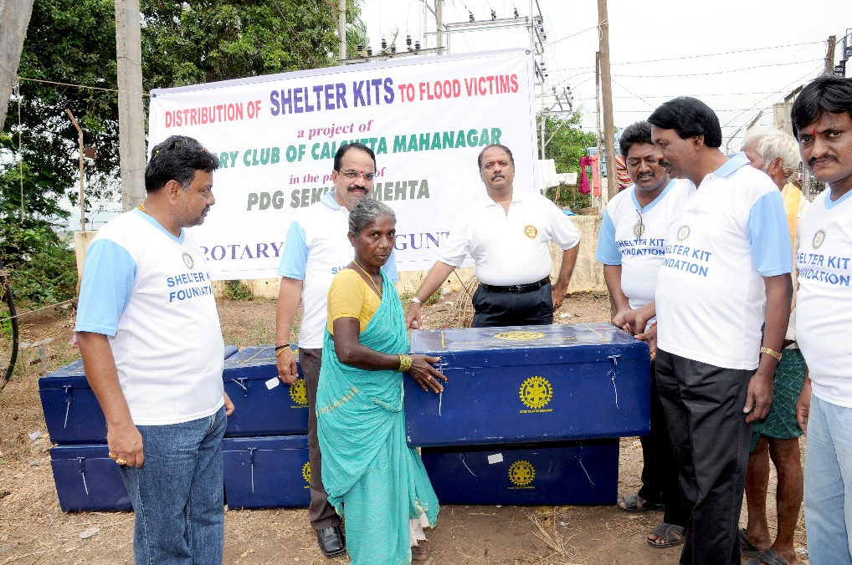
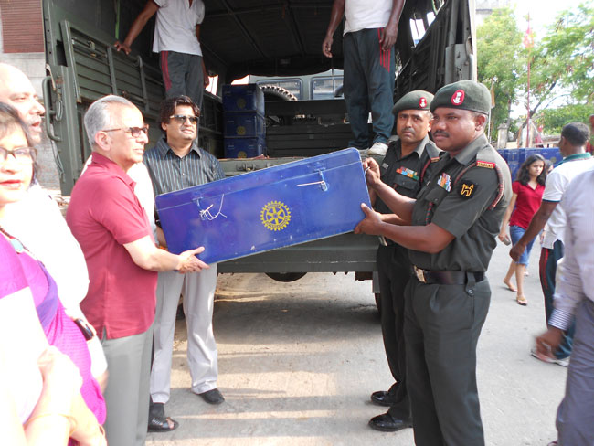
Relief – Hands on Service

Slide 16
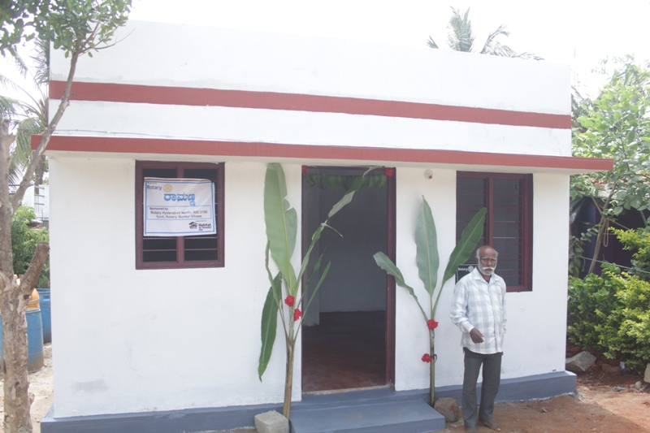
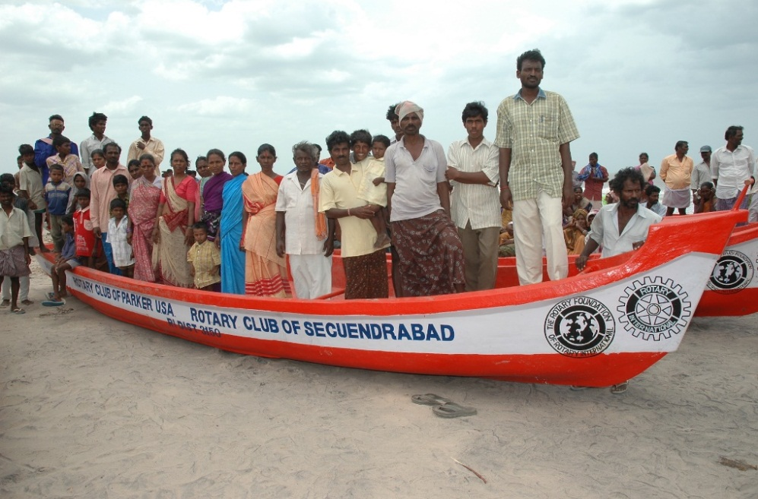
Rehabilitation
    Re-building of Homes
    Re-building of Schools
    Others

Slide 17
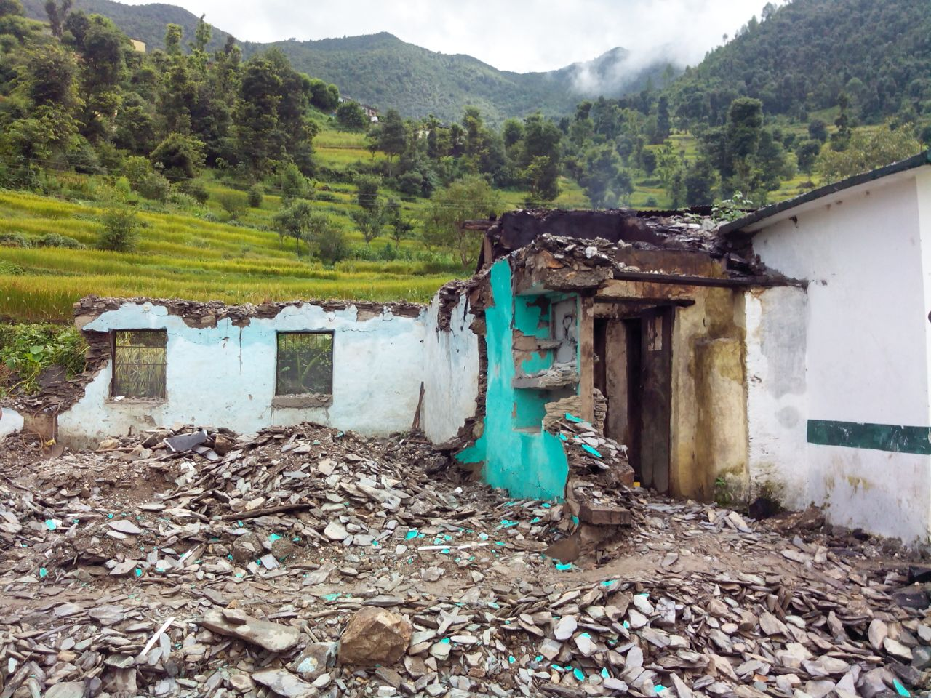
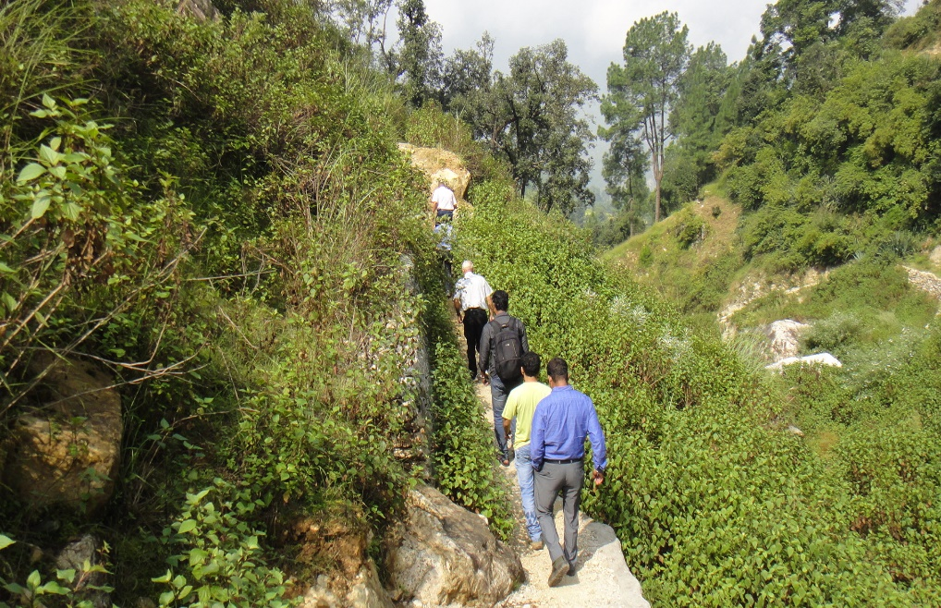
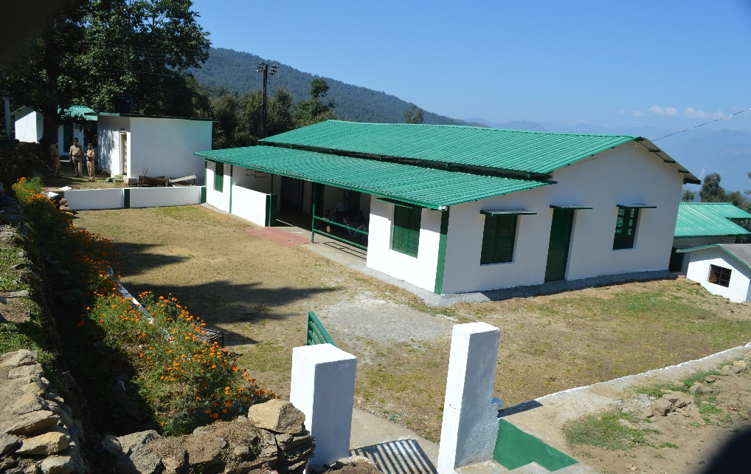
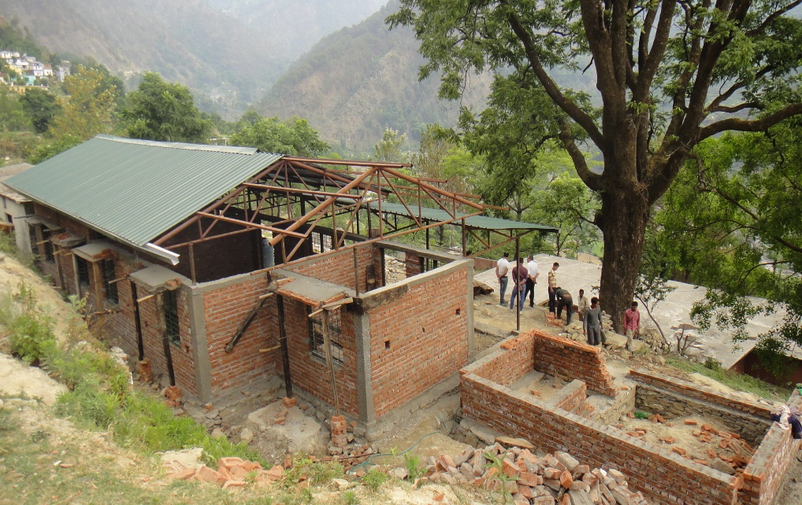
Rehabilitation – Uttarakhand Schools
Disaster struck school
Rotarians visiting the disaster affected site
New School built
Rebuilding of School

Slide 18
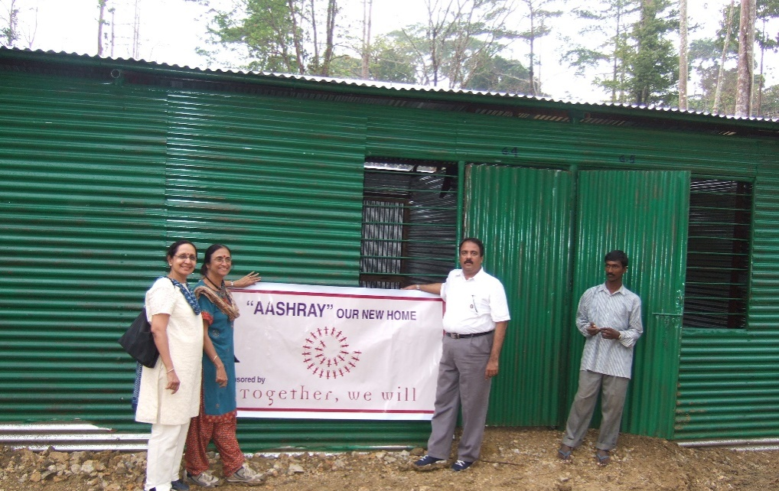
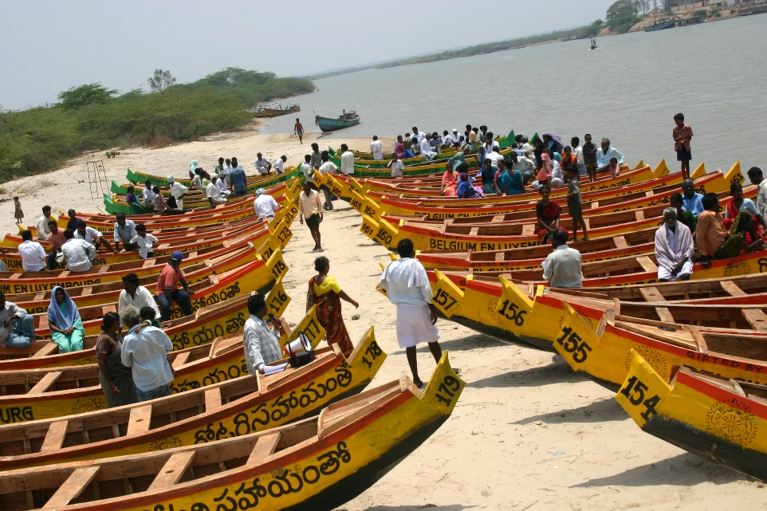
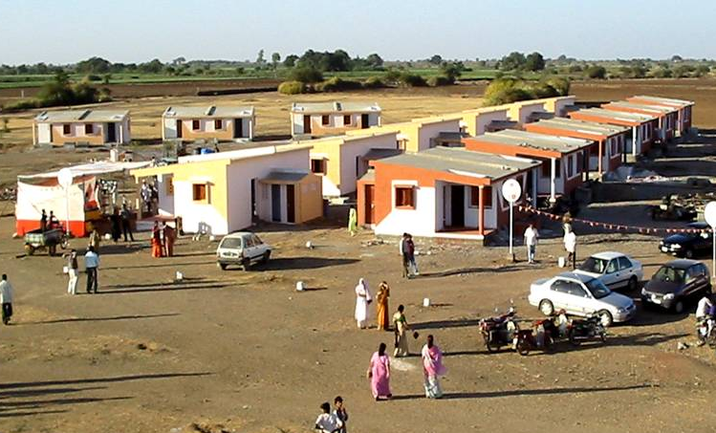
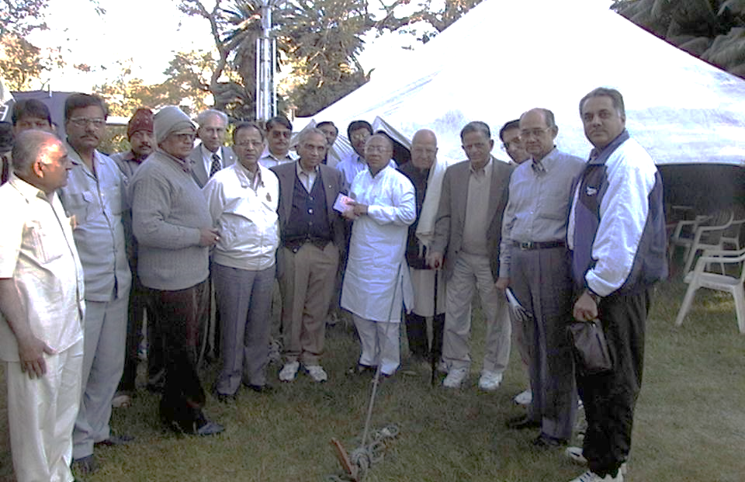
Rehabilitation

Slide 19






POSSIBLE Partnerships
    NGOs
    Habitat for Humanity
    Shelter Box
    Art of Living etc.
    Isha Foundation
    Rotary India Literacy Mission
    Government
    NDMA
    Military & Para – Military
    Railways
    NIMHANS
    Corporates
    Airlines
    Transport Companies

Slide 20
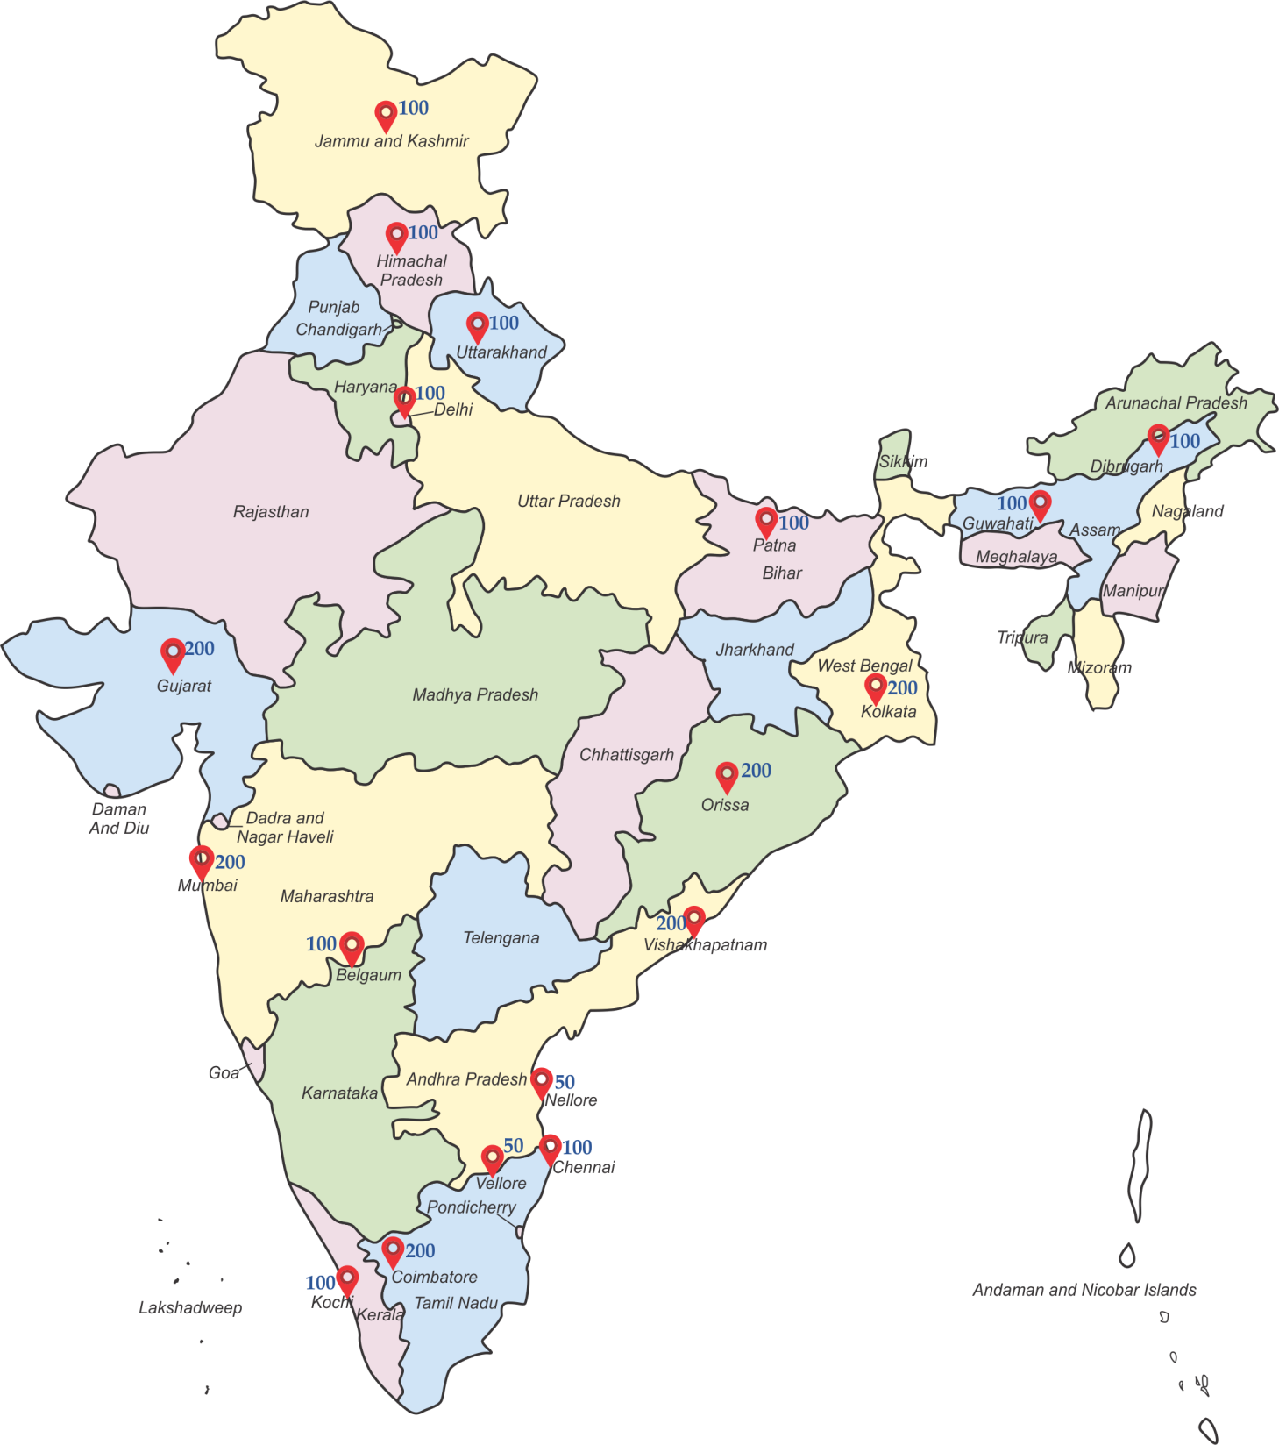
Shelter KIT
Locations

Slide 21
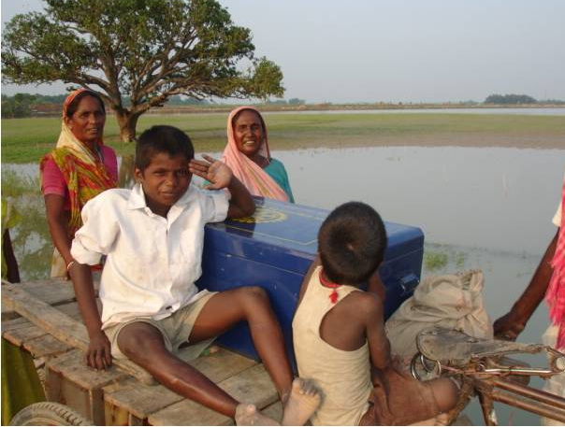
India is a disaster prone country.
Disasters have been part of our lives – Let us face it!

